Slide 1
Understanding Direct Object Pronouns [1 / 1]
Recognition in listening and reading passages
French
Monsieur Lowe

Slide 2
Understanding direct object pronouns [1 / 1]
your understanding of the near future tense.
Phonics focus - [e]
Revising vocabulary
Understanding direct object pronouns
Deepening understanding: listening
Deepening understanding: reading
Spontaneous translation
Translation into French
Summarising learning
Notes:
The plan for today’s lesson is as follows. Press RETURN. Tu es prêt? Tu es prête? On y va!

Slide 3
Phonétique

Slide 4
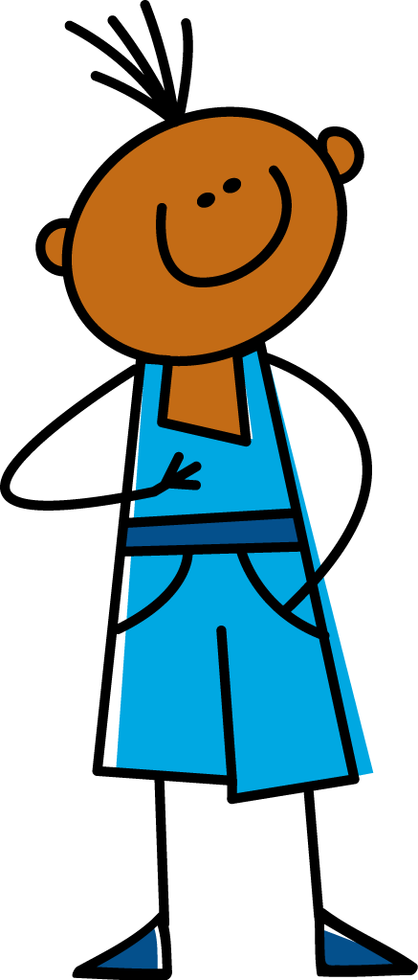
[ e ]
je
Notes:
The sound that we are going to consider in this lesson is the [e] sound, or euh. RETURN, here is an example, the French word for I, je, ecoute et repete, je.

Slide 5
[ e ]
samedi
cela
[that]
devoir
[to have to]
Notes:
Now let’s take a look at some further examples of the [e] or euh sound. RETURN, the first word is the french word for Saturday, samedi, ecoute et repete, samedi. RETURN, the second is the French verb to have to, devoir. Ecoute et repete, devoir. RETURN, finally the French word for that, cela, ecoute et repete, cela.

Slide 6
_n_/ém_ss_ _n
l_s/_ct_ _l_tés
_n/j_ _/télév_sé
m_nq_ _r
r_t_r
déb_l_
v_lg_ _r_
un(_) _n_m_t_ _r/tr_c_
l_ scén_r_ _
_n/v_rs_ _n/_r_g_n_l_ (VO)
_n/d_r_ct
une émission
les actualités
un jeu télévisé
manquer
rater
débile
vulgaire
un(e) animateur/trice
le scénario
en version originale (VO)
en direct
a programme
the news
a game show
to miss, missing
to miss, missing (familiar)
silly, idiotic
rude, vulgar
presenter
the plot
original version
live
Notes:
On the screen are all of the words that we have already encountered and they are all linked to the topic of televion. However, they are missing their vowels, so you need to put them in to spell the words correctly! For clarity, there is a forward slash to denote the space. You should pause the video to try and write the complete list. Met la video en pause maintenant.
Press RETURN. Did you get the same answers as my list? If so, super, but if not pause to make any corrections and highlight the words that you found tricky. Met la video en pause maintenant.
The final part of this activity is for you to translate the core vocabulary into English, met la video en pause.
Press RETURN. Here are the correct English translations for this vocabulary list. I am now going to call out the English and you should point to to the correct French word on the screen.
Comment dit-on … en francais? (Order - live, presenter, to miss (familiar), the news, original version, rude, to miss, a programme, the plot, silly, a fame show)
If you need to write this vocabulary into your exercise books, press pause.

Slide 7
There are three direct object pronouns in French: le, la, and les.
Je déteste le scénario
Je déteste les actualités
Je le déteste
Je les déteste
Je déteste la télévision
Je déteste les émissions
Je la déteste
Je les déteste
The direct object pronoun is placed between the subject of the sentence (in this case the word for I) and the verb
Notes:
Now, you should make a note of how to use the direct object pronouns. Copy these notes into your exercise book showing what is replaced in each sentence. Alors, mets la video en pause maintenant.

Slide 8
Verbs starting with vowels.
J’adore le scénario
J’adore les films
Je l’adore
Je les adore
J’adore la télévision
J’adore les dessins animés
Je l’adore
Je les adore
When the verb starts with a vowel or silent [h], le and la become l’
Notes:
What about if our verb starts with a vowel?
Let’s see what happens. Then go through the examples. MENTION LIASION WITH LES ADORE
Bring in the rule. Read it out. Then add then to add to their notes. You should now copy these notes into your exercise book, alors mets la video en pause.

Slide 9
Using direct object pronouns. Practice
1. | Jeregardesouventlesfilms.Jelesadore.
2. | Jeneregardepaslesactualités.Jelesdéteste.
3. | J’aimeregarderlesémissionsdesport.Jelestrouveintéressantes.
4. | Jeregardelesdessinsanimésmaisjelestrouveunpeudébiles.
Notes:
Let’s practise using these pronouns now. Please writing the title ……………….. and 1,2,3,4 in your book.
I’m going to show you four sentences - they’re going to be hard to understand as all of the gaps have been taken away. I want you to work out where the gaps should go and write the correct French sentence in your book. Leave a gap as we’ll add in the English in a few moments too.
RETURN Voila les phrases.

Slide 10
Understanding direct object pronouns [1/1]
1. Direct object pronouns replace …………. in a sentence.
2. Masculine nouns are replaced by…...
3. Feminine nouns are replaced by …..
4. Plural nouns are replaced by …….
5. If the verb begins with a vowel/h the direct object pronoun is ……...
nouns
le
la
les
l’

