Slide 1
How do we construct a food web?
Science
Miss Roberts

Slide 2
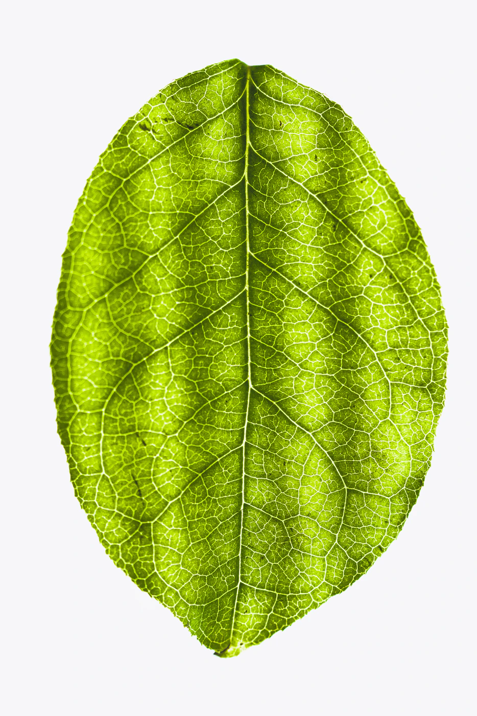
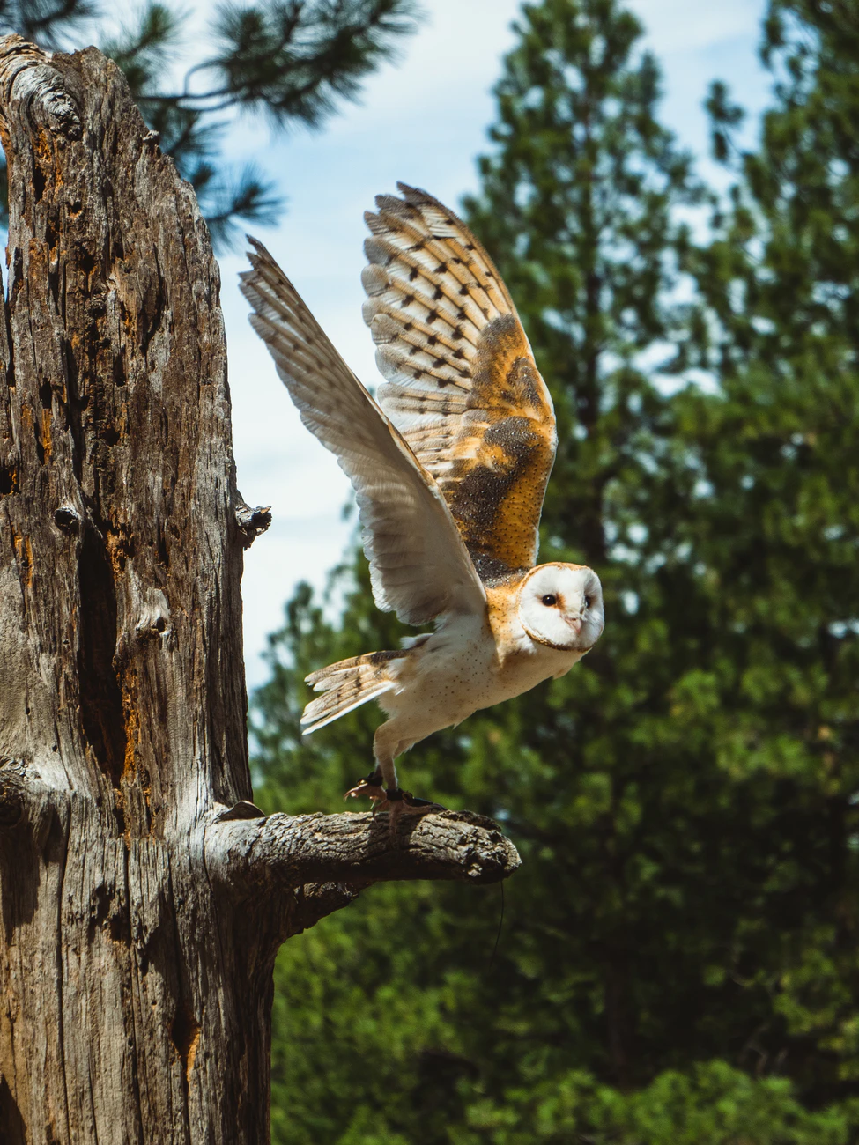
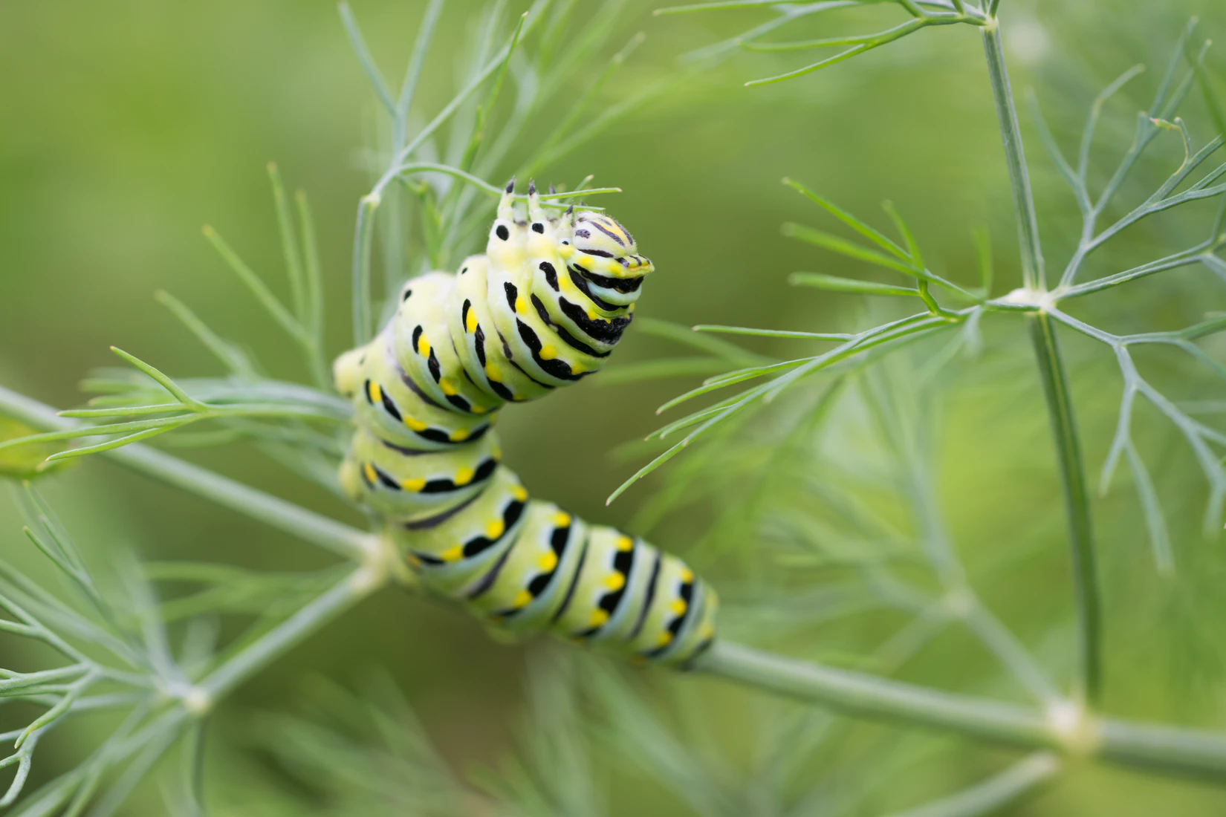
Construct this food web and add labels
Tertiary consumer
Primary consumer
producer
Secondary consumer
Notes:
Unsplash
Owl vole leaf centipede

Slide 3
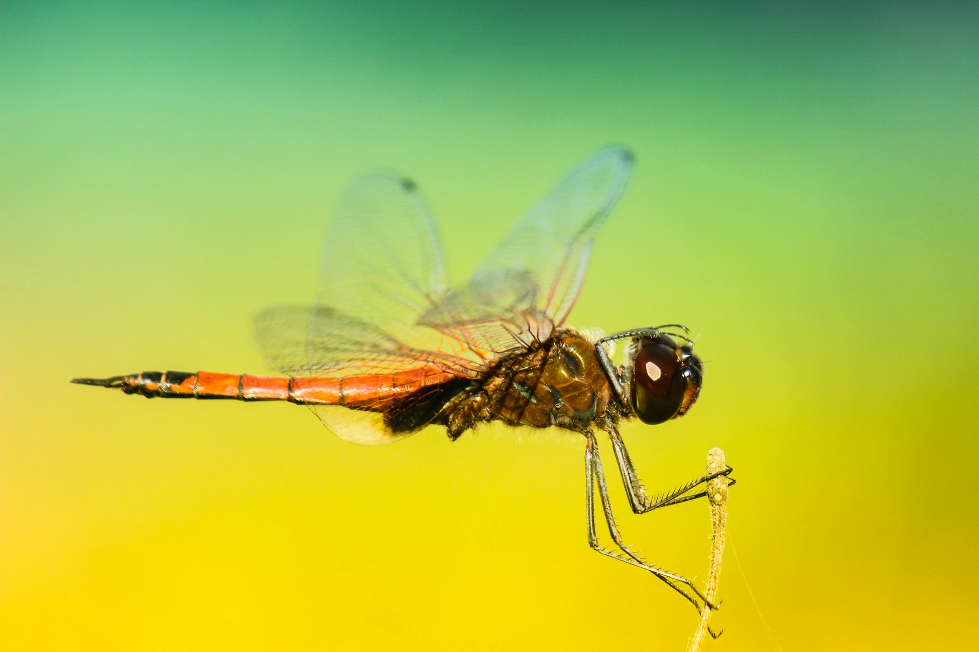
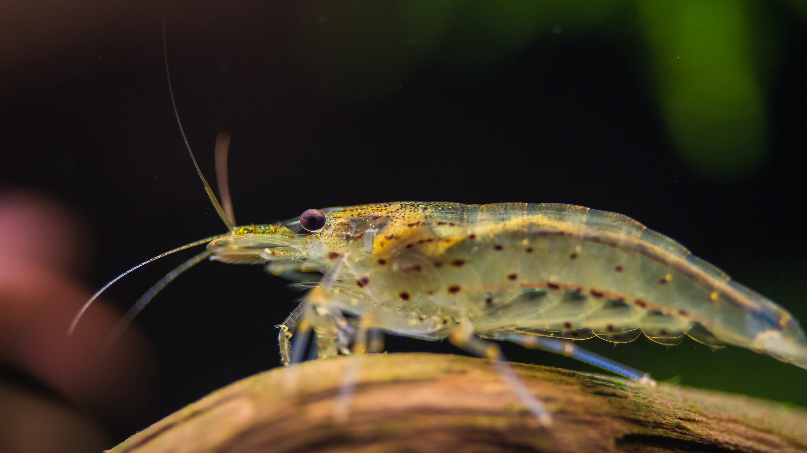
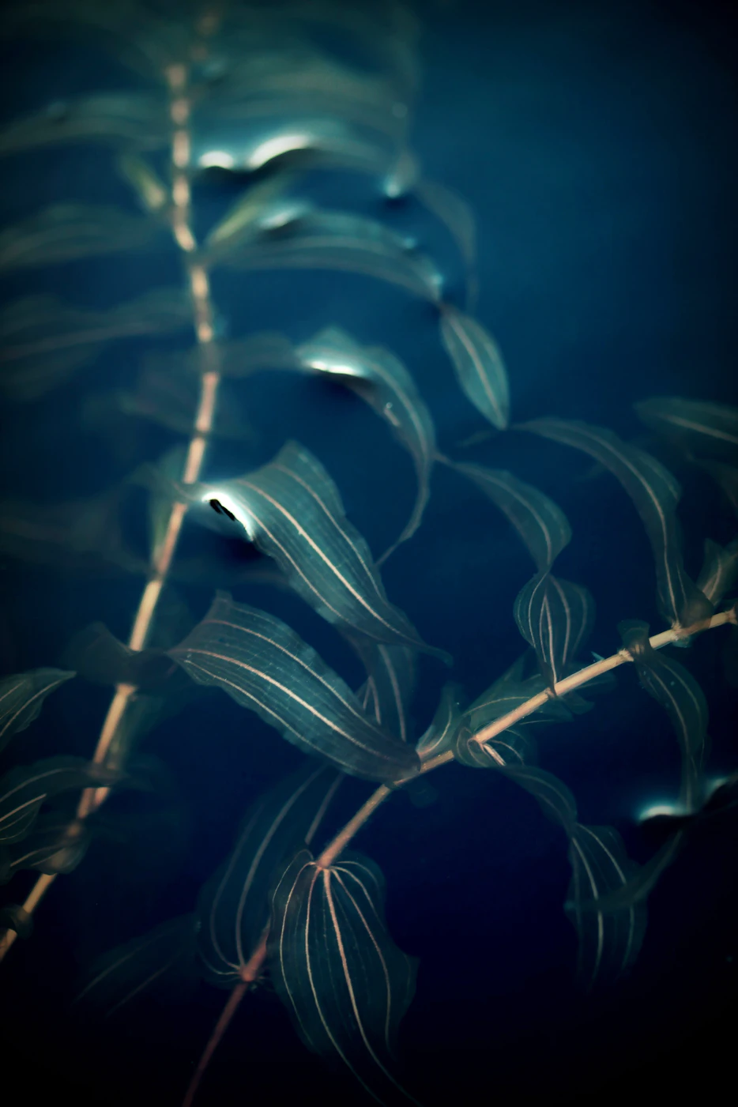
Food web
Microscopic algae
Mayfly nymph
Dragonfly nymph
Freshwater shrimp
Pond weed
Brown trout

Slide 4
TASK
 | Organism | Diet
 | Mayfly nymph | Pondweed, microscopic algae
 | Microscopic algae | Makes its own food
 | Dragonfly nymph | Freshwater shrimp, mayfly nymph
 | Freshwater shrimp | Microscopic algae
 | Brown trout | Mayfly nymphs, dragonfly nymphs, freshwater shrimps
 | Pond weed | Makes its own food
Notes:
Unsplash

