Slide 1
Independent Living Unit 1- Home Management
Oak Specialist
Building Understanding

Slide 2
Unit 1- Home Management
Lesson 1- Cleaning in the home
Lesson 2- Setting the table
Recognising common cleaning equipment and where to use it.
Counting equipment needed and using a visual to set the table.
Lesson 3- Sorting in the kitchen
Lesson 4- Organising clothes
Recognising kitchen appliances and what we use them for.
Sorting clothes by category and folding correctly.
Lesson 5- Clothes for occasions
Lesson 6- Using a washing machine
Identifying different items of clothing dependent on the occasion or weather.
Following step by step instructions to use a washing machine.
‹#›
Notes:
Depending on how many lessons for each unit, there could be a 2nd page for lesson 5…etc

Slide 3
Lesson 6- Using a washing machine

Slide 4
Teacher notes- Using a washing machine
Learning Intention- To develop independence in the steps to putting a wash on.
To learn the steps to using a washing machine.
Use white and dark clothes to sort into two piles. Make this visual. Use clean clothes if practising.
Identify seven steps to putting on a wash. Talk through each step using the images.
Can you sort the steps into the correct order. First try with the description, next try without. Eg what’s step one?
Use a camera to take a photo of each step so that you can follow at home. Watch the video for support before following images to put on a wash.
Resources needed: white and dark clothes, washing machine, camera phone
Notes:
This is the equivalent to a loose lesson plan/overview for teachers before starting the lesson.

Slide 5
Safety notice
This lesson uses washing detergent. Please use with caution and ensure learners are supervised when using it to complete the lesson.

Slide 6
Using a washing machine
Home Management
Building Understanding
Notes:
Lesson 1 starting screen. Repeat for each lesson

Slide 7
Lesson Activity Stages
Sort clothes
Identify steps to using a machine
Follow steps to put on washing

Slide 8
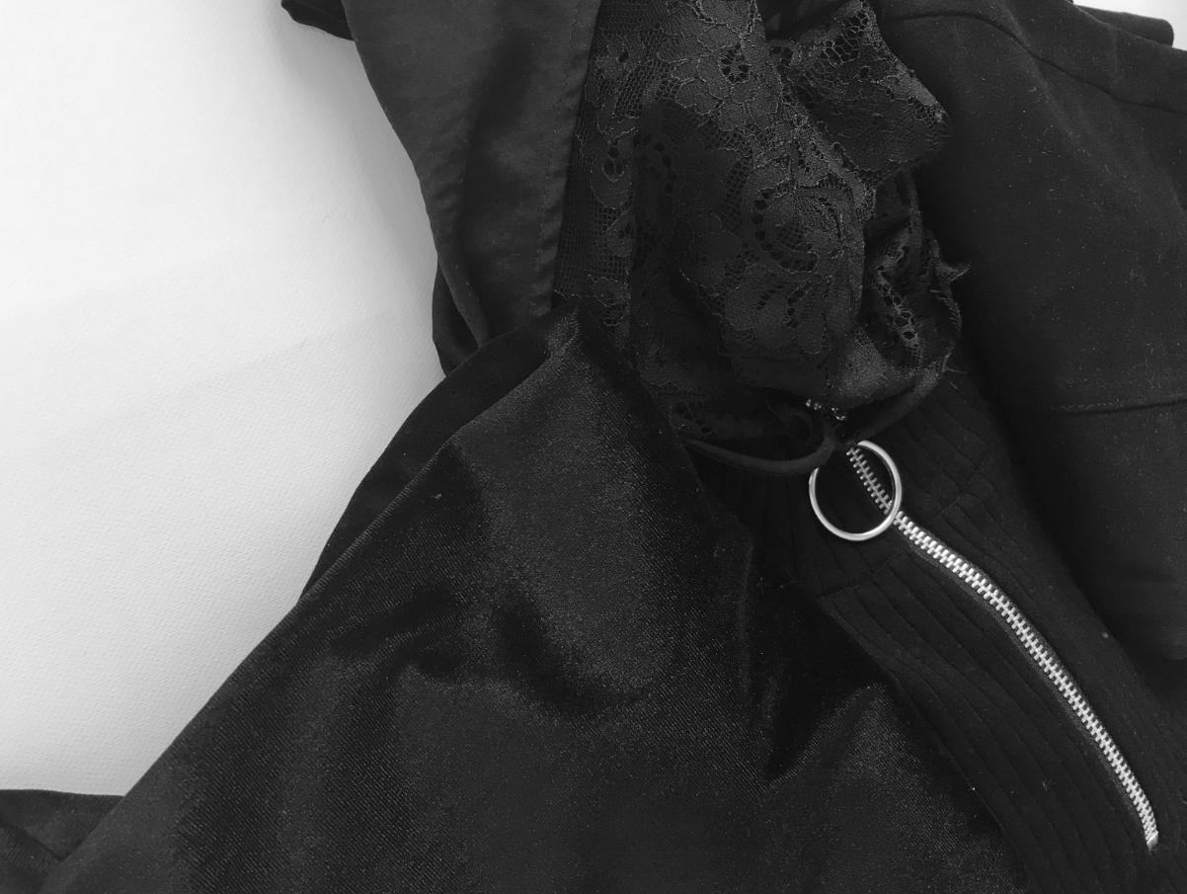
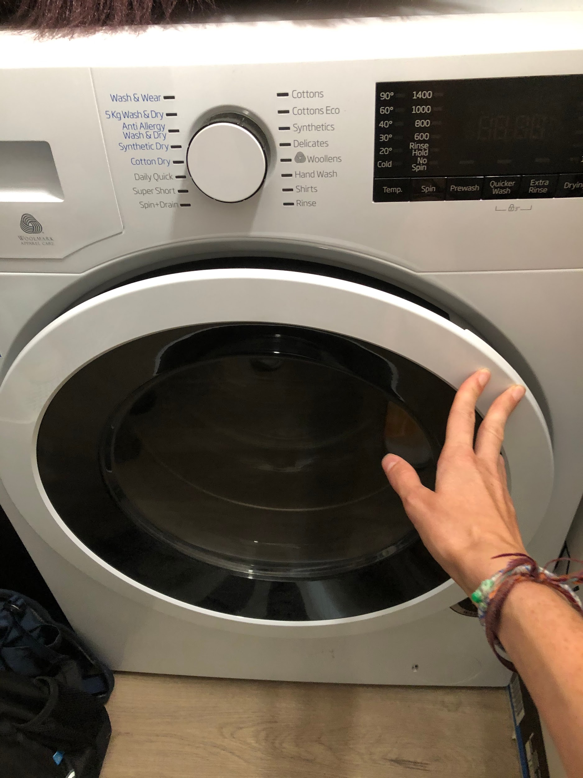
You will need
white/light clothes
dark clothes
washing basket
phone camera
washing machine
Notes:
These are the things that you will need to complete this lesson.

Slide 9
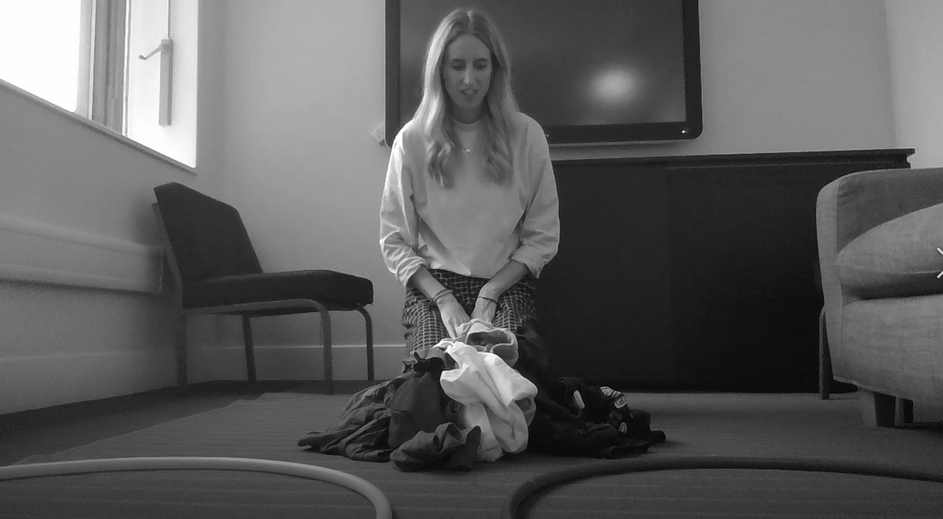
Sorting washing
Use two baskets or areas to sort your washing from the washing basket into two piles - whites/lights and dark/colours. Choose one item at a time.
Whites
Darks
Whites
Darks
Teacher’s own images
Notes:
Use two baskets or areas to sort your washing from the washing basket into two pile- whites/lights and dark/colours. Choose one item at a time.

Slide 10
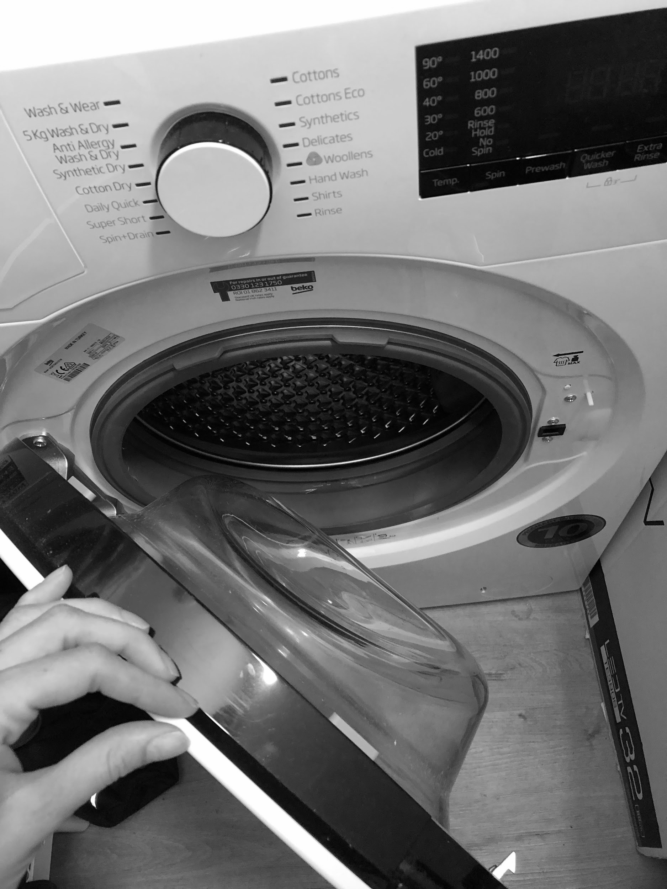
Step 1- Open the door
Teacher’s own image
Notes:
Work through the following slides, talking about what each photo shows. Start with the step number e.g. Step one, open the door.

Slide 11
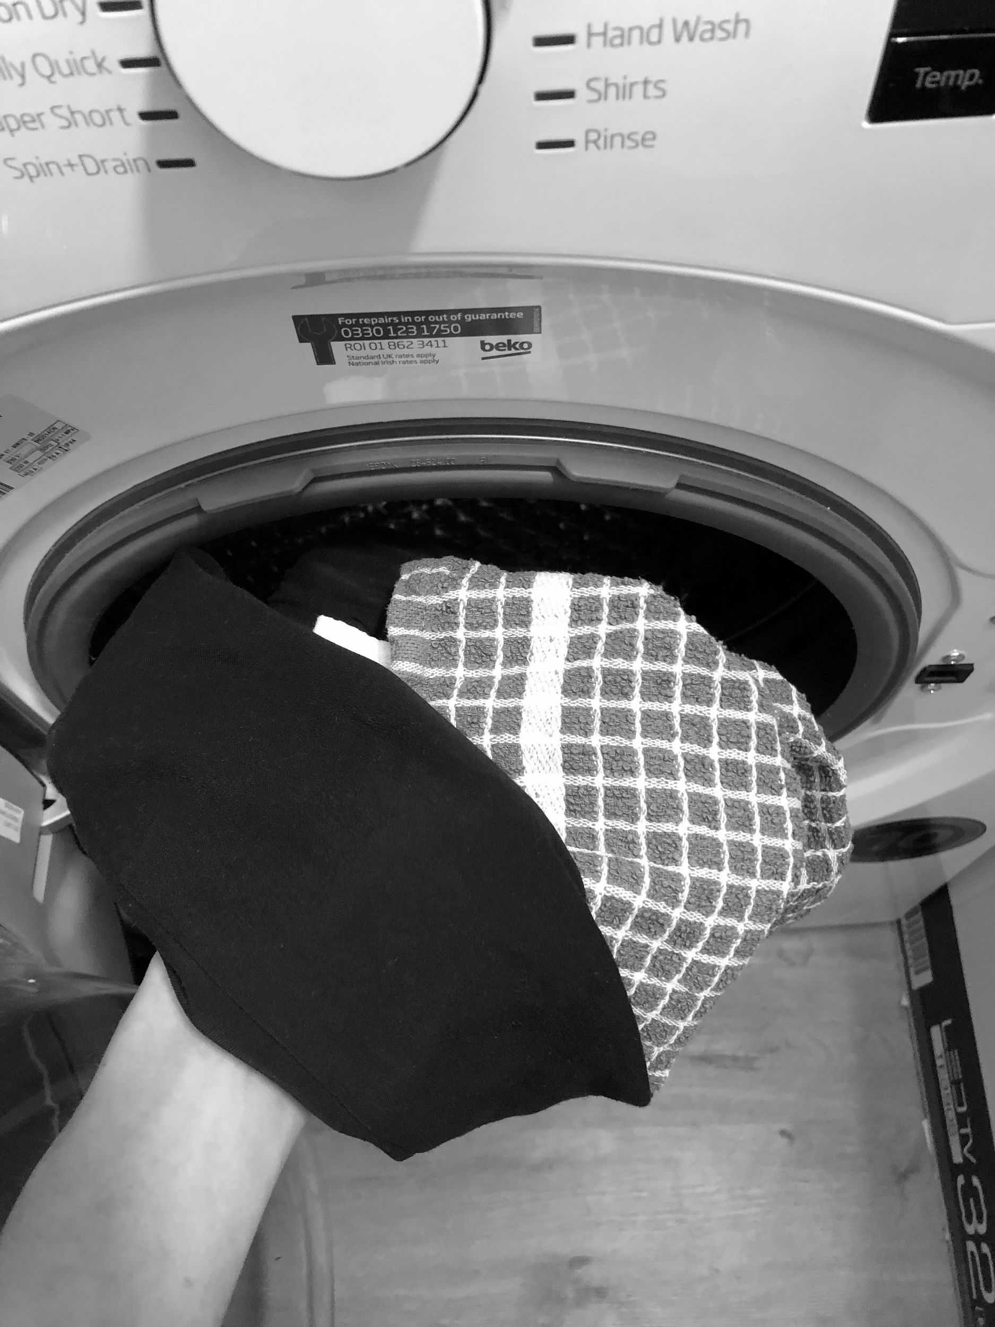
Step 2- Put clothes in
Teacher’s own image
Notes:
Work through the following slides, talking about what each photo shows.

Slide 12
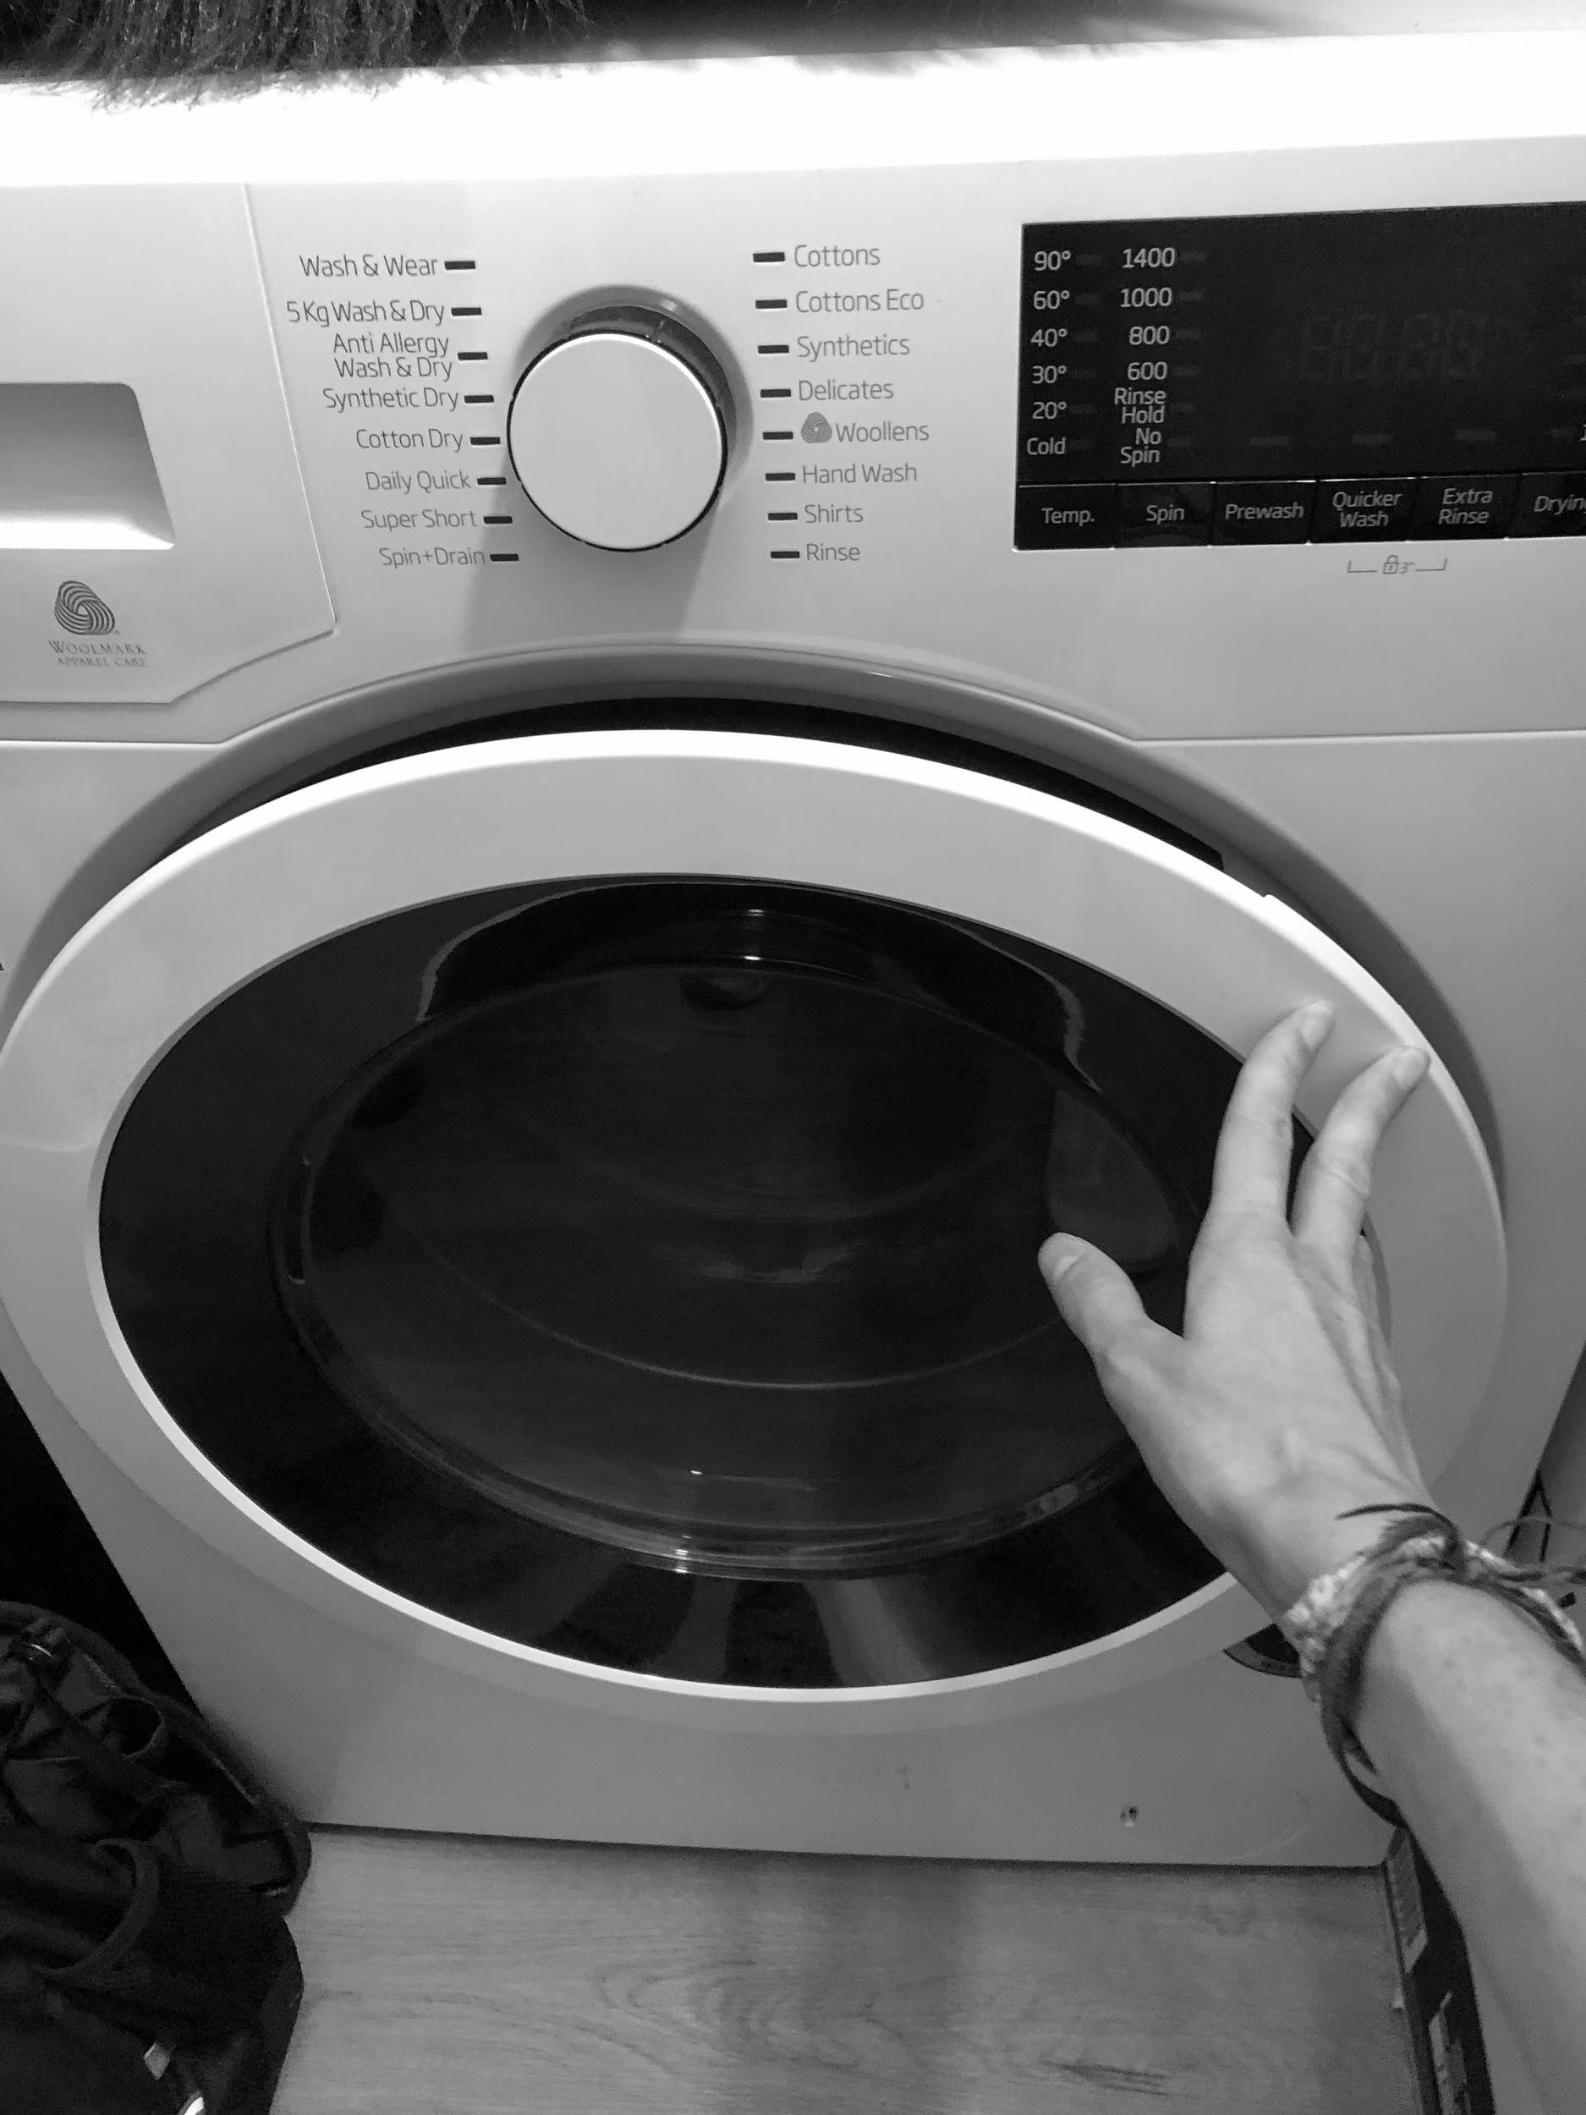
Step 3- Close the door
Teacher’s own image
Notes:
Work through the following slides, talking about what each photo shows.

Slide 13
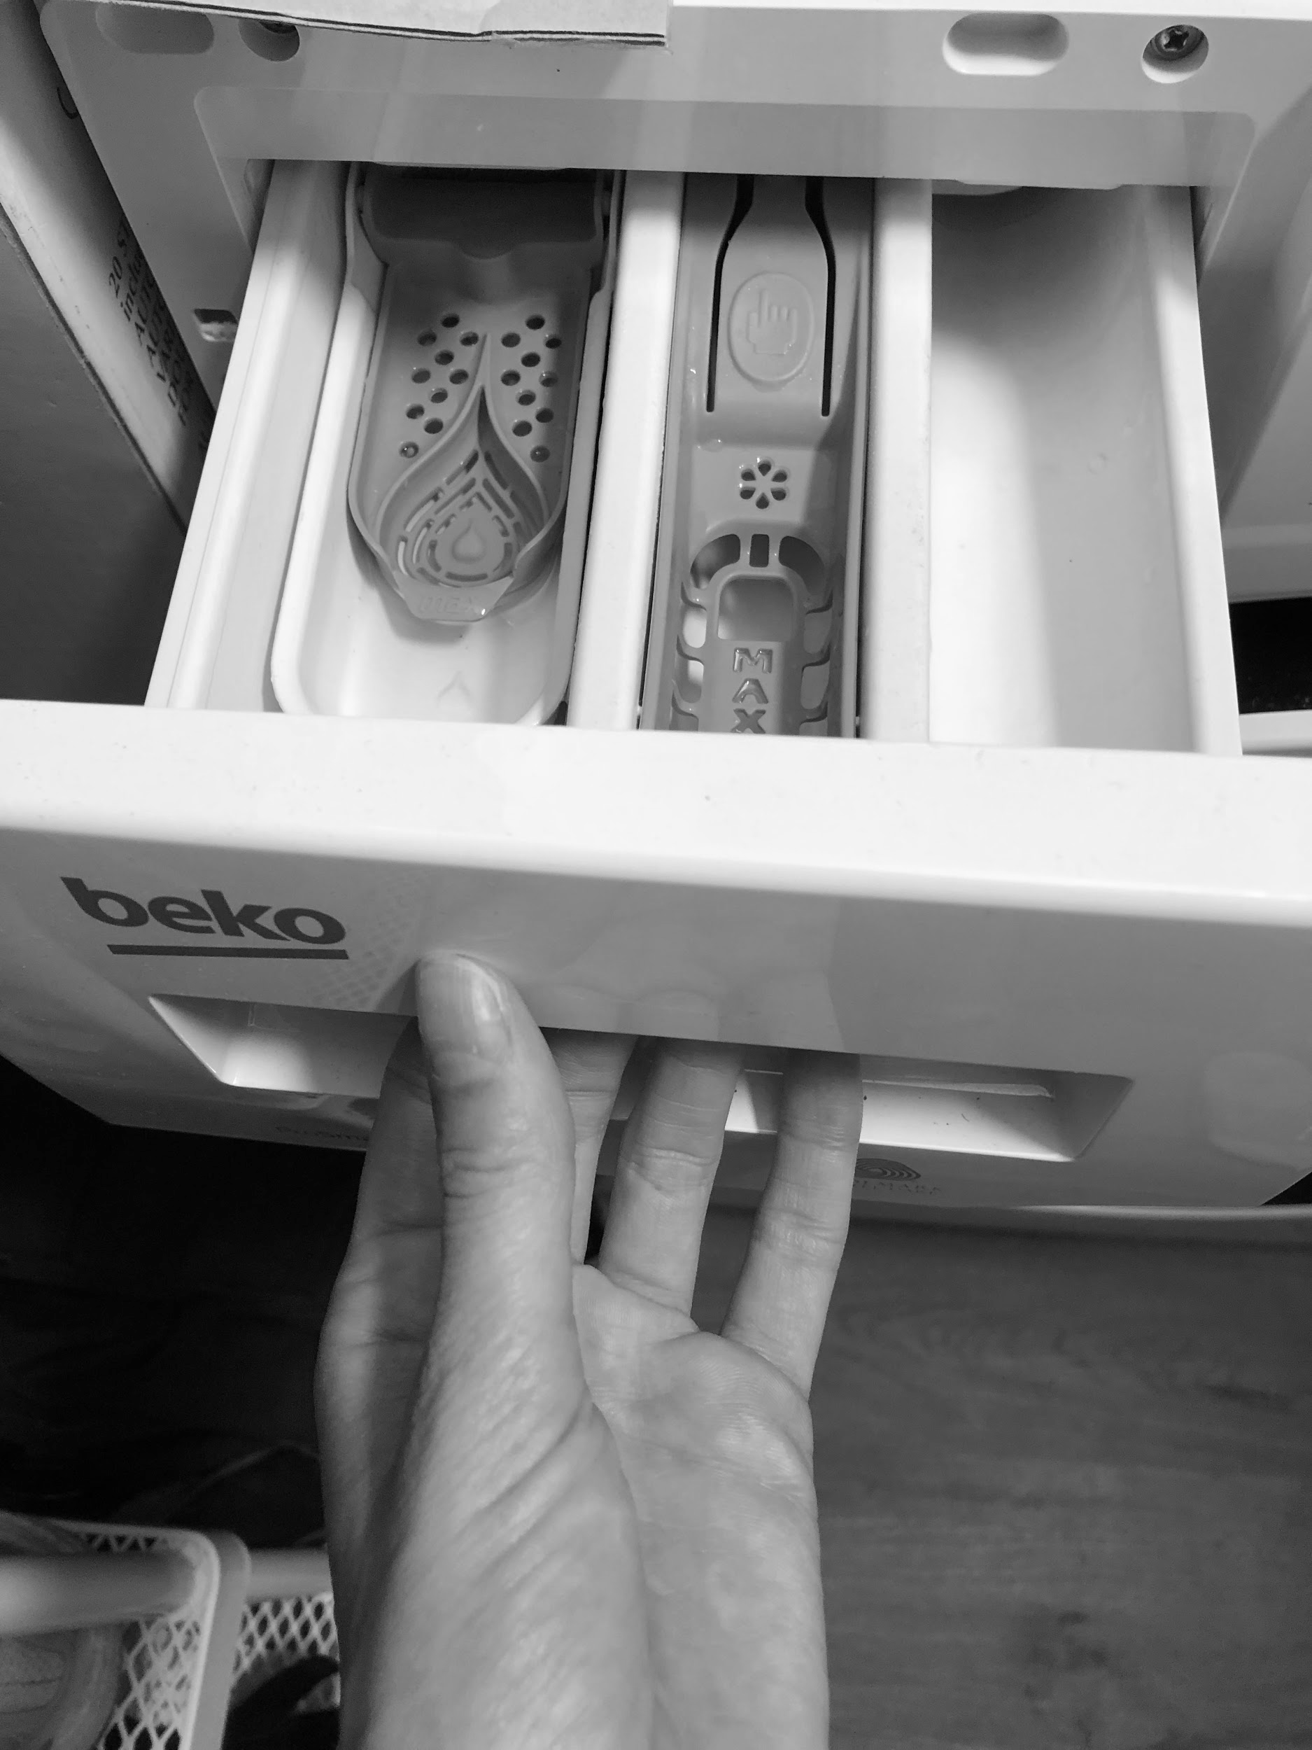
Step 4- Open drawer
Teacher’s own image
Notes:
Work through the following slides, talking about what each photo shows.

Slide 14
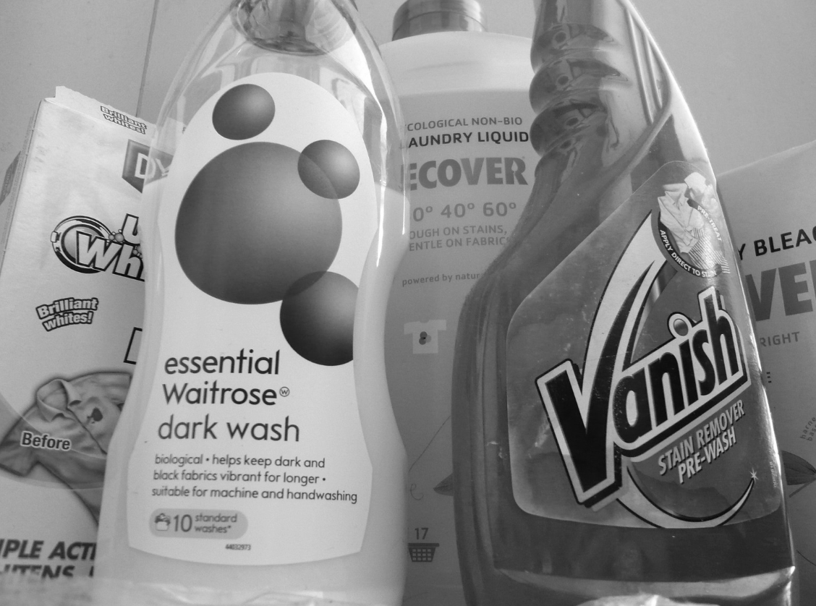
Step 5- Put detergent in
Teacher’s own image
Notes:
Work through the following slides, talking about what each photo shows.

Slide 15
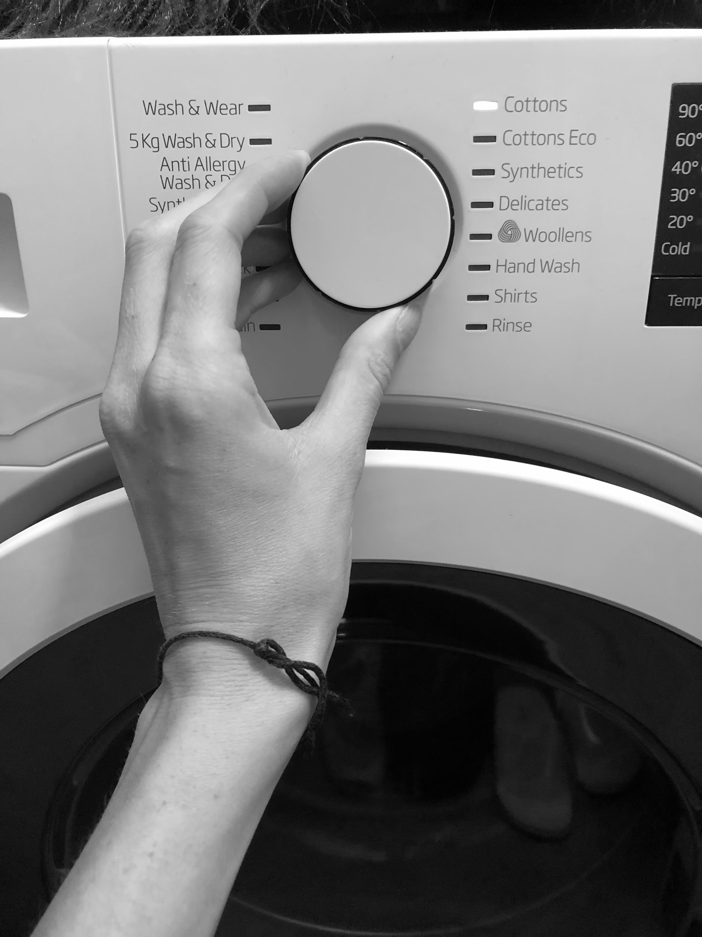
Step 6- Choose setting
Teacher’s own image
Notes:
Work through the following slides, talking about what each photo shows.

Slide 16
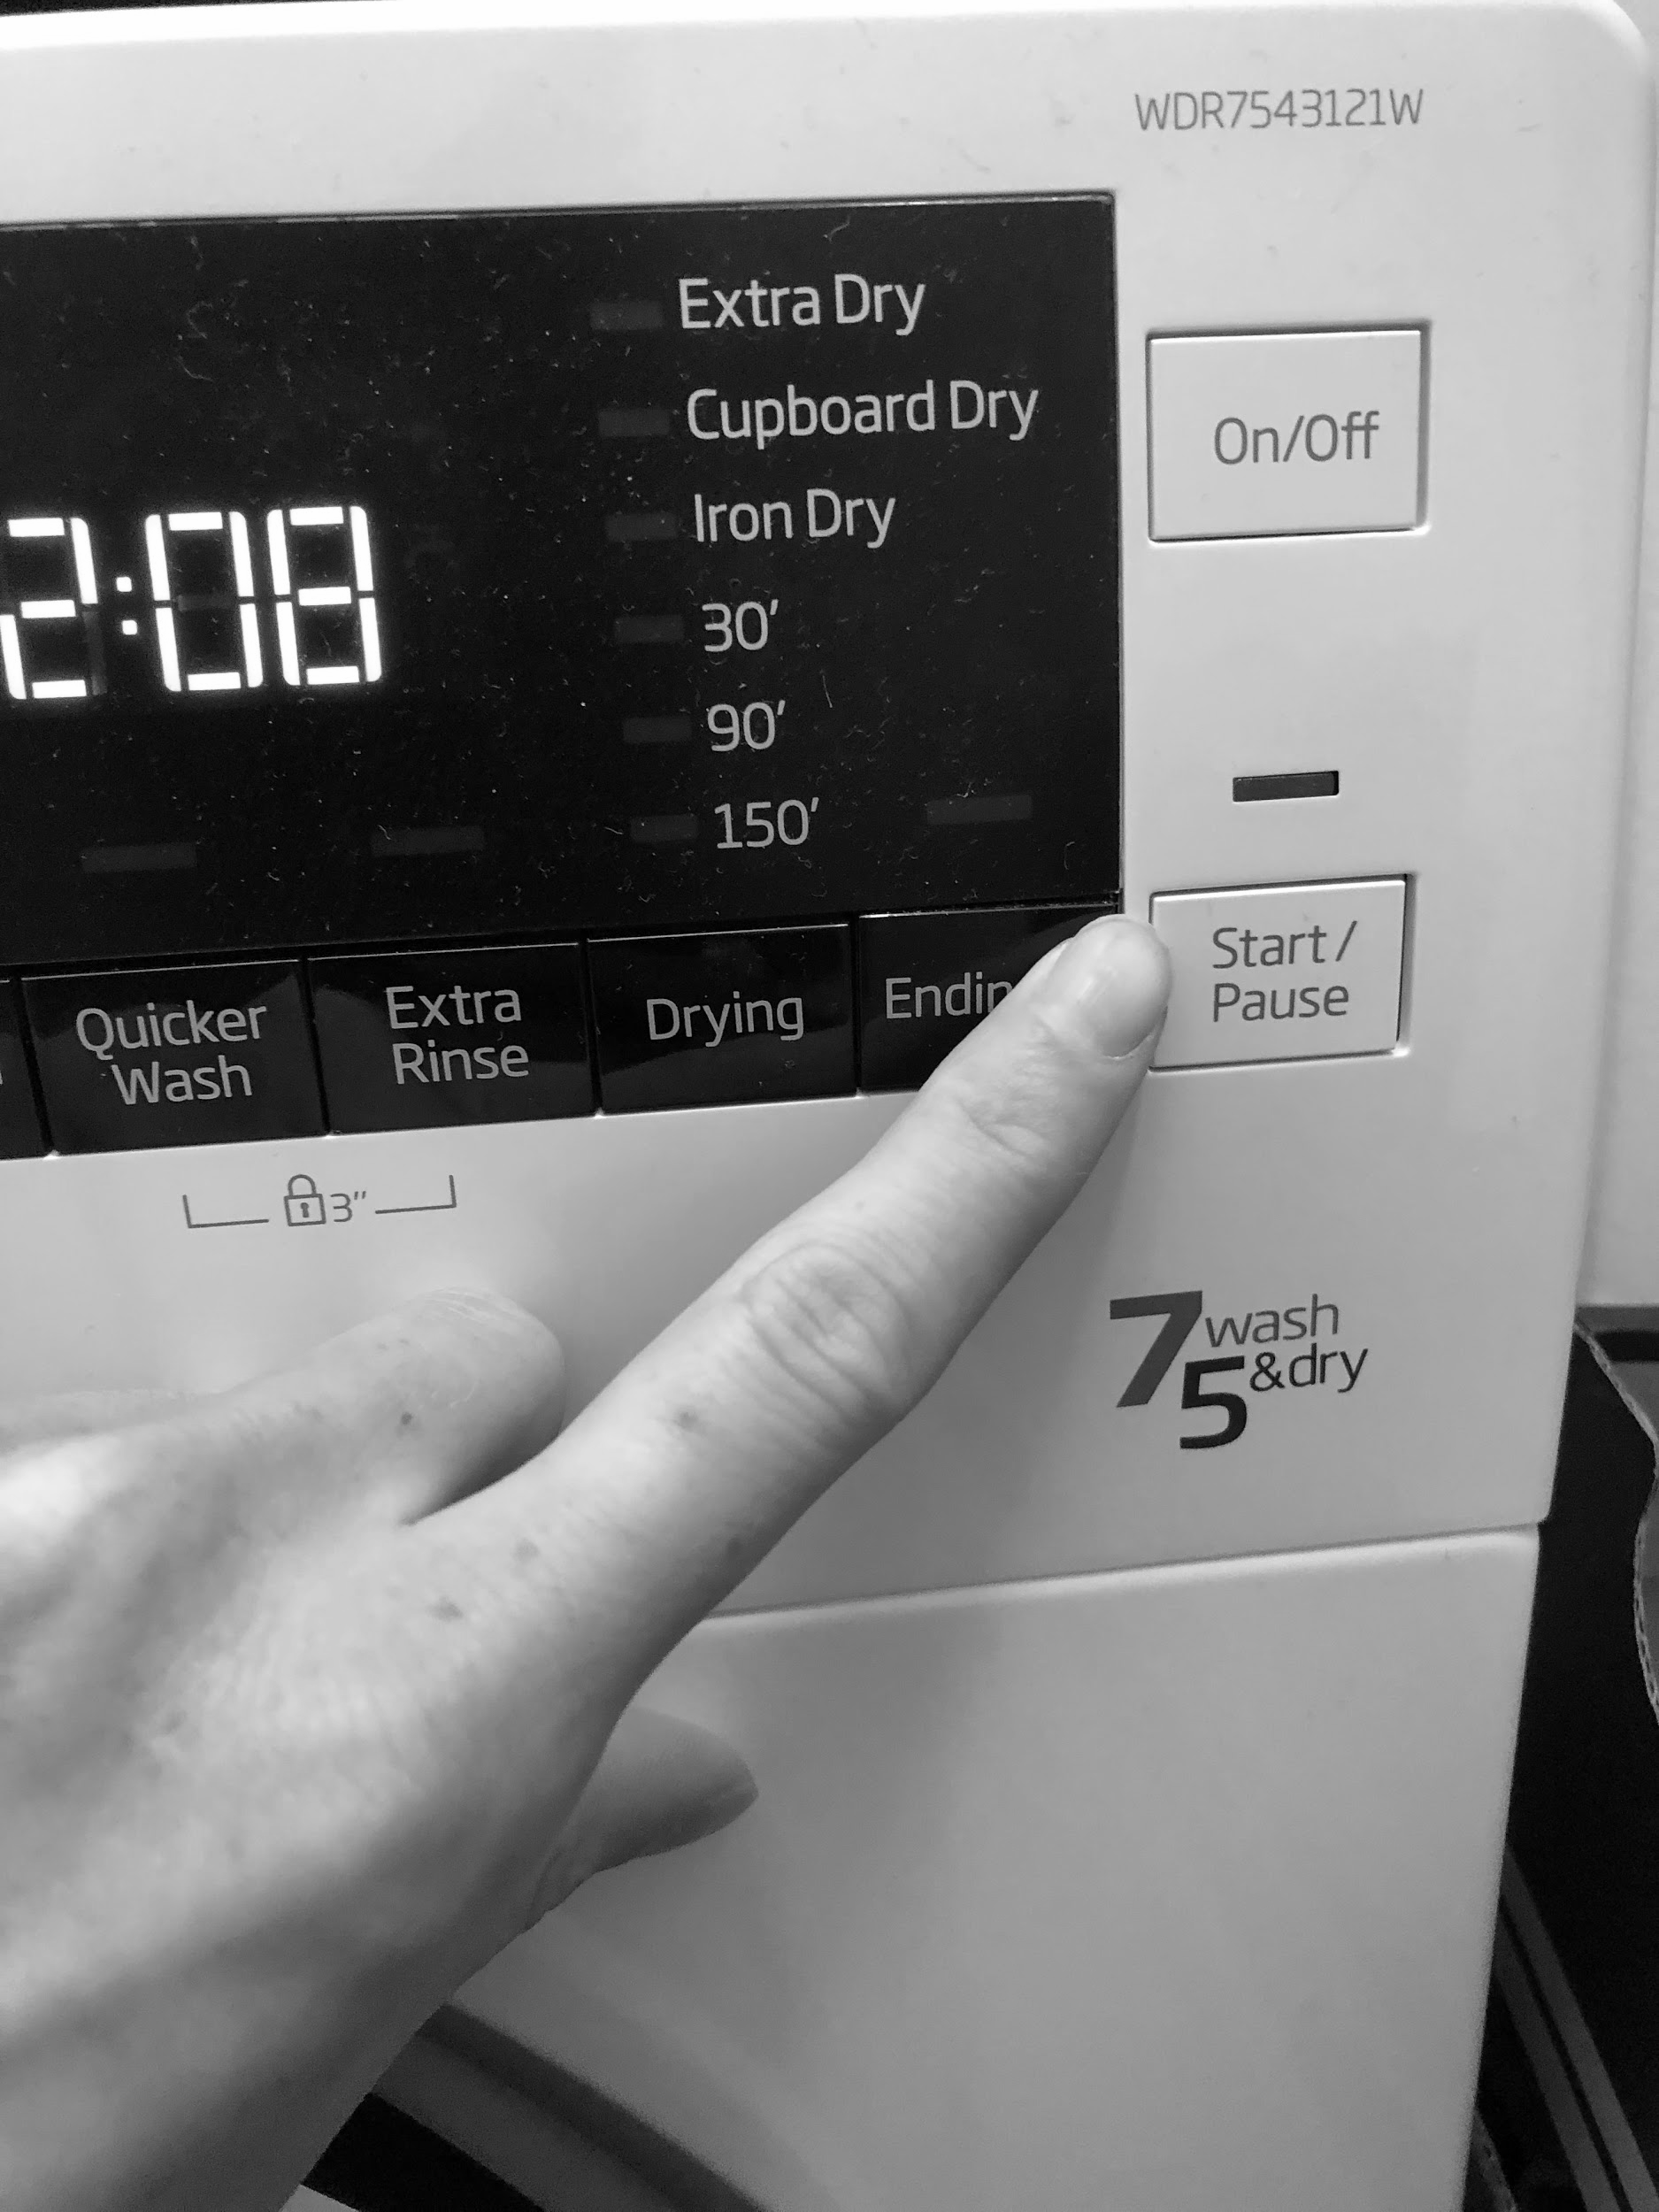
Step 7- Press start
Teacher’s own image
Notes:
Work through the following slides, talking about what each photo shows.

Slide 17
The images are mixed up- Can you put the steps in order?
Step 1 | Step 2 | Step 3 | Step 4 | Step 5 | Step 6 | Step 7
Open door | Put clothes in | Close door | Open drawer | Put detergent in | Choose setting | Press start
Notes:
Read through each step from 1 to 7. Ask your learner to match the images to the correct step box. You can do this by- pointing to the screen, writing the steps down or printing the page to cut and stick the images in the correct boxes.

Slide 18
The images are mixed up- Can you put the steps in order?
Step 1 | Step 2 | Step 3 | Step 4 | Step 5 | Step 6 | Step 7
Notes:
Can you match the images to the steps without the description? Ask your learner to match the images to the correct step box. You can do this by- pointing to the screen, writing the steps down or printing the page to cut and stick the images in the correct boxes. E.g. ask “what’s the first step?”.

Slide 19
Take photos of each of the 7 steps
Notes:
Use a camera phone to take a photo of each of the seven steps using your washing machine.

Slide 20
Independent Living Building Understanding
Using a washing machine
Make it easier
Make it harder
More ideas
-Explore hand washing clothes using water and bubbles
-Build up to completing all the steps
-Build using the washing machine into your weekly routine
-Can you hang the wet washing?
-Pair the job with a song. Can you make putting on the washing fun?
-After the washing is dry, sort it into family member piles

Slide 21
Further learning with Oak National
Independent Living:
Building Understanding- Organising clothes (Unit 1)
Applying Learning- Organising clothes (Unit 1)
Applying Learning- Reading clothes labels (Unit 1)
Communication and Language:
Building Understanding/Applying Learning- Clothes and Fashion (Unit 3)
Occupational Therapy:
Activities of daily living (Unit 6)

Slide 22
References
Slide 8- Linen, Unsplash / Materialmix black clothes Sari Montag, Flickr Attribution-ShareAlike 2.0 Generic (CC BY-SA 2.0) / Plastic laundry basket vector drawing, Publicdomainvectors.

