Slide 1
Recognise 3-D shapes
Worksheet
Mathematics
Miss Parsons

Slide 2
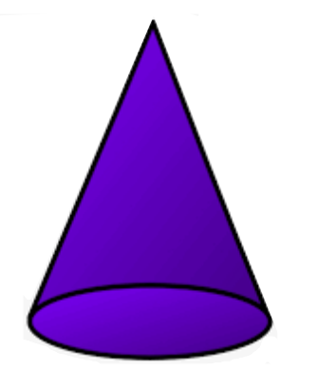
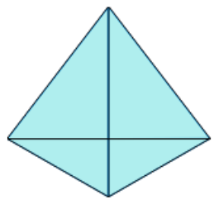
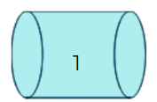
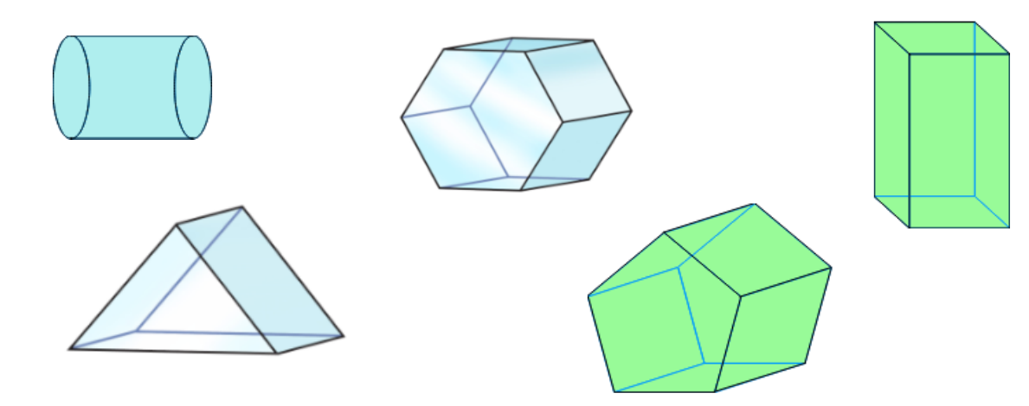
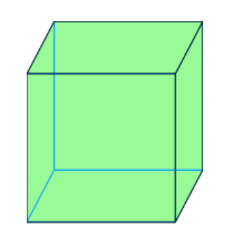
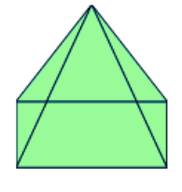
Question 1
8
6
Match the shape to its name.
- cone
- cuboid
- hexagonal prism
- cylinder
- pentagonal prism
- cube
- tetrahedron
- square based pyramid
- triangular prism
1
3
7
2
5
9
4

Slide 3
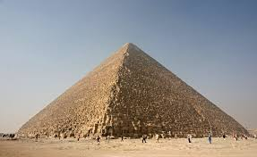
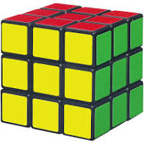
Question 2
Complete the table of shape properties.
Name
Vertices
Edges
Faces

Slide 4
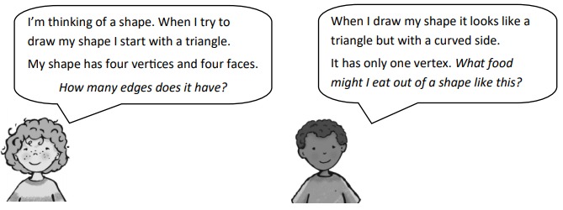
Question 3
What shape is each person describing?
Write the name of the shape, sketch a diagram of the shape and answer their questions.

Slide 5
Question 4
Raeesa has drawn a 3-D shape.
His shape has 5 vertices, 8 edges and 5 faces.
What 3-D shape has Raeesa drawn?
Fran has drawn a 3-D shape.
Her shape has 5 faces, 9 edges and 6 vertices.
What 3-D shape has Fran drawn?

Slide 6
Question 5
Flat faces
Curved faces
cuboid
sphere
cube
cylinder
cone
square based pyramid
triangular prism

