Slide 1
Numeracy: Shape and Sorting -Applying Learning
Creating patterns using simple 2D shapes
Lesson 4
Simon

Slide 2
Here are a selection of shapes which can be used for pattern making in Unit 2, Lesson 4.
Pages 3-6 are colour to aid with recognition
Pages 7-10 are in black and white
Page 11- symbols
Page 12 and 13 Salt dough recipe

Slide 3
Circles

Slide 4
Squares

Slide 5
Rectangles

Slide 6
Triangles

Slide 7
Circles

Slide 8
Squares

Slide 9
Rectangles

Slide 10
Triangles

Slide 11
Key Vocabulary
side
corner
curved
straight

Slide 12
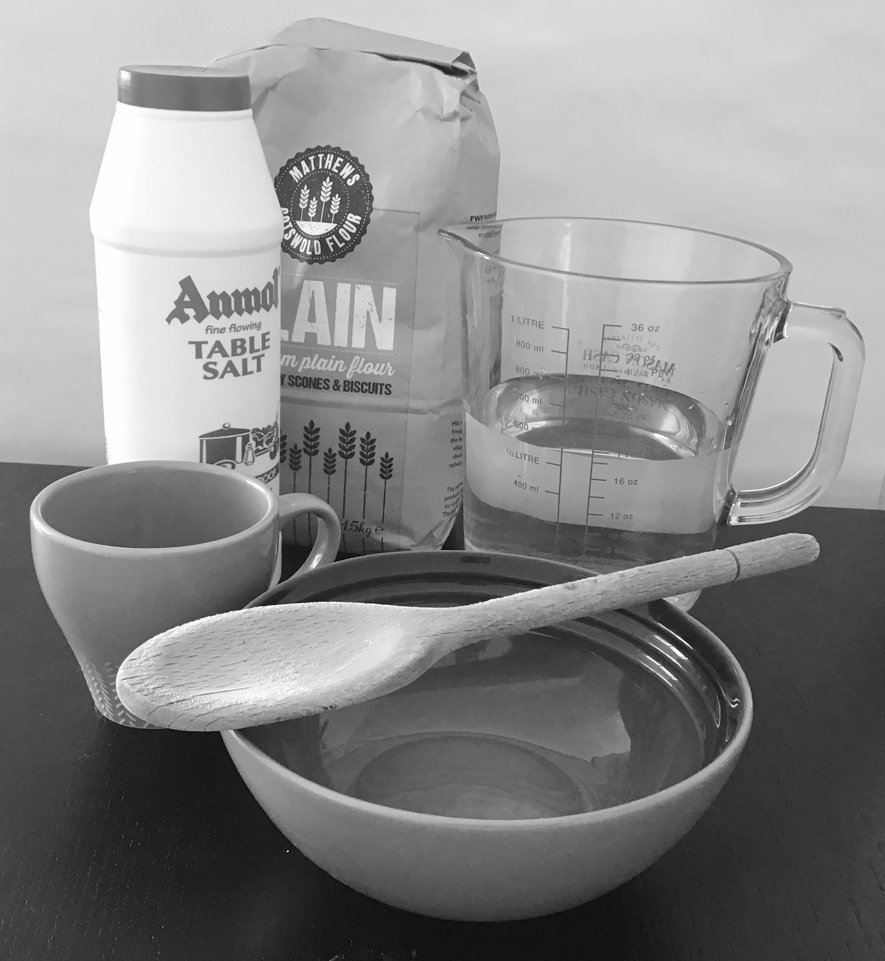
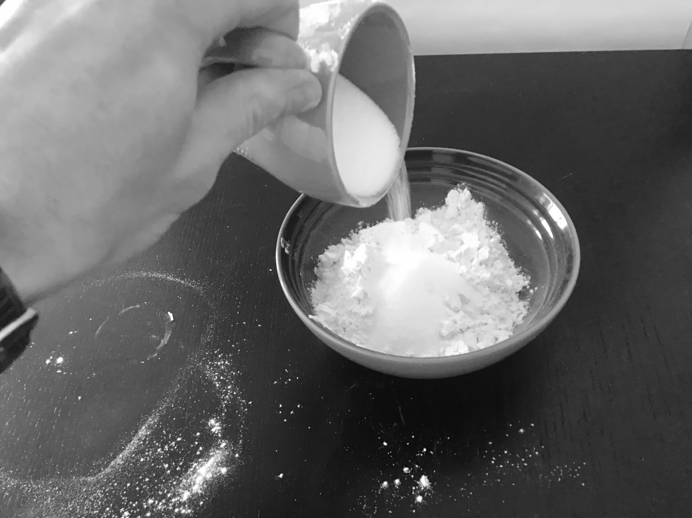
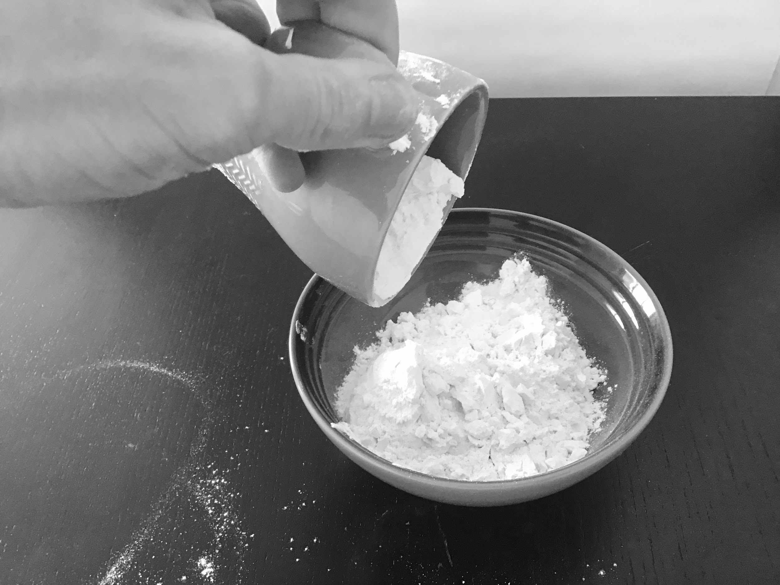
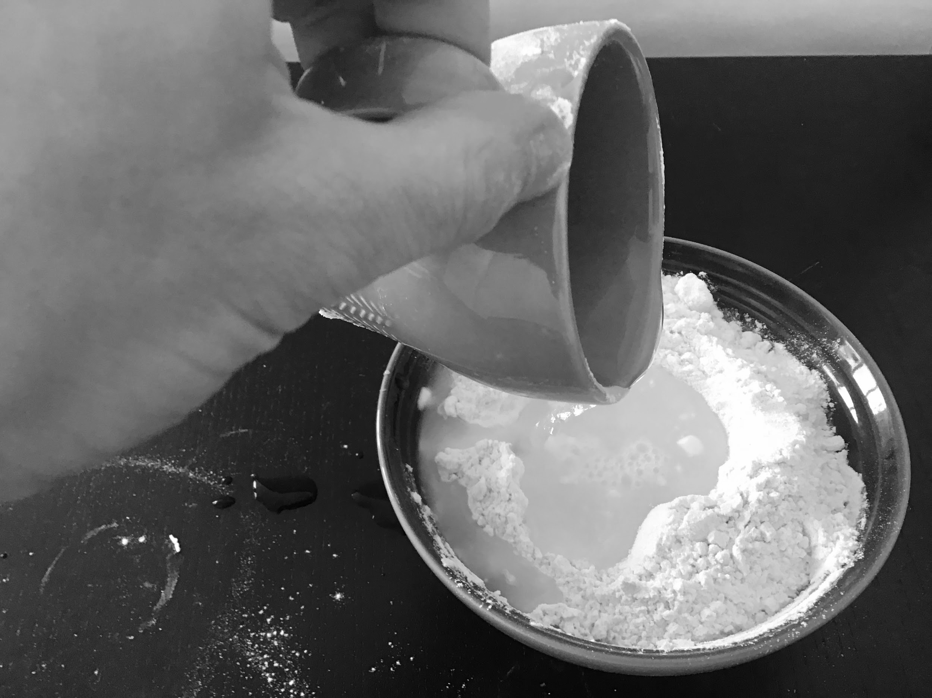
Salt dough recipe and instructions
½ cup salt
1 cup plain flour
½ cup water
Bowl
Cup
Spoon to mix
Put the flour in the bowl.
2. Add the salt.
3. Add the water.

Slide 13
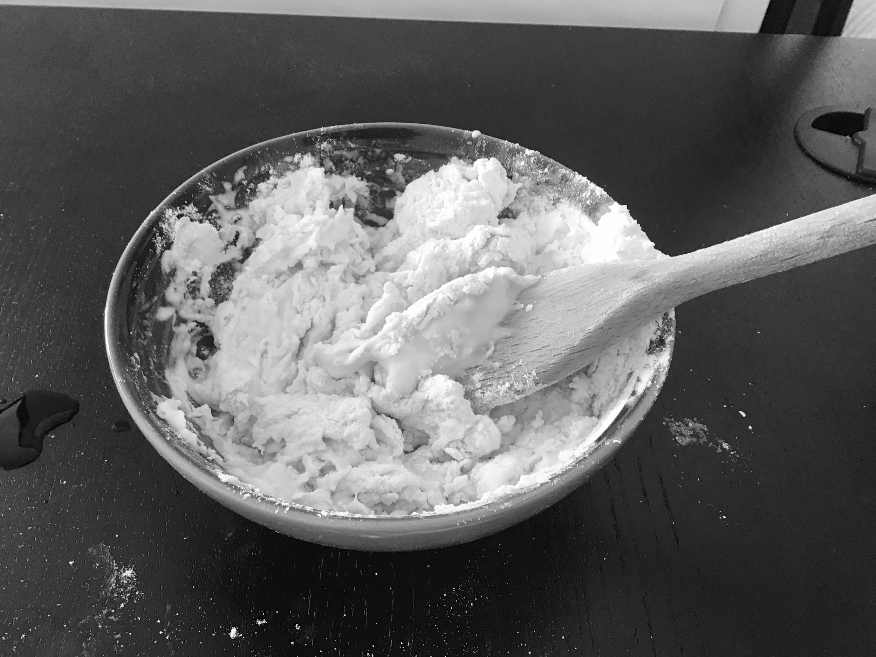
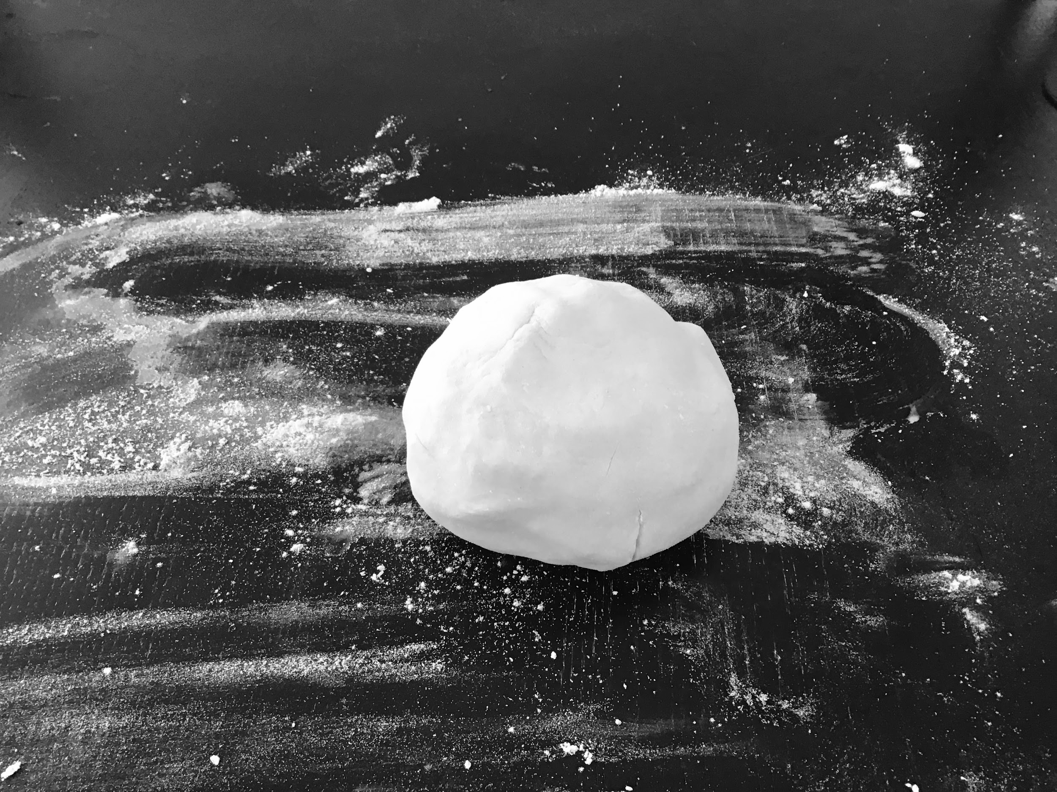
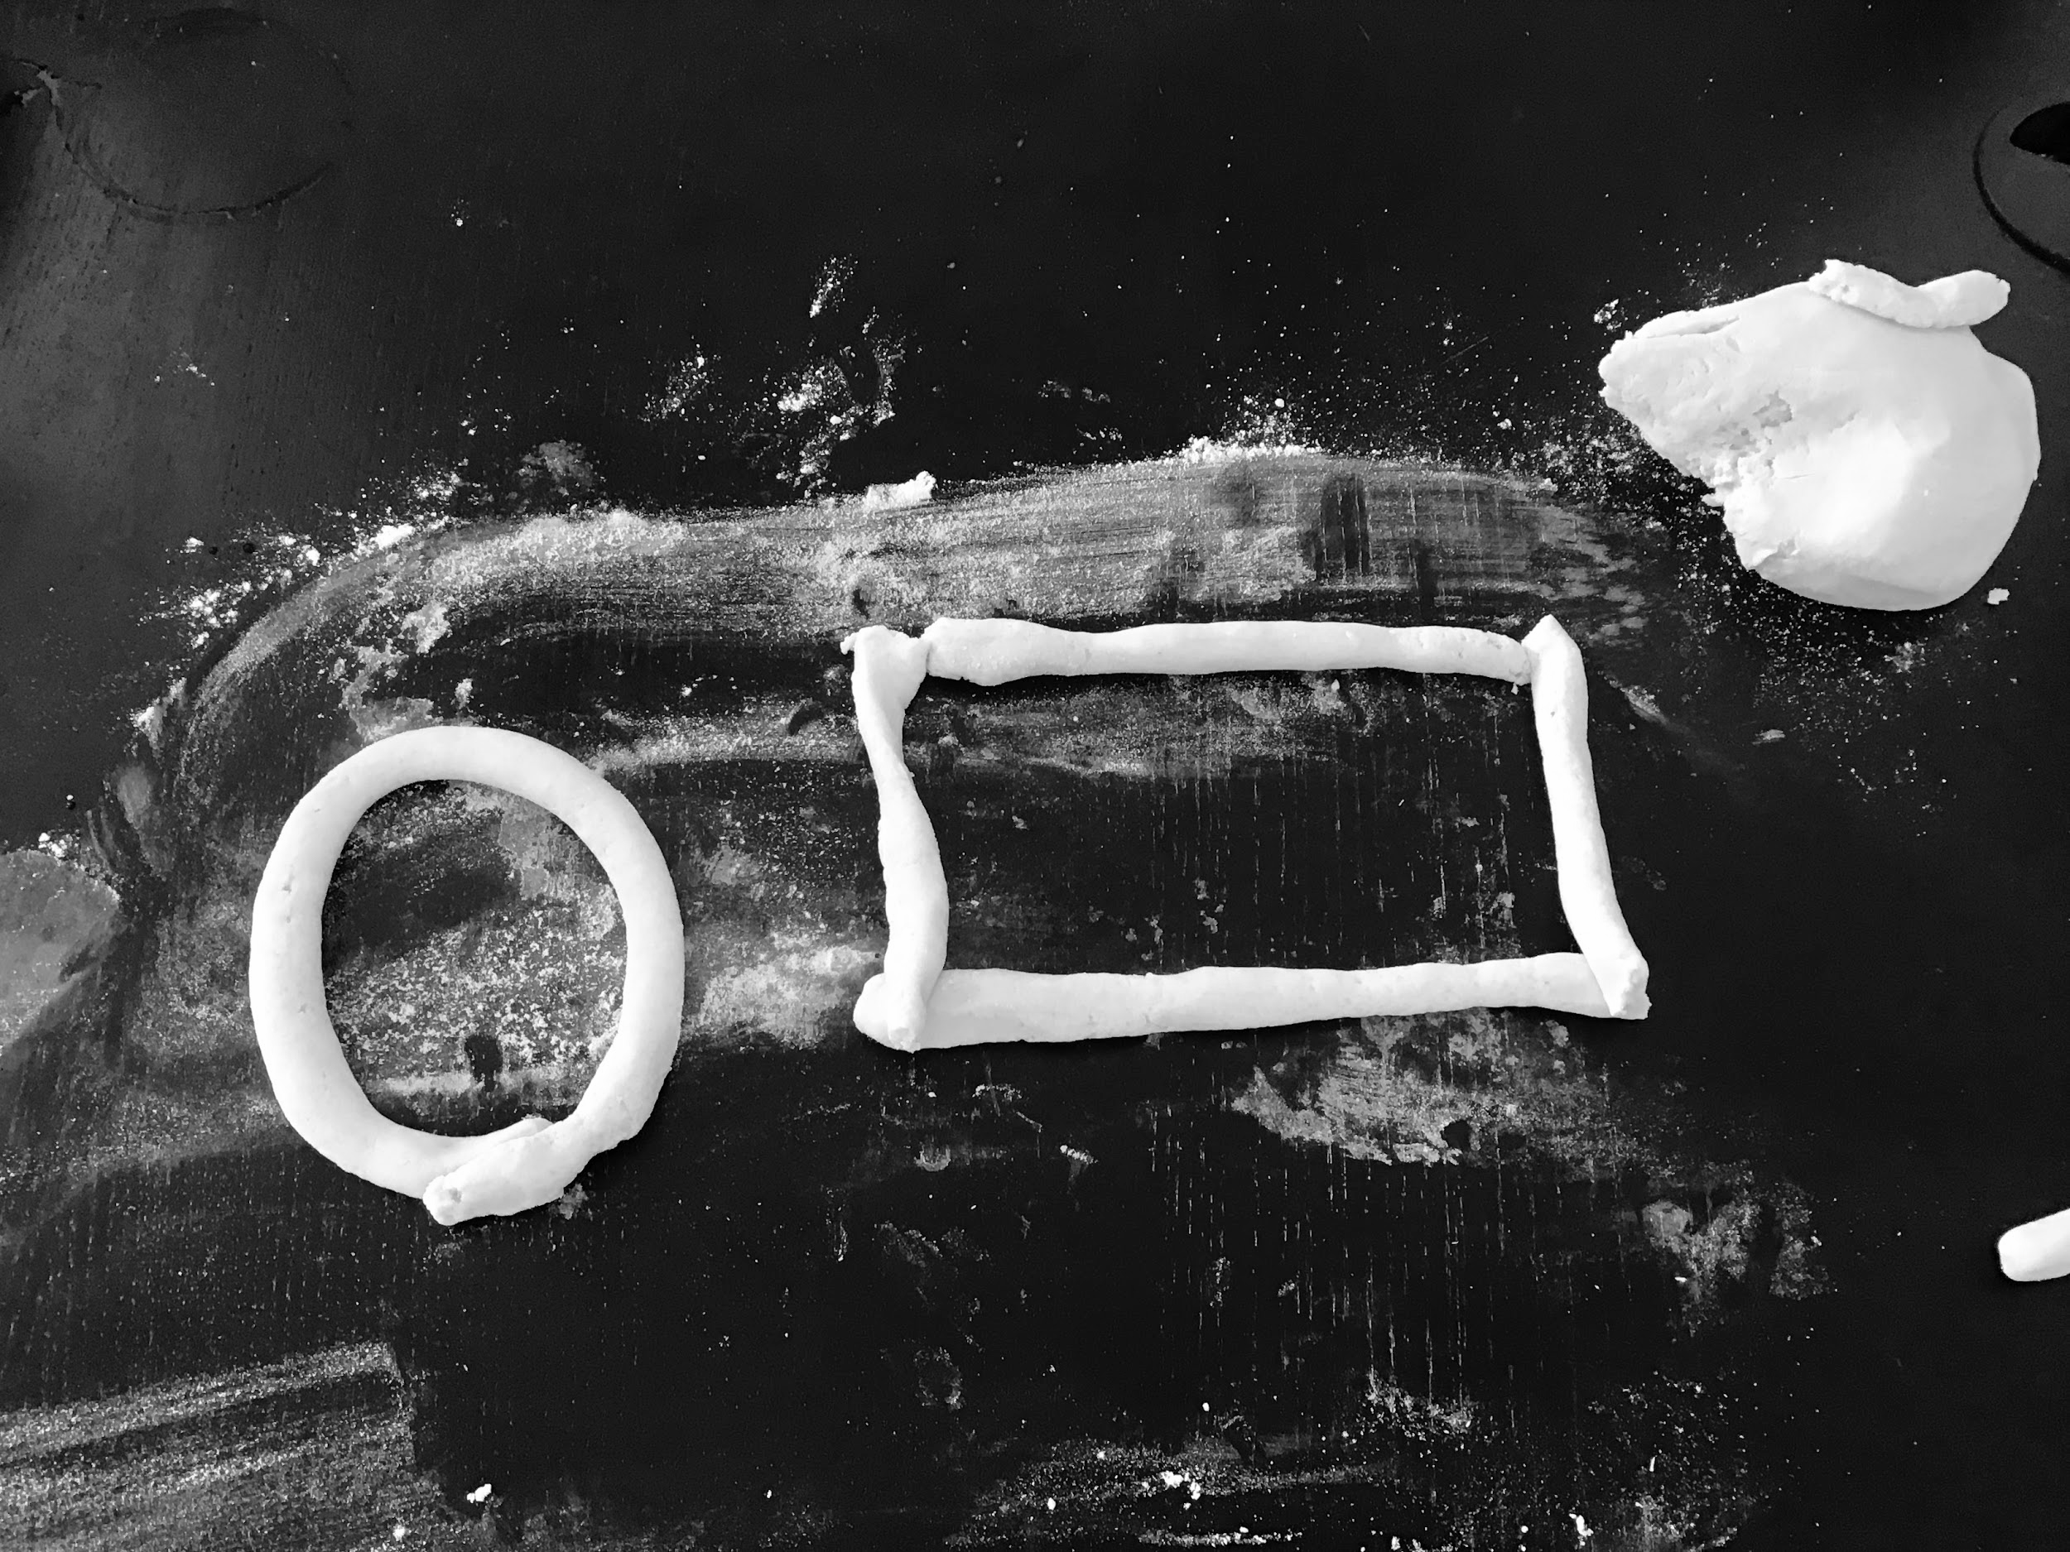
4. Mix everything together.
5. Knead the dough on a floured surface.
6. Complete the activities.

