Slide 1
Combined Science Review - worksheet
Combined Science - Physics - Key Stage 4 - Waves
Miss Walrond

Slide 2
Answer these questions after watching the lesson. Click through the slides to look at the answers when you’re done.
At the end of this document are some of the tasks from within the lesson in case you want to print these.
TV satellites use short wavelength radio waves (microwaves) to receive and send signals.
Explain why these waves have to be used rather than long wavelength radio waves.
………………………………………………………………………………………………………………………………………………………………………………………………………………………………………………………………………………………………………………………………………...
…………………………………………………………………………………………………………………………………………………………………………………………………………………………………………………………………………………………………………………………………[2]
OCR GCSE Science June 2014 | B752/01

Slide 3
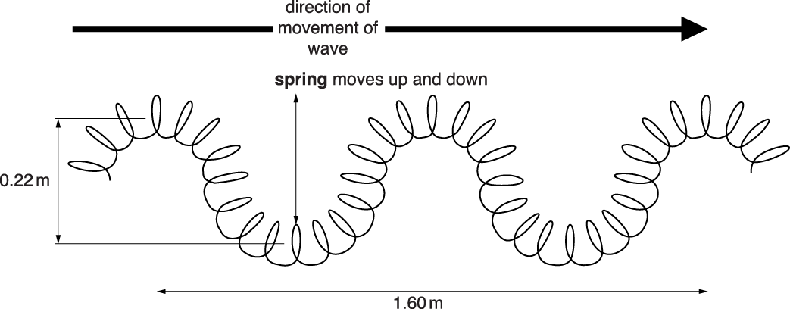
OCR GCSE Science June 2015 | B751/02
2. P waves and S waves are different.
P waves are longitudinal and S waves are transverse. Look at the diagram of a model of a wave made with a slinky spring.
The wave is made by moving the spring up and down with a frequency of 1.2 Hz.
Look at the diagram.
i. Calculate the speed of the wave. answer ........................................................................ m/s [2]
ii. What is the amplitude of the wave?
Choose from:
0.11 m 0.22 m 0.80 m 1.60 m 1.82 m [1]

Slide 4
Higher tier only
3. Look at the diagram. It shows white light entering a glass prism at A.
The red light refracts away from the normal at B.
Use ideas about waves to explain why this happens. …………………………………………………………………………………………………………………………………………………………………………………………………………………………………………………………………………………………………………………………………………………………………...
…………………………………………………………………………………………………………………………………………………………………………………………………………………………………………………………………………………………………………………………………………………………… [2]
OCR GCSE Science June 2016 | B752/02

Slide 5
Answers to the exam questions

Slide 6
Question |  |  | Answer/Indicative content | Marks
1 |  |  | any 2 from short waves penetrate atmosphere / Long waves don't penetrate atmosphere / AW [1] long waves absorbed or refracted or reflected (by atmosphere) [1] (therefore) short waves reach the receiver / long waves don't reach the receiver [1] | 2

Slide 7
Question |  |  | Answer/Indicative content | Marks
2 |  | i | speed = 0.96 (m/s) [2] but if answer is incomplete then 0.80 × 1.2 [1] | 2
 |  | ii | 0.11(m) [1] | 1

Slide 8
Question |  |  | Answer/Indicative content | Marks
3 |  |  | change in wave speed / refractive index [1] but (in air) wave speed increases / lower refractive index / ora [2] | 2

Slide 9
Questions from within the lesson

Slide 10
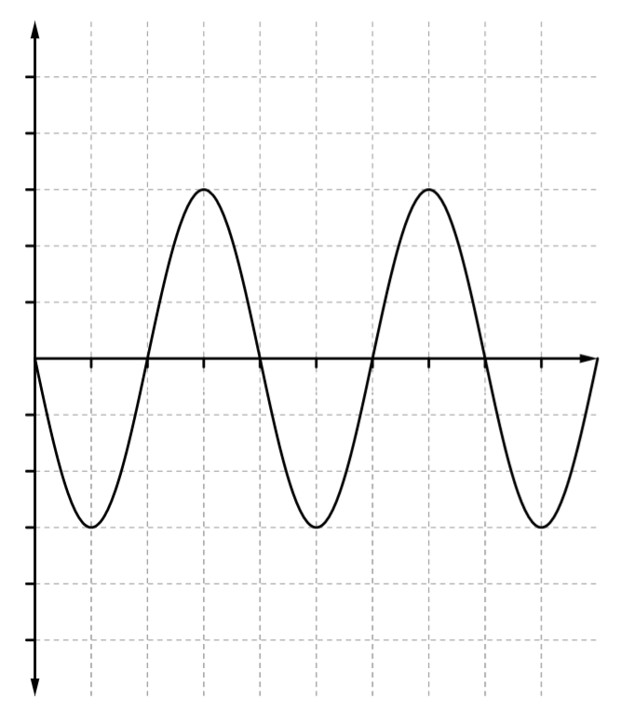
Properties of waves
Copy the diagram and add these labels:
Peak
Wavelength
Trough
Amplitude
How many waves are shown?
If these waves were produced in 10 s, what is the frequency?
What is the period?
Displacement (m)
Credit: Mr Benyohai

Slide 11
Answering common questions
Compare radio and sound waves
Compare means similarities and differences
Type of wave
Oscillations
Speed
Medium
Interaction with surfaces
Sound waves are longitudinal.
Radio waves are transverse.
The oscillations in a longitudinal wave are…
Whereas in a radio wave they are...
Sound travels at…
Whereas radio waves....
Sound can only travel when…
But radio waves can…
Both waves will…
And both waves transfer...

Slide 12
Can you spot the 6 mistakes?
Set the motor to go as fast as possible to create plenty of waves.
Shine a light from underneath the tank onto a piece of white paper.
Video the waves for 1 hour and count how many waves pass a particular point.
Divide this number by 3600 (seconds) to get the frequency.
Take a photo of the waves on the piece of paper.
Measure the distance between two consecutive shadows once, use a ruler.
This is the wavelength in centimetres.
Divide wavelength by frequency to get the wave speed in m/s.

Slide 13
Can you spot the mistake?
Redraw this diagram correctly and label the 4 angles
Air
Glass block

Slide 14
Redraw your corrected diagram here
Air
Glass block

