Slide 1
Reasoning with large whole numbers: Ordering and comparing 6-digit numbers
Mathematics
Ms Jeremy

Slide 2
Pause the video to complete your task
Resume once you’re finished
Calculate the intervals.
Look at the number before and the number after.
Identify the value.
350 000
470 000
a
b

Slide 3
Pause the video to complete your task
Resume once you’re finished
What 6-digit numbers are the arrows pointing to here?
Larger intervals =
Smaller intervals =
a
b

Slide 4
Pause the video to complete your task
Resume once you’re finished
250 000
?
?
If we know the placement of 250 000, what numbers could be at the start and end of our number line?

Slide 5
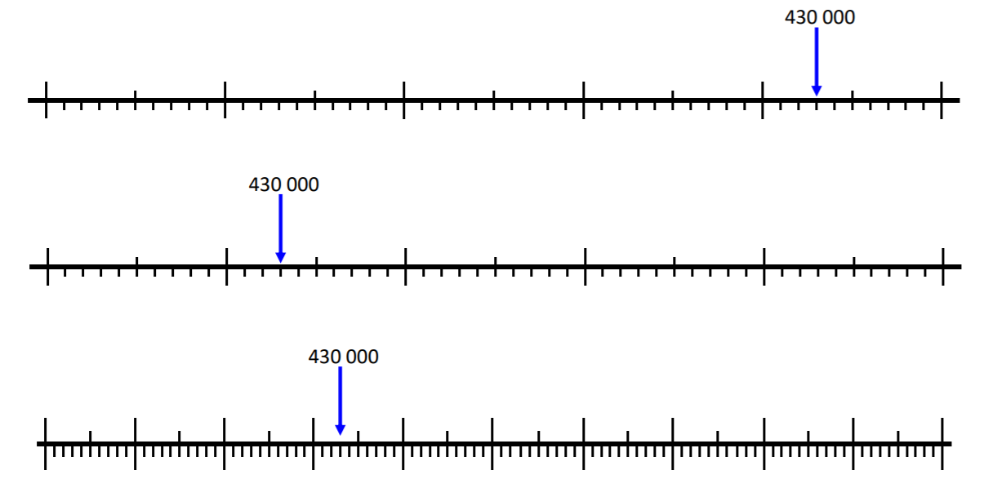
Independent Task
?
?
?
?
?
?

