Slide 1
Describe people [2/ 2]
Être plural : ils / elles
Plural marker on adjectives
French
Madame Sooden

Slide 2
[ ou ]
trouver
toujours
jouer
[always; still]

Slide 3
[ ê / è ]
fête
collège
frère

Slide 4
Vocabulary list for this lesson:
En français
En anglais
ouvert | open-minded
strict | strict
sage | well-behaved
le frère | brother
la sœur | sister
les parents | parents
5
4
3
2
1

Slide 5
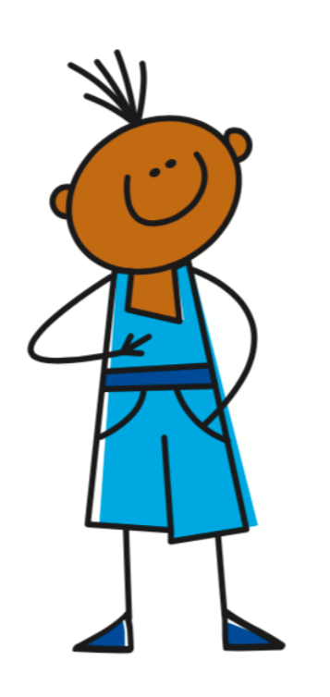
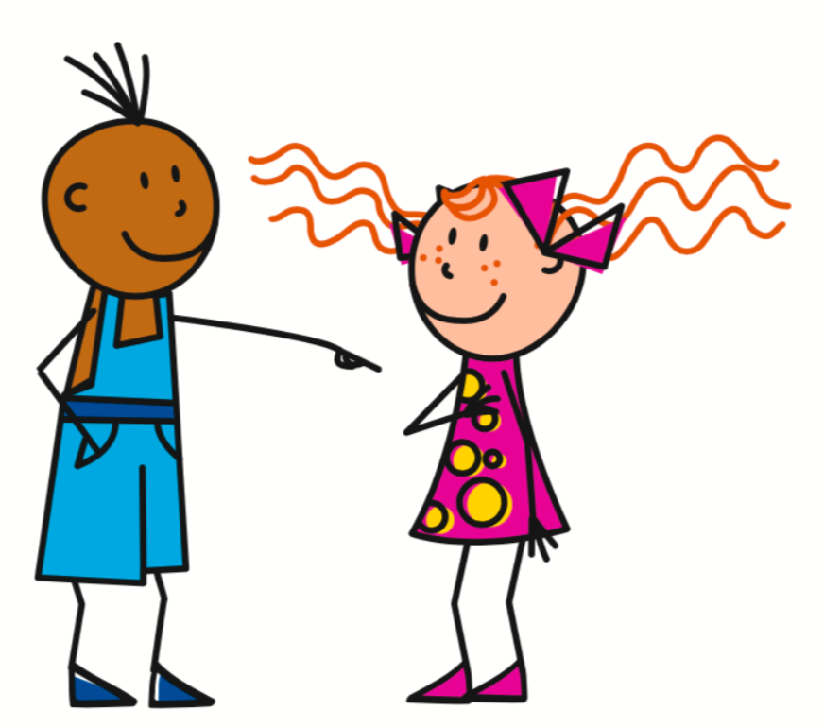
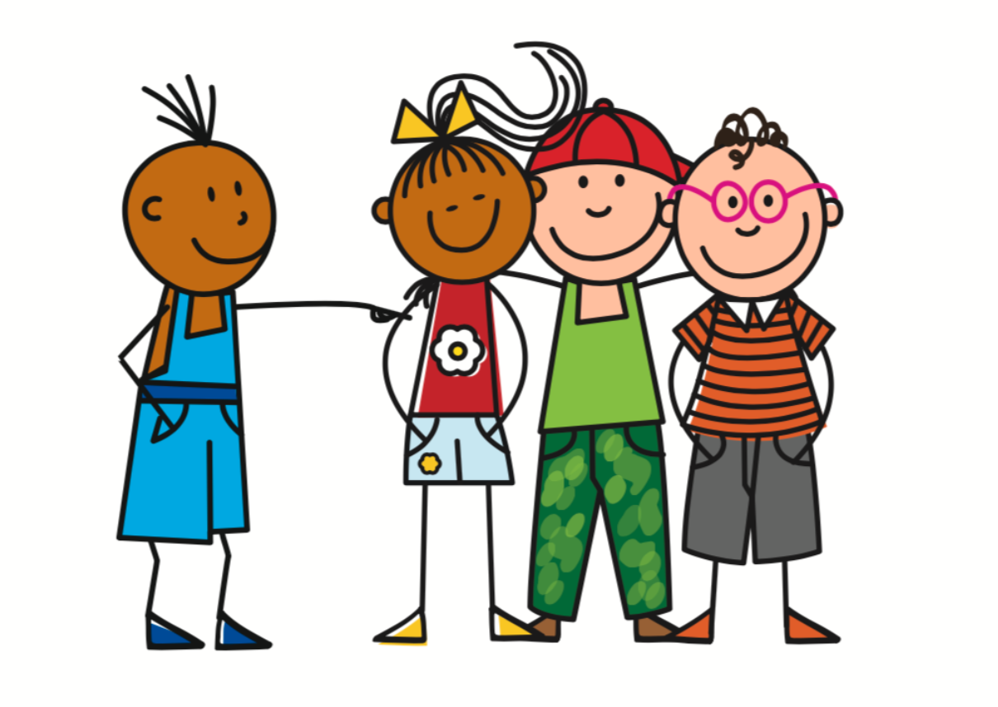
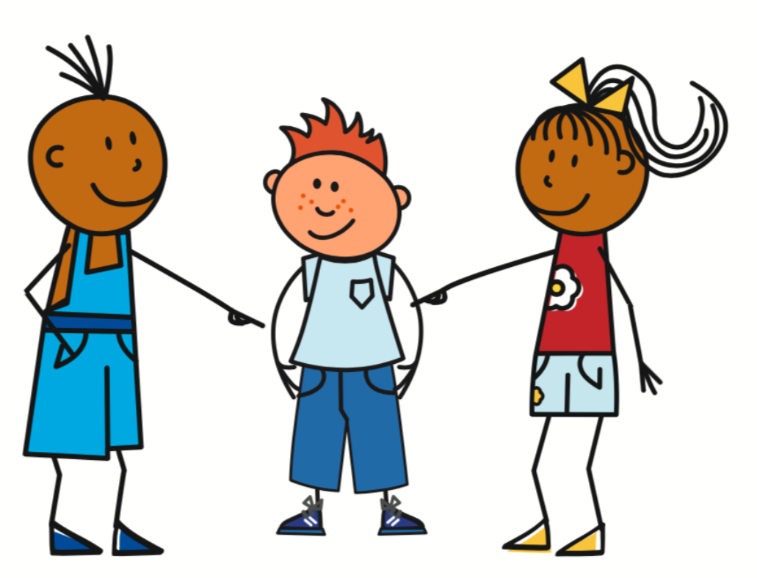
Present Tense - Irregular verbs
To conjugate être into the present tense, you must memorise the irregular pattern.
Être - To be
Je suis - I am
Nous sommes - We are
Tu es - You are
Vous êtes - You are
Il est - He is
Ils sont - They are

Slide 6
Definite articles
In English, the definite article is the.
In French, there are three definite articles le/ la/ les.
This depends on whether the noun is masculine, feminine or plural.
 | Masculine | Feminine | Plural
Definite a | le | la | les

Slide 7
Definite articles and adjectives
Ils sont calmes
Elles sont calmes
= They are calm
= They are calm
Les frères sont calmes
Les sœurs sont calmes
= The brothers are calm
= The sisters are calm

Slide 8
Translate into English
1.
Vous
êtes
tristes
et
malades
You are sad and sick
2.
Elles
sont
méchantes
mais
drôles
They (fp) are mean but funny
5
3.
Les
frères
sont
sages
et
ouverts
4
The brothers (mp) are well-behaved and open-minded
3
2
4.
Les
parents
sont
stricts
mais
calmes
1
The parents (mp) are strict but calm

Slide 9
Describe people
1 | Name the two pronouns for ‘they’.
2 | Which is feminine plural?
3 | Name a plural definite article.
4 | Translate ‘strict’ into English.
5 | Translate ‘drôle’ into English.
6 | Translate ‘ils sont tristes’ into English.
ils / elles
elles
les
strict
funny
they are sad

