Slide 1
Lesson 1: Spreadsheet Warm-Up
KS4 - Spreadsheets
Kashif Ahmed
Materials from the Teach Computing Curriculum created by the National Centre for Computing Education

Slide 2
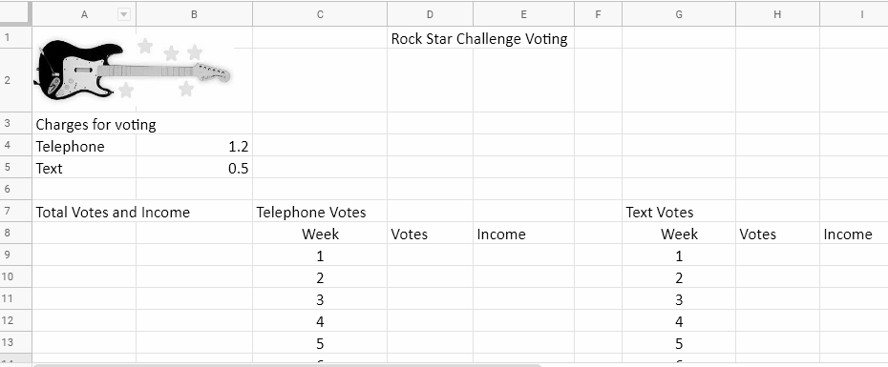
Task 1 - enter data and formulae - part 1
Enter the data on the following slides into the spreadsheet named ‘RSC voting’, which can be downloaded from oaknat.uk/comp-rsc-voting

Slide 3
Task 1 - enter data and formulae - part 2
Week | Telephone Votes | Text Votes
1 | 189034 | 134789
2 | 195754 | 159348
3 | 201456 | 205267
4 | 212674 | 219169
5 | 176432 | 159438

Slide 4
Task 1 - enter data and formulae - part 3
Week | Telephone Votes | Text Votes
6 | 148934 | 174903
7 | 153212 | 175491
8 | 203256 | 210475
9 | 176549 | 183603
10 | 224965 | 226820

Slide 5
Task 1 - enter data and formulae - part 4
In cell E9 enter a formula to calculate the week 1 income from telephone votes. This formula could be =D9*1.2 but that’s not the best one to use.
A better formula would be =D9*B4
Use the fill handle to drag the formula down to the cells below.
You should see that something has gone wrong: the formula is not giving the expected answer in these cells. Using the fill handle the formula is dragged down and is changed RELATIVE to the row, so =D9*B5 becomes =D10*B6 becomes =D11*B7, etc.

Slide 6
Task 1 - enter data and formulae - part 5
We need to change the formula in cell E9 to ABSOLUTE then use the fill handle. An ABSOLUTE formula always refers back to the same cell, so our formula in E9 now looks like this: =D9*$B$4

Slide 7
Task 1 - enter data and formulae - part 6
Note
For the TV show I’m a Celebrity telephone votes cost 50p plus an access charge from your phone provider; it also costs I’m a Celebrity to set up this type of call so they pass on the cost to you.
The amount in B4 is made up of the BT access charge (20p) plus the charge made by Rock Star Challenge for the setup plus the amount which goes to Rock Star Challenge (50p). All this gives a total of £1.20 for each vote. In real life, different landline providers charge different setup fees, so the cost could be more or less with a different provider.

Slide 8
Task 1 - enter data and formulae - part 7
Cell E19 calculates the total income from telephone votes. You could use this formula: =E9+E10+E11…, etc.
This will give the correct result but it’s not a very elegant formula; better to use
=SUM(E9:E18)
Now, enter similar formulae in the H and I columns to calculate the income from text votes.

Slide 9
Task 2 - charity donation and profit - part 1
Charity donation
I’m a Celebrity 2019 donated 15p from every vote to the Make A Wish charity. Of course, Rock Star Challenge wants to do the same. For every vote RSC will donate 15p to charity.
Cell K4 – enter an amount per vote to donate

Slide 10
Task 2 - charity donation and profit - part 2
Cell L8 – enter a formula to calculate the amount donated to charity from telephone votes. The rule here is add up the total number of telephone votes then multiply this by the amount to be donated. There are two ways to do this: either =SUM(D9:D18)*0.15 or, better, =SUM(D9:D18)*K4
By using a cell reference here instead of an amount, if we change the amount of the charitable donation the formula will recalculate automatically.
Cell L9 – use a similar formula to calculate the donation amount from text votes
Cell L10 – add cells L8 and L9

Slide 11
Task 2 - charity donation and profit - part 3
Calculate the profit
Now that we know how much will be donated to charity we can calculate how much profit RSC will make.
The rule for profit is generally income minus expenses or, in this case, income minus donation.
Cell L13 – enter a formula to calculate profit. First we need to add together the two incomes from voting, then subtract the donation amount: =(E19+I19)-L10
Remember that 15p should be entered as 0.15 in cell K4

Slide 12
Task 3 - formatting
Cells containing money should be formatted as currency. Some headings which cover multiple columns could be merged and it might help to add a background fill colour to headings. Example:

