Slide 1
Angles in a Triangle
Downloadable Resource
Mathematics
Miss Oreyomi
Miss Oreyomi

Slide 2
Questions

Slide 3
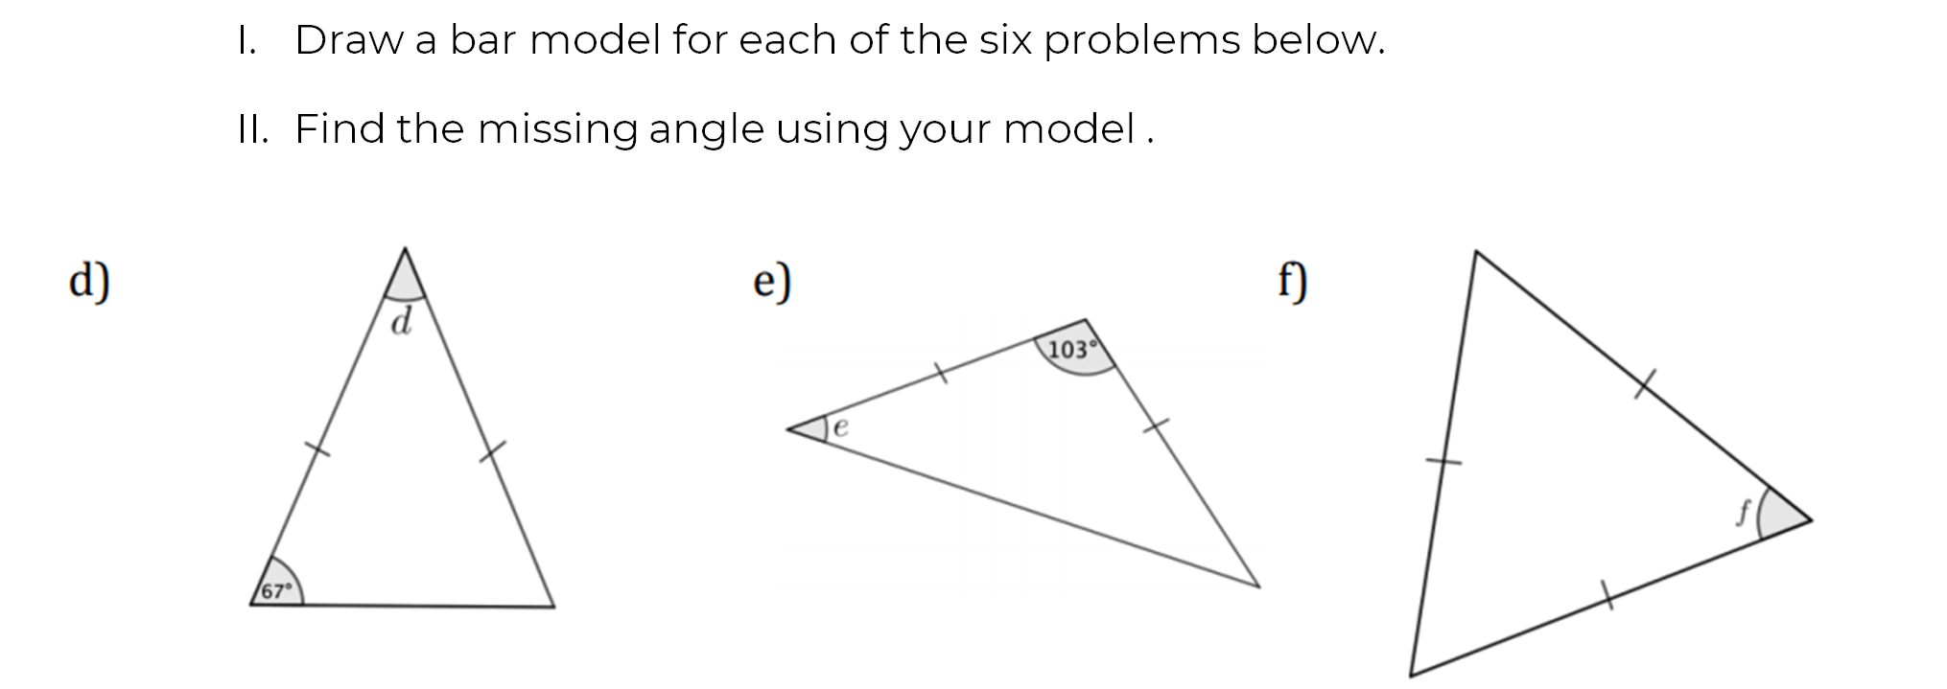
Questions

Slide 4
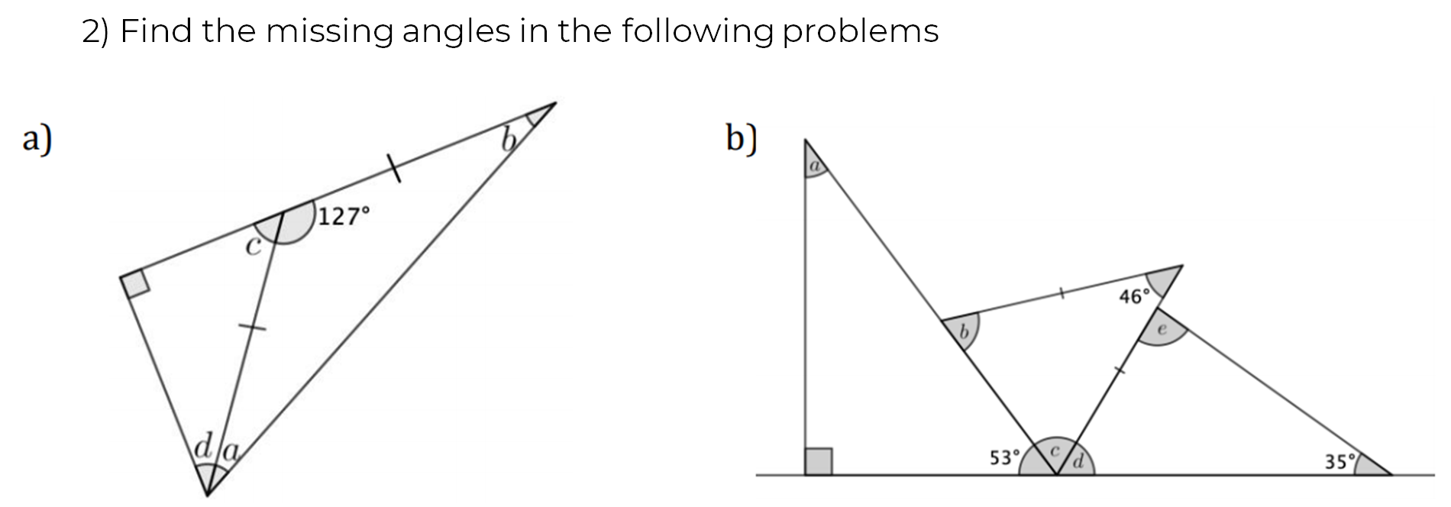
Questions

Slide 5
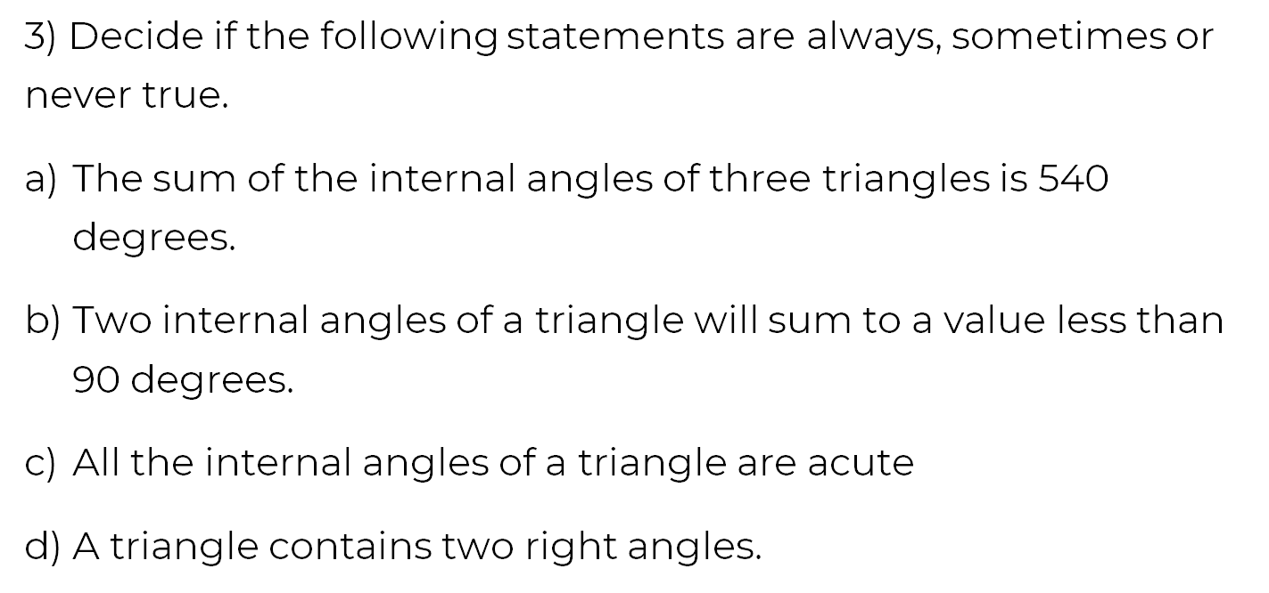
Questions

Slide 6
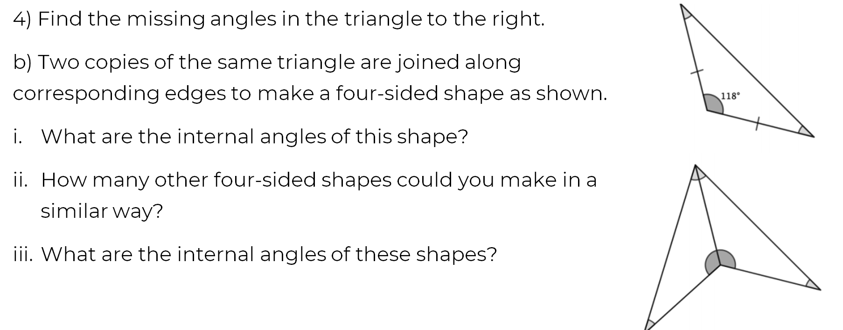
Questions

