Slide 1
Sharing numbers beyond 20
Mathematics Independent Task
Miss Robson

Slide 2
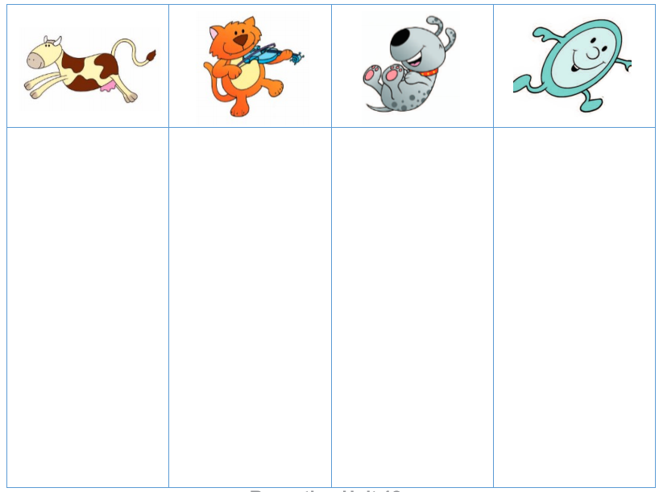
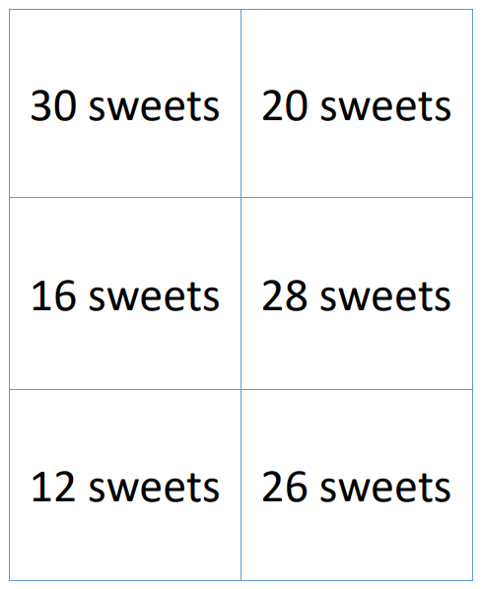
Activity

