Slide 1
To compare and order three numbers within 20
Mathematics
Miss Charlton

Slide 2
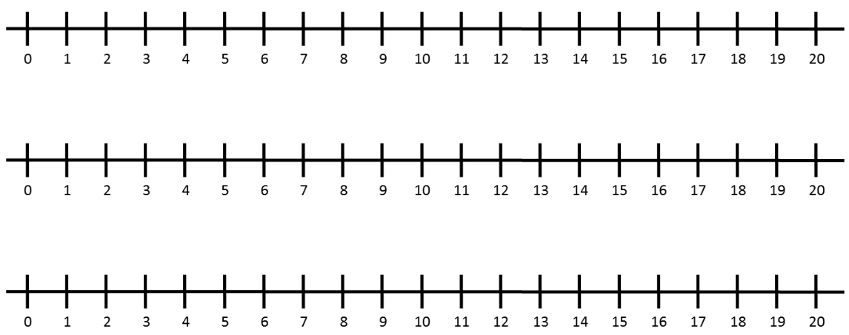
Independent task
‹#›

Slide 3
Independent task
6
20
1
2
12
14
17
13
7
3
19
16
9
8
15
5
11
10
4
18
‹#›

Slide 4
Sentence structure
____ is greater than ____ because it has ___ tens and ____ ones.
____ is smaller than ____ because it has ___ tens and ____ ones.
___ is the greatest number of the three I compared.
___ is the smallest number of the three I compared.

