Slide 1
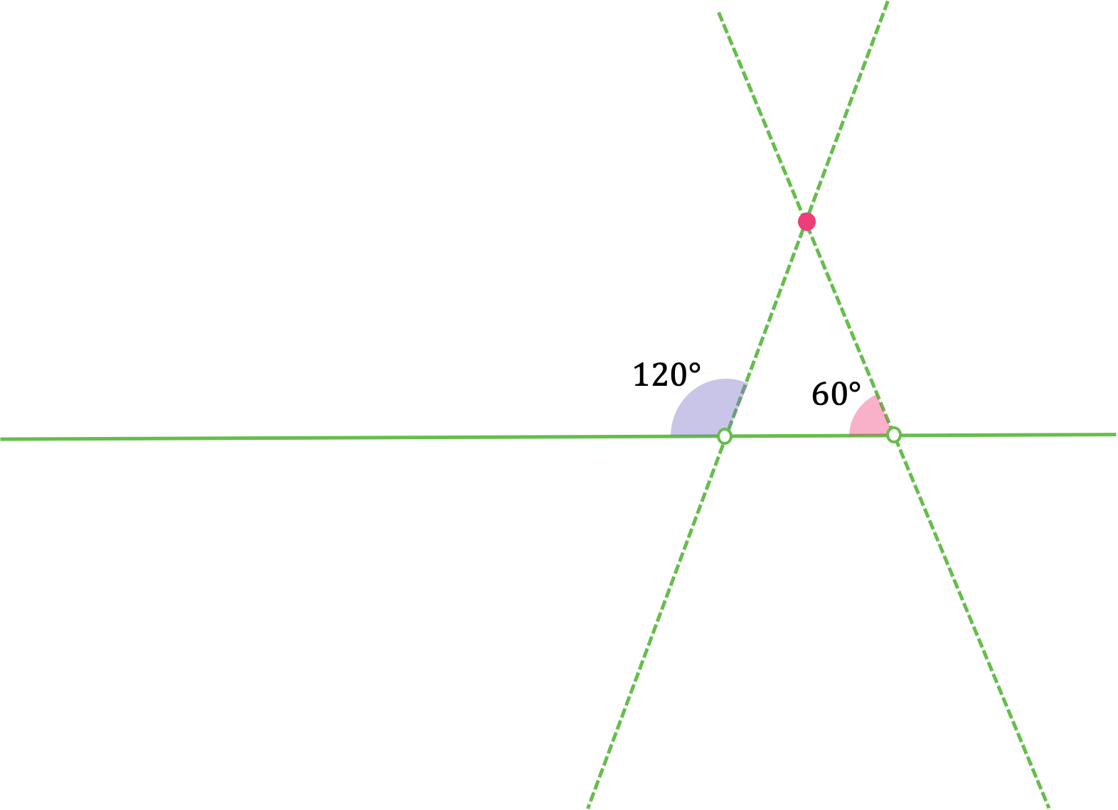
How would you change the angles so that the Intersection point moves:
Further away from the horizontal line?
Closer to the horizontal line?

Slide 2
Do you agree with Xavier statement? Draw a diagram to support your answer.
If a < b the lines will intersect below the horizontal line.

Slide 3
How you would change the angles to ensure the lines never intersect?

Slide 4
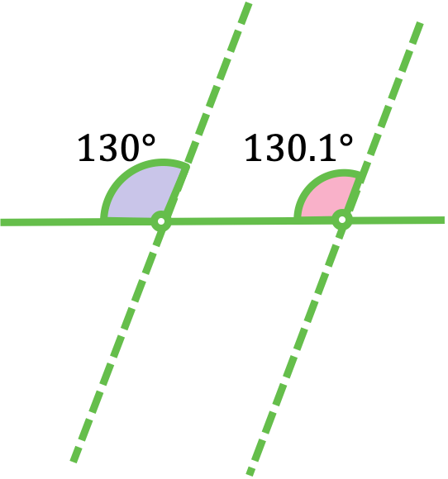
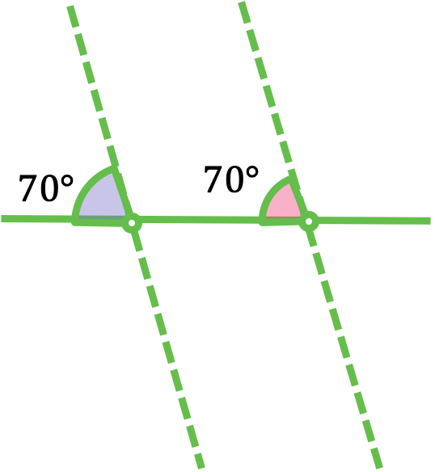
Decide whether or not each pair of lines will intersect
If they do intersect, describe where the intersection point is.

Slide 5
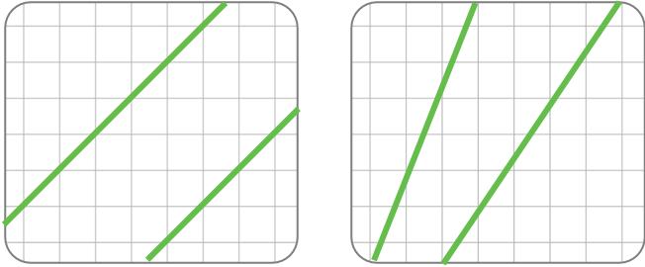
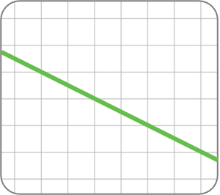
1. Decide whether or not the pairs of lines are parallel.
3. Match the descriptions to the diagrams
Intersection above the horizontal line
Intersection below the horizontal line
Do not intersect
2. Draw a line parallel to the one below

Slide 6
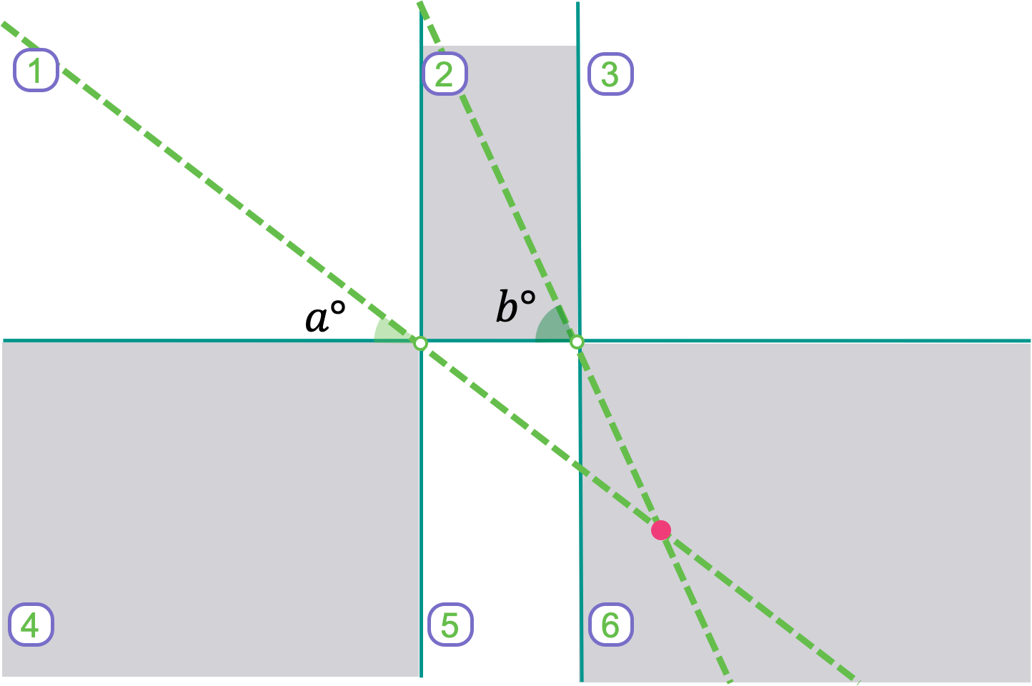
Suggest values for angles a and b that makes the point of intersection lie in each region.
Suggest value for a and b that would make the two lines parallel.

