Slide 1
Oak Specialist
Independent Living Unit 4- Community Living
Applying Learning

Slide 2
Unit 4- Community Living
Lesson 1- Knowing which shop to buy from
Lesson 2- Putting shopping away
Identifying a range of high street shops and knowing what they sell.
Knowing where to store food in the kitchen and other items.
Lesson 4- Health support in the community
Option 3
Lesson 3- Best Value
Option 4
Comparing same items from different shop including price, quality and quantity.
Who can support us with health and where to find help in the community.
Lesson 5- People who help us
Lesson 5- Travel in the community/planning a journey
Option 3
Option 4
Identifying emergency services and their roles.
Following steps to plan a journey and choose the correct mode of transport.
Notes:
Choose a lesson from the list

Slide 3
Lesson 2- Putting shopping away

Slide 4
Teacher notes- Lesson 2
Putting shopping away
Learning Intention- To know where different items belong in the kitchen and the home.
Identify the different food items and the correct place to store them.
Think about different temperatures of items: freezing - warm.
Where do we store other items such as cleaning products and toiletries?
Complete the ‘putting away’ challenge.
Celebrate work completed.
Additional resources: paper and pen, visual support, shopping items
Notes:
Plan of the lesson

Slide 5
Community Living
Putting shopping away
Applying Learning

Slide 6
Lesson Stages
Different food items and where to put them in the kitchen
Video: Temperatures- freezing, cold or warm?
Where do toiletries and cleaning products go?
Putting the shopping away
Notes:
What are we doing in today’s lesson?
Read through each step with your learner..

Slide 7
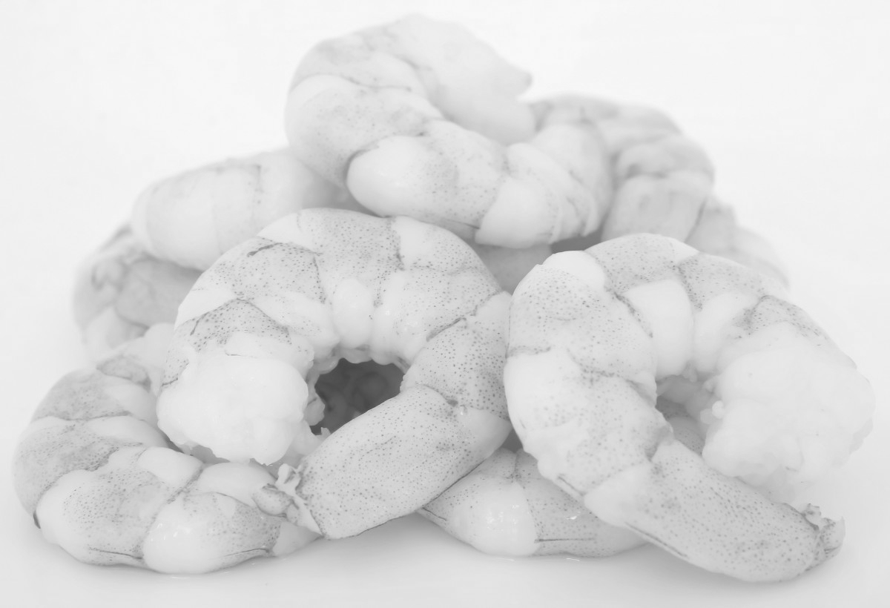
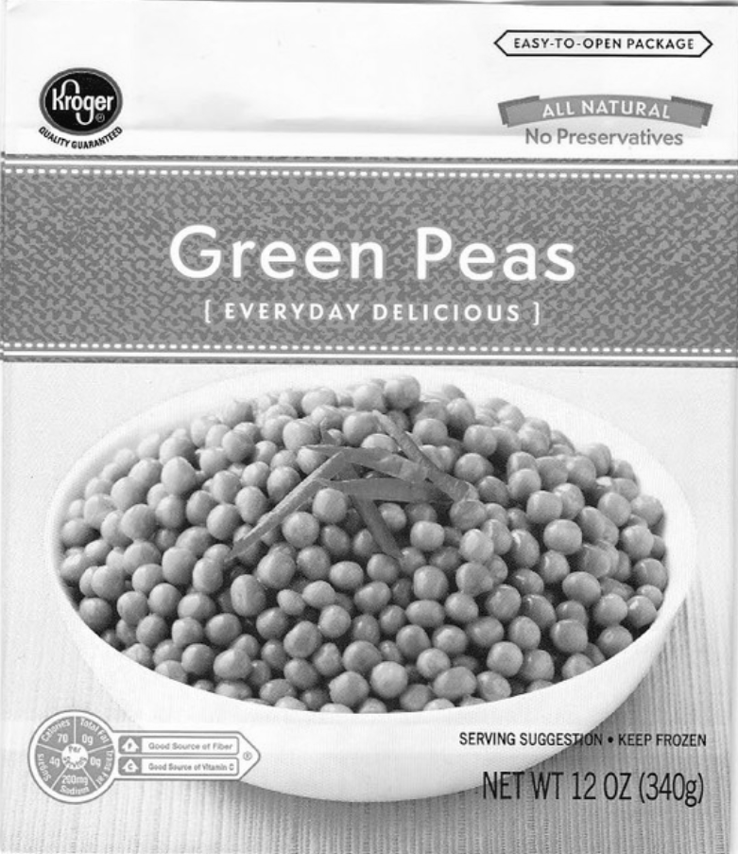
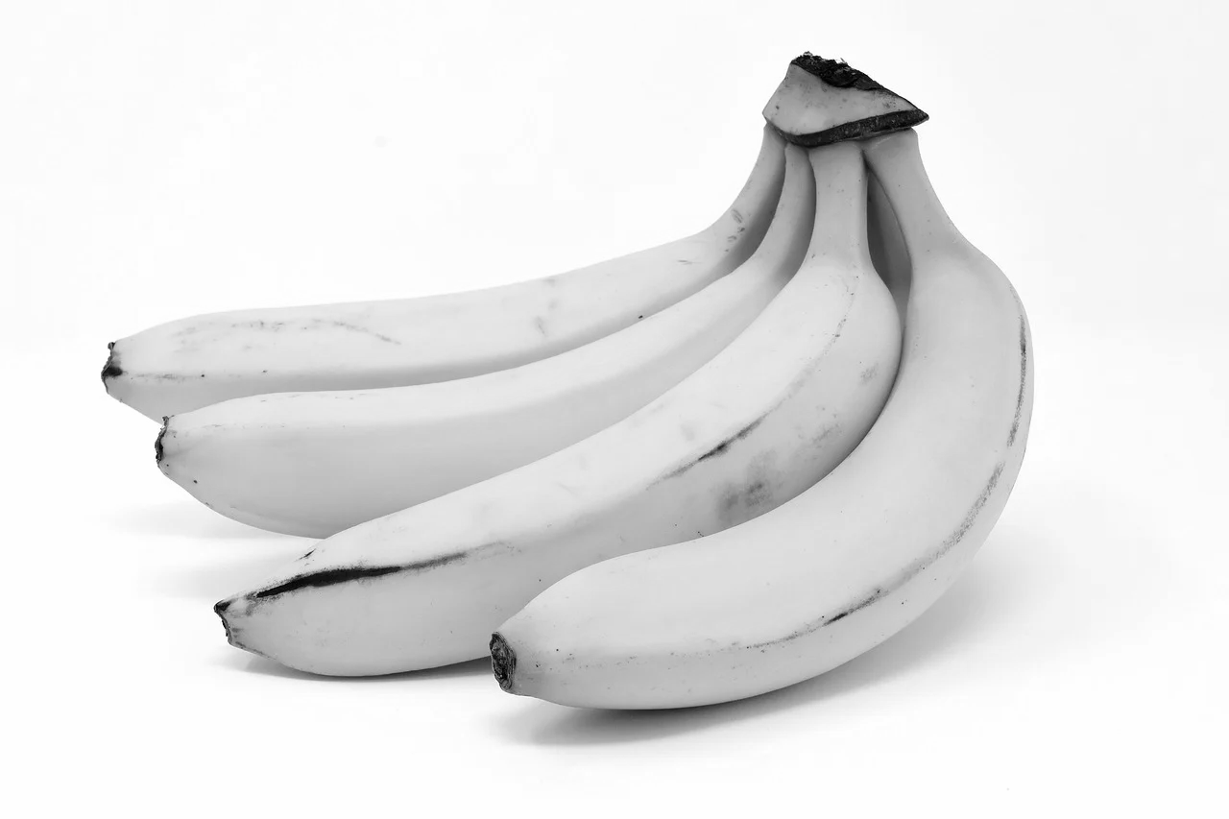
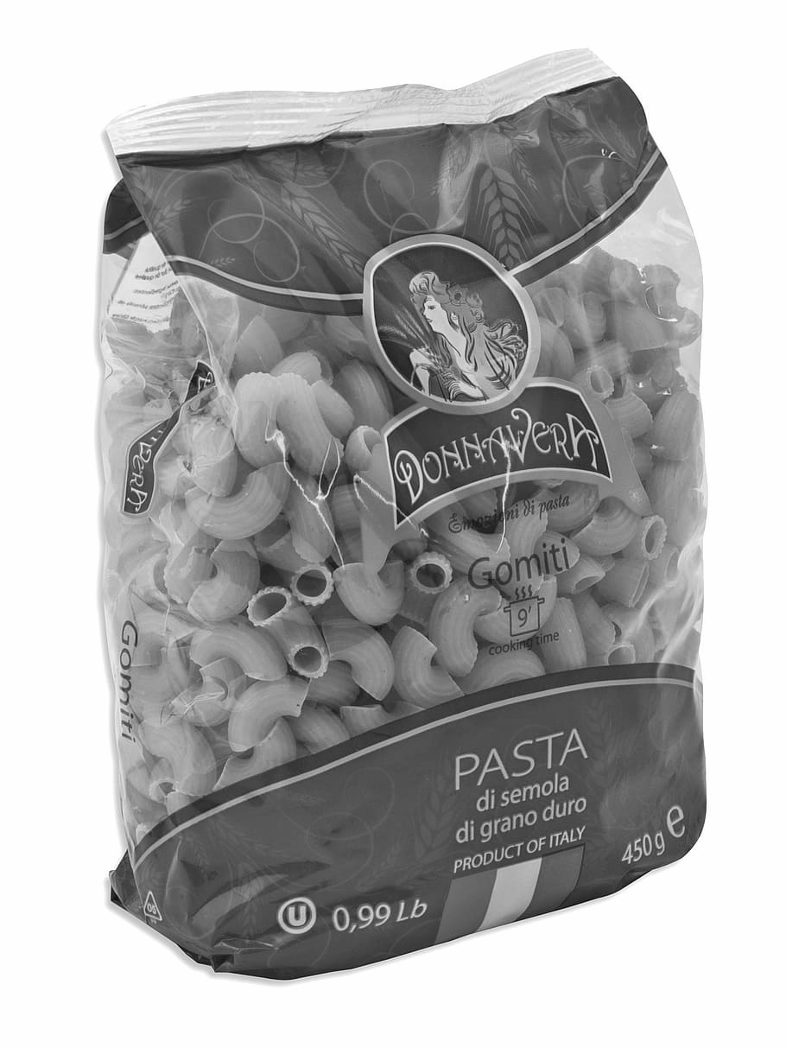
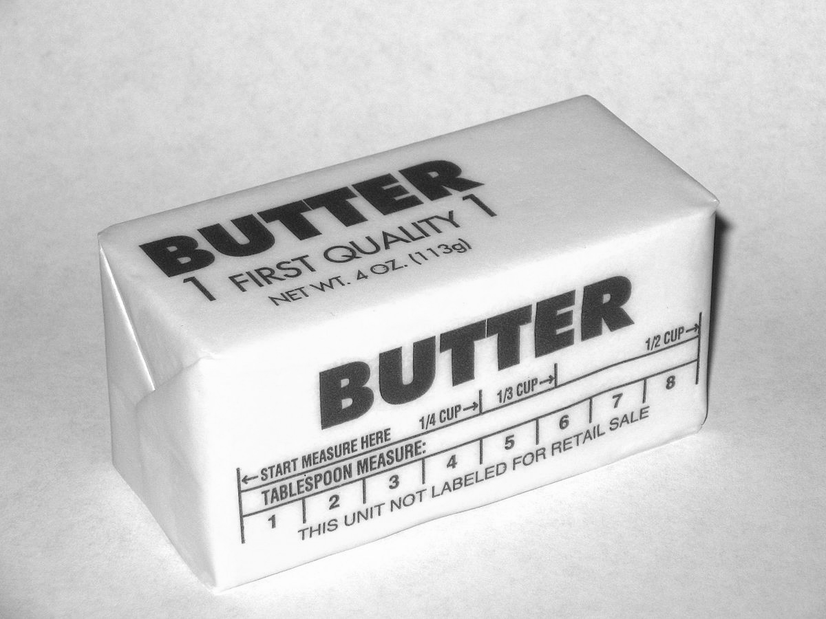
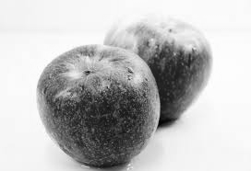
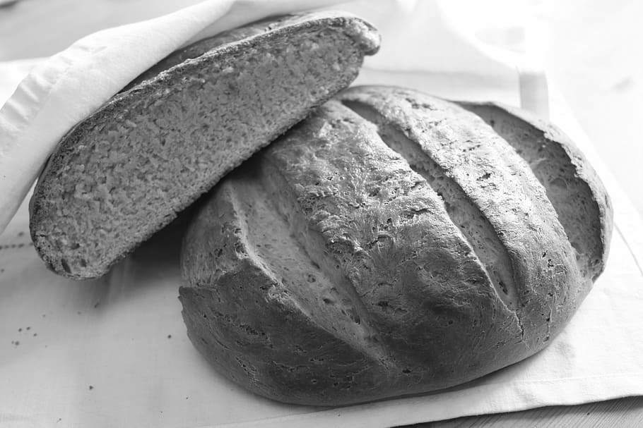
Look at these different food items. Where would you store them in the kitchen?
Cupboard
Fridge
Freezer
Fruit bowl
Notes:
Look at each item with your learner..
Discuss the different options of places to store them in the kitchen.

Slide 8
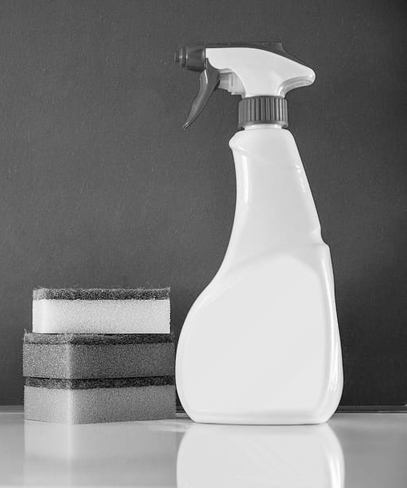
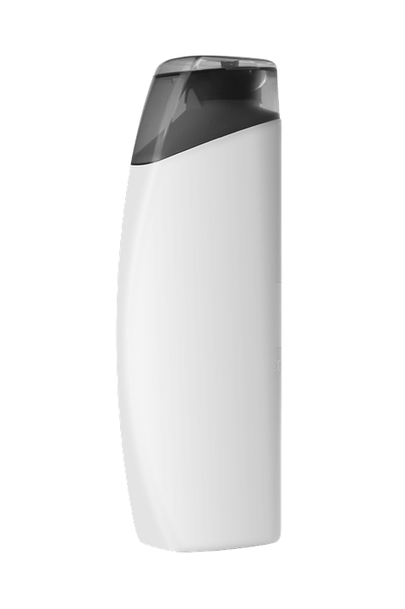
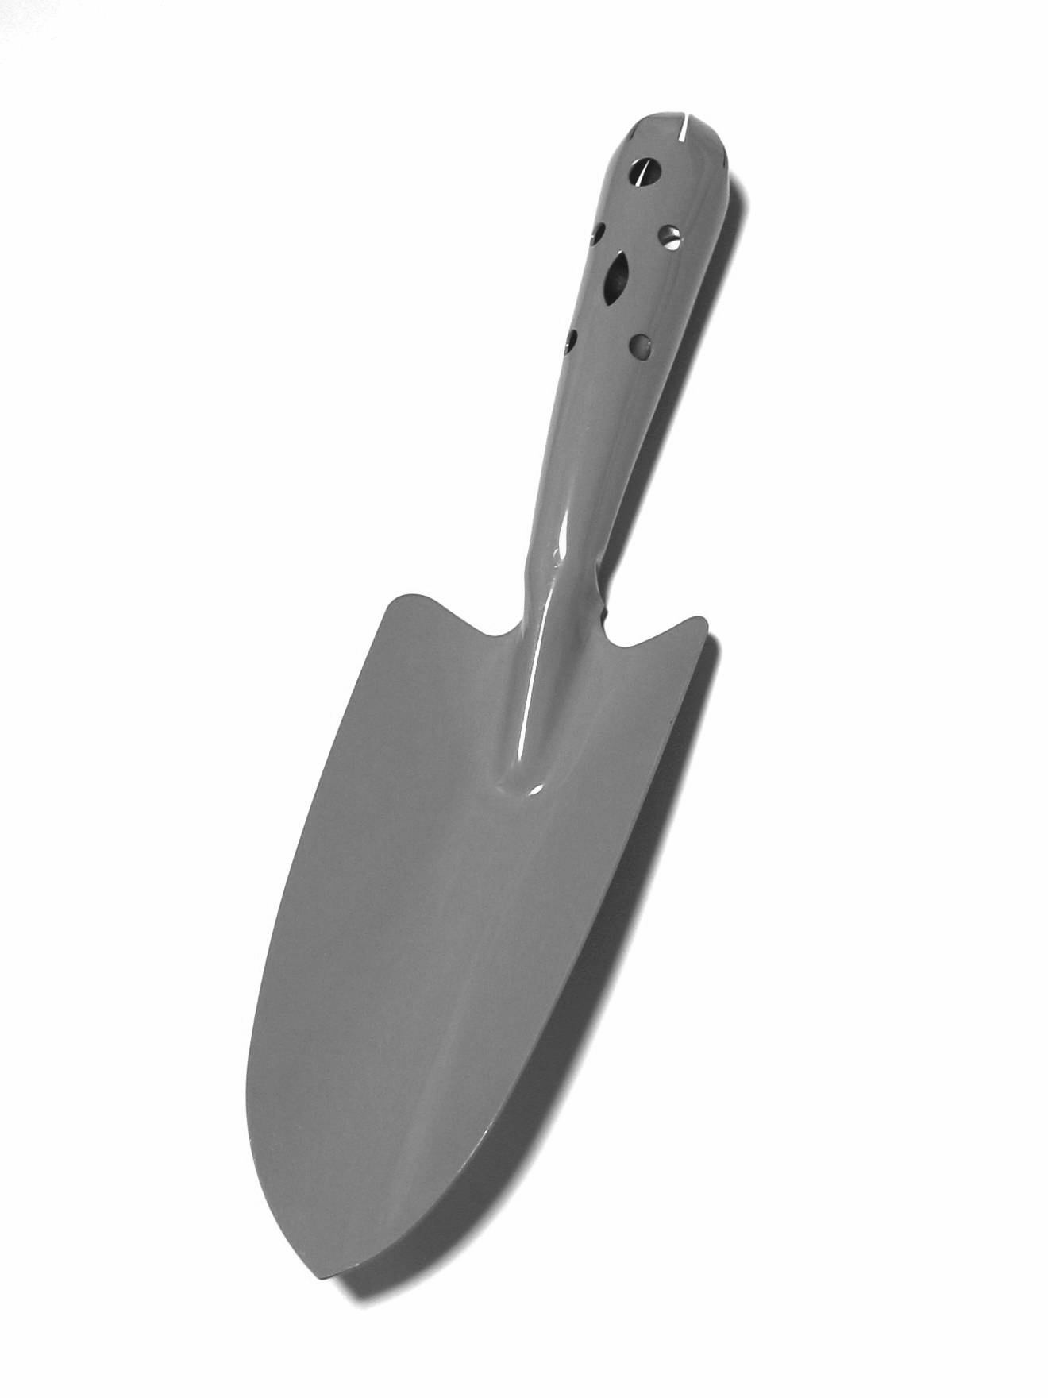
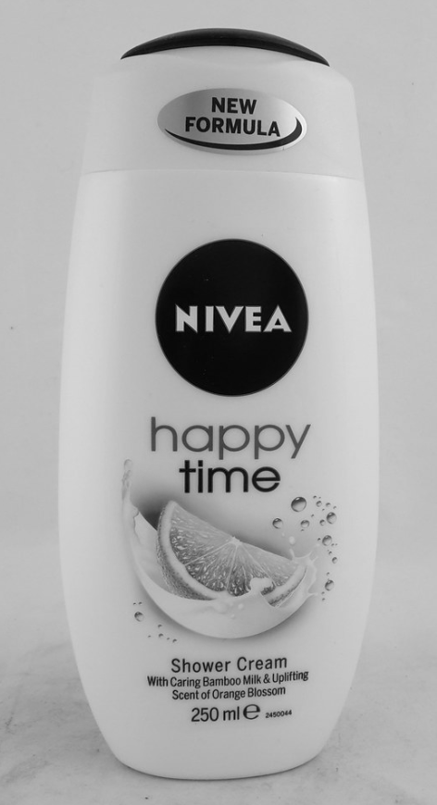
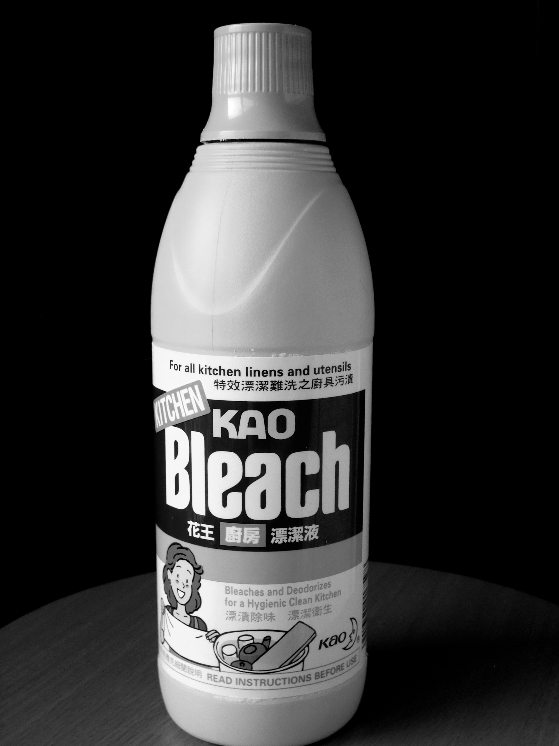
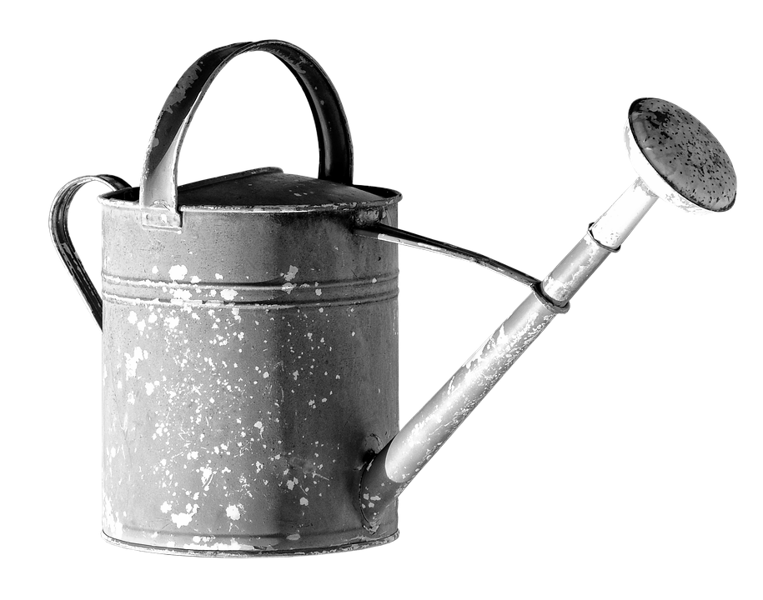
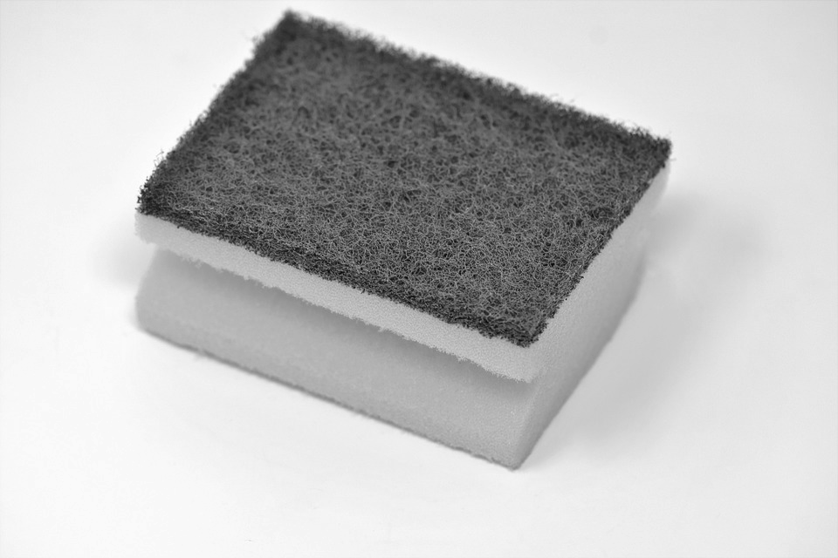
Where do other shopping items go?
Look at the items. Which room in the house do they belong?
Bathroom
Kitchen
Shed
shampoo
paint
cleaning spray
garden trowel
shower gel
toilet roll
watering can
sponge
bleach
Notes:
Go through each item and discuss the place in the house that they belong.
Discuss: are there any other rooms in the house that these items could belong, such as a utility room or a storage cupboard?

Slide 9
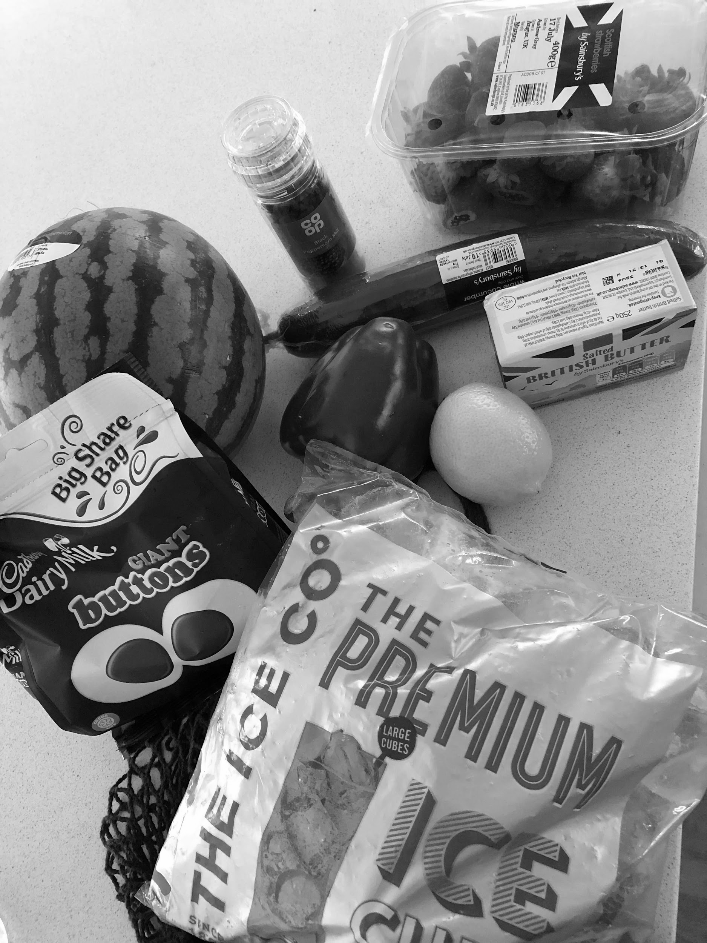
Putting the shopping away:
What can you see?
Where does it go?
Fridge
Cupboards
Freezer
Fruit bowl
Notes:
Task:
First look at the picture and discuss what items you can see on the table.
Decide where in the kitchen you would put the items.

Slide 10
Putting the shopping away
Does the food need freezing?
Is it in a tin?
Can it go in a fruit bowl?
Task:
After you have been shopping, have a go at putting the shopping away into the correct
place- cupboard, fridge or freezer.
?
Notes:
After you have been shopping, please help your learner to put the shopping away.
Alternatively, get 10 items out of the cupboards, fridge and freezer, place them on a table and ask your learner to put them back into the correct place.

Slide 11
Independent Living
Community Living
Putting shopping away
Make it easier
Make it harder
More ideas
Label the cupboards, fridge and freezer in the kitchen, with pictures, symbols or words of where certain items belong.
When you unpack the shopping, group the items first before putting them away.
Decide where other shopping items belong, such as clothes, DVDs, books.
Role play visiting the shops, buying different items, bringing them home to put away.
Turn the activity into a game by timing each other with a stopwatch: who can put the shopping away the quickest?
Notes:
Suggest adaptations for teachers/parents.

Slide 12
Further Learning with Oak National
Independent Living:
Building Understanding- Shopping in the supermarket (Unit 4)
Building Understanding- Knowing which shop to buy from (Unit 4)
Building Understanding- What’s on the high street (Unit 4)
Applying Learning- Best value (Unit 4)
Applying Learning- Knowing which shop to buy from (Unit 4)
Occupational Therapy:
Activities of Daily Living (Unit 6)
Notes:
Links to other Oak Videos across different subjects.

Slide 13
References
Slide 7- Popsicle decision, Pickpik/ Baked beans, Needpix/ Dairy Crest Semi Skimmed Milk Bottle, Unisouth, Wikimedia Commons/ Frozen prawns, Pxhere/ RECALLED - Frozen Green Peas, The U.S. Food and Drug Administration, Flickr Attribution 2.0 Generic (CC BY 2.0) / Bananas, Pixabay/ Western-pack-butter, Steve Karg, Wikimedia Commons/ Bread, Wallpaper Flare/ Apples, Pxhere/ Pasta packet, Pxfuel
Slide 10- Shampoo, Pixabay/ Paint pot, Pixabay/ Cleaning spray, Wallpaper Flare/ Steel trowel, Qurren, Wikimedia Commons/ NIVEA SHOWER GEL 250ML HAPPY TIME, Toiletries & Cosmetics Wholesaler, Flickr Attribution 2.0 Generic (CC BY 2.0)/ Toilet roll, Pixabay/ Watering can, Pixabay/ Cleaning sponge, Pixabay/ Kitchen bleach, Mk2010, Wikimedia Commons

