Slide 1
Experiences now and in the past [2/2]
Present vs preterite tenses: 3rd person singular
AR verbs
Hacer
Spanish
Señorita Allinson

Slide 2
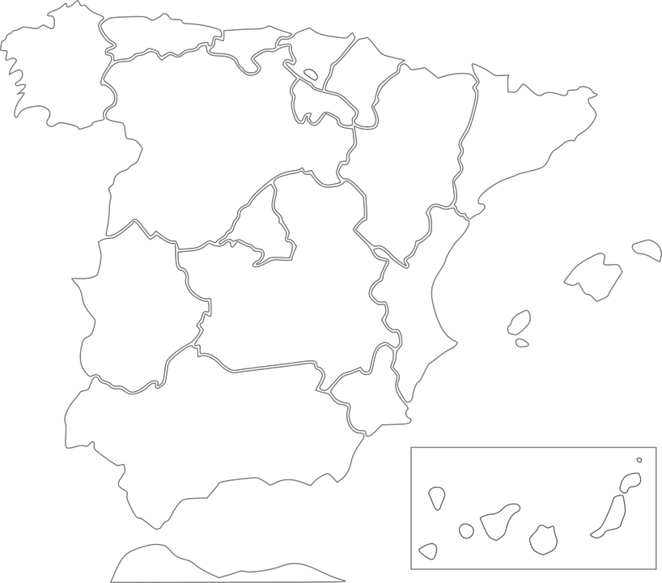
La fonética
Bilbao
Galicia
Lleida

Slide 3
el examen | the exam
hacer | to do, doing; to make, making
repasar | to revise, revising
pronunciar | to pronounce, pronouncing
la cultura | culture
después | afterwards
el ejercicio | exercise
ayer | yesterday
por la tarde | in the afternoon/evening
por la mañana | in the morning
sobre | about
hoy | today

Slide 4
Present tense - ar verbs
3rd person singular (‘s/he, it’ form)
To mean ‘s/he’ or ‘it’ with ar verbs in the present tense, remove –ar and add –a.
This part of the verb is called the ‘stem’.
hablar
habl
habla
(he/she/it speaks)
repasar
repas
repasa
(he/she/it revises)

Slide 5
Preterite tense - ar verbs
3rd person singular (‘s/he, it’ form)
To mean ‘s/he’ or ‘it’ with ar verbs with actions completed in the past, remove –ar and add –ó.
hablar
habl
habló
(he/she/it spoke)
repasar
repas
repasó
(he/she/it revised)

Slide 6
HACER
Remember, some verbs don’t follow the regular patterns.
The verb HACER is an example of this.
 | Present tense |  | Preterite tense
hacer (to do, doing; to make, making) | hace | he/she/it does/makes | hizo | he/she/it did/made

Slide 7
Summary
The AR verb ending for ‘he/she/it’ in present tense is:
The AR verb ending for ‘he/she/it’ in preterite tense is:
The word for “s/he did/made” is:
Translate: “pronunció las palabras”
5. “He spoke with the teacher after the exam” is:
-a
-ó
hizo
“he pronounced the words”
“Habló con el profesor después del examen.”

