Slide 1
Unit 3 Multiplication and division
Three 1-digit multiplication equations.
Mathematics
Independent Task
Miss Thomas

Slide 2
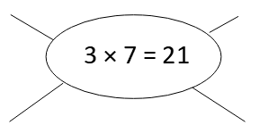
Independent task
What multiplication facts can we derive?
Step 1) Derive facts from 3 x 7 = 21 and represent by drawing arrays that have counter values of 10 or 100.
Step 2) Write the equations to match the array.

Slide 3
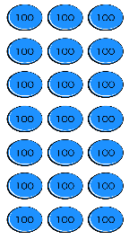
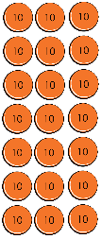
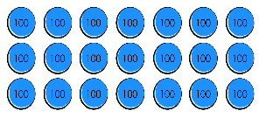
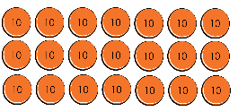
Answers

