Slide 1
Understanding Other Powers of Ten Within One-Million
Worksheet
Mathematics
Mrs Harris

Slide 2
1,00,000
1,00,000
1,00,000
1,00,000

Slide 3
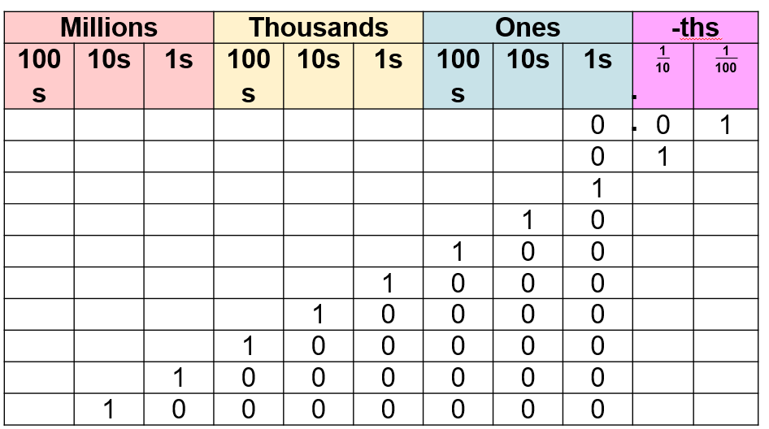
Notes:
Write numbers for them to say aloud using PV chart for scaffolding

Slide 4
10,000,000
1,000,000
100,000
10,000
1,000
100
10
1
0.1
0.01
Ten Million
One Million
One Hundred Thousand
Ten Thousand
One Thousand
One Hundred
Ten
One
One Tenth
One Hundredth

Slide 5
1,000
1,000
1,000
1,000

Slide 6
1,00,000
1,00,000
1,00,000
1,00,000

Slide 7
Independent Task
Question 1: It is about 10,000km from Manchester to Cape Town. A plane is ¼ of the way through the journey. How many kilometres of the journey does it have left?
Question 2: About 1 million people live in Birmingham. About ⅕ of them are over 60 years old. Approximately how many over 60 year-olds live in Birmingham?
Question 3: A builder orders 1,000kg of sand. She has 100kg left. What fraction of the total amount does she have left?

