Slide 1
Solving quadratic equations graphically
Mathematics
Mr Coward

Slide 2
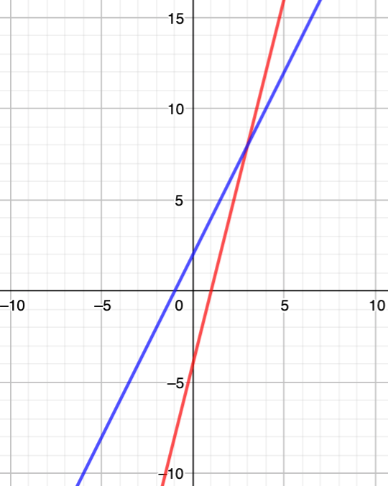
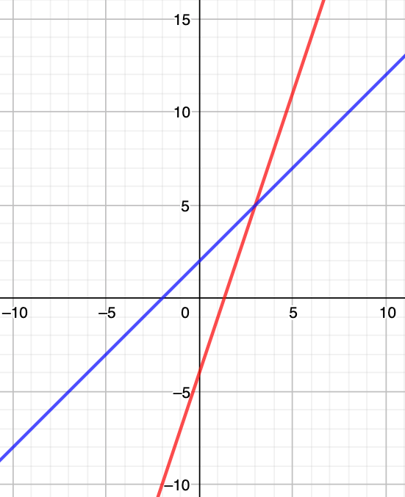
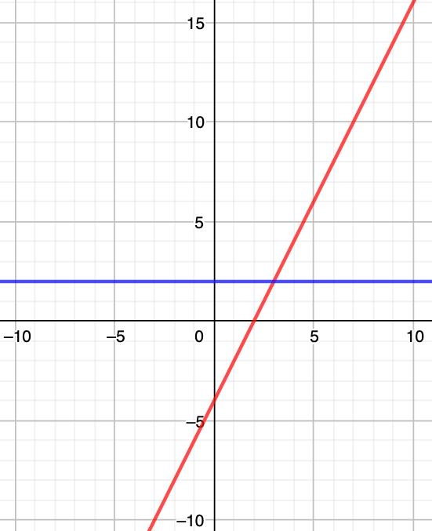
Try this
Solve the following simultaneous equations, what do you notice?
Notes:
Answers

Slide 3
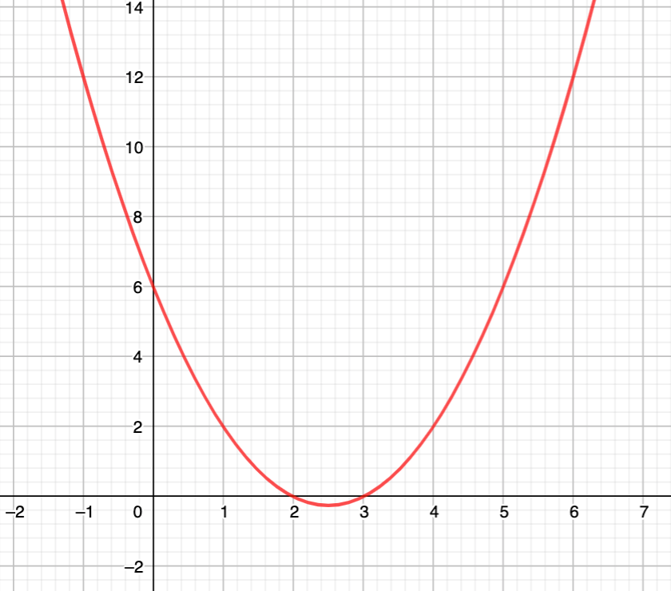
Independent task
Notes:
Answers

Slide 4
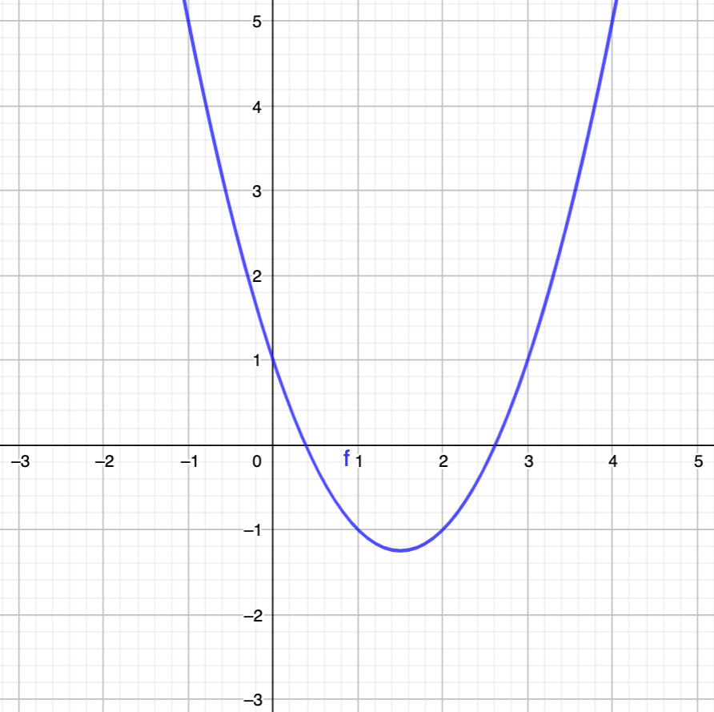
Independent task
Notes:
Answers

Slide 5
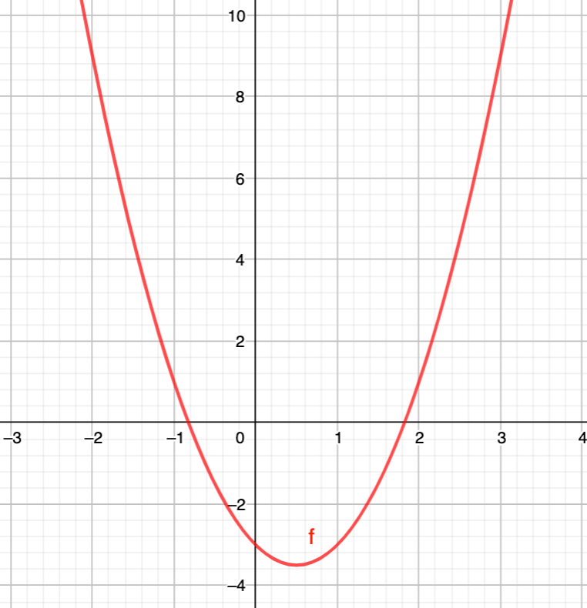
Independent task
Notes:
Answers

Slide 6
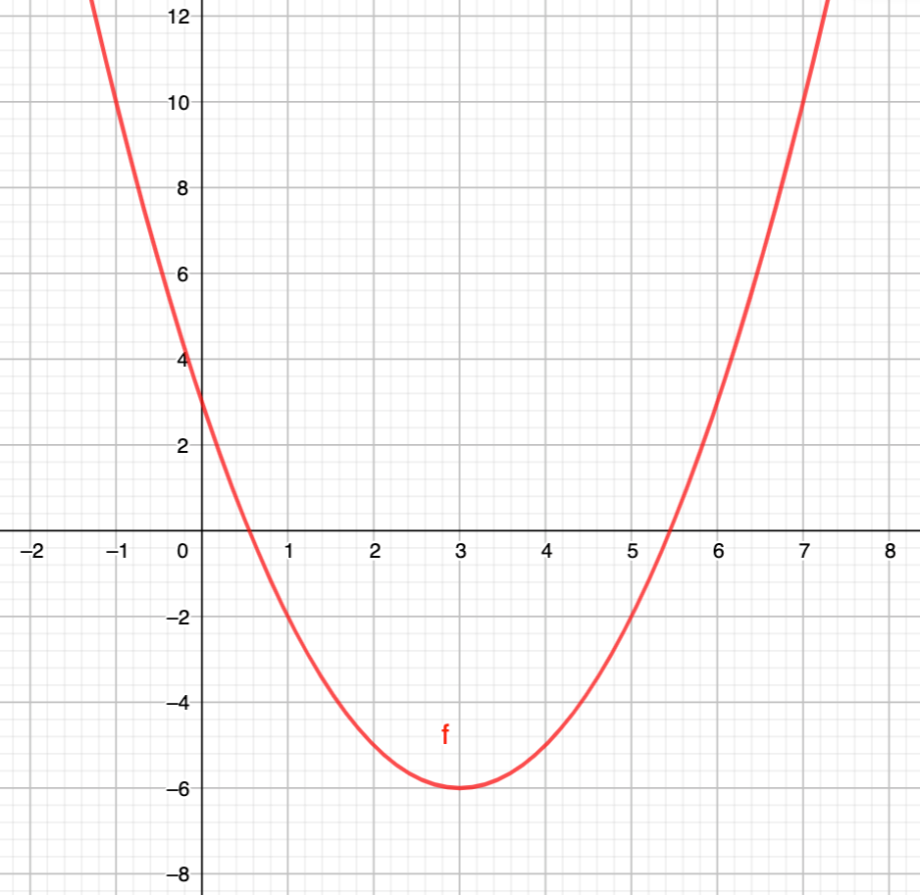
Explore
Notes:
Students may notice that 5/6 and 3/4 can also be compared by denominating by 12ths

