Slide 1
Independent Living Personal Care
Lesson 5 - Managing emotions
Oak Specialist
Building Understanding

Slide 2
Unit 2- Personal Care
Lesson 2- Morning hygiene routine
Lesson 1- Five a day
Making a healthy smoothie using five fruit and vegetables.
Identifying morning hygiene activities and creating a routine.
Lesson 3- Turn taking
Lesson 4- Fine/gross motor circuit
Games and activity suggestions to encourage turn-taking.
Activity suggestions to encourage development of fine and gross motor skills
Lesson 5- Managing emotions
Lesson 6- How to relax
Recognising familiar emotions and identifying strategies to manage these.
Activity suggestions to learn how to relax and self regulate.
‹#›

Slide 3
Teacher notes- Managing emotions
Learning Intention: To label common emotions and explore self regulations strategies
Label common emotions.
Use a mirror to model facial expressions and explore how the face changes depending on the emotion.
Identify different strategies that can help us when we are feeling different ways.
Create help cards for emotions which are tricky to manage. E.g. when you are feeling angry it may be hard to remember what strategies help.
Resources- mirror, paper and pens
Notes:
This is the equivalent to a loose lesson plan/overview for teachers before starting the lesson.

Slide 4
Lesson Activity Stages
Label emotions and feelings
Copy the emotions
How to manage our emotions
Notes:
Introduction 2. Emotions 3. Manage? Or ‘activities’ and ‘emotions’

Slide 5
Recognising emotions
These are familiar emotions. Can you label them? Point to each emoji and ask your learner if they can label the emotion or feeling. You could you symbols or colours to support understanding. Label each one.
SAD/UPSET
TIRED/BORED
CALM/HAPPY
EXCITED
FRUSTRATED/ANGRY
Notes:
These are familiar emotions. Can you label them? Point to each emoji and ask your learner if they can label the emotion or feeling. You could you symbols to support understanding. Label each one.

Slide 6
Task
This task is to be used with the following 4 pages.
Use a mirror to copy the facial expressions of someone with each emotion.
Talk about how our face changes when we feel the same emotion.
E.g. Talk about a furrowed brow and tears and an upturned mouth when you are sad / upset.
Talk about yawning, closed eyes and using hands to hold our head up when we are tired / bored;
mouths turning into a smile and open eyes when we are happy;
open mouths, clenched mouths, open eyes, raised eyebrows and moving our hands when we are excited; and
Having furrowed brow, a scrunched up face, an open mouth showing teeth and closed fists when we express anger.
You could also take photos of yours and your learner’s face after practising with the mirror.
To extend the activity you could ask or give an example of a time when you each have felt each emotion.

Slide 7
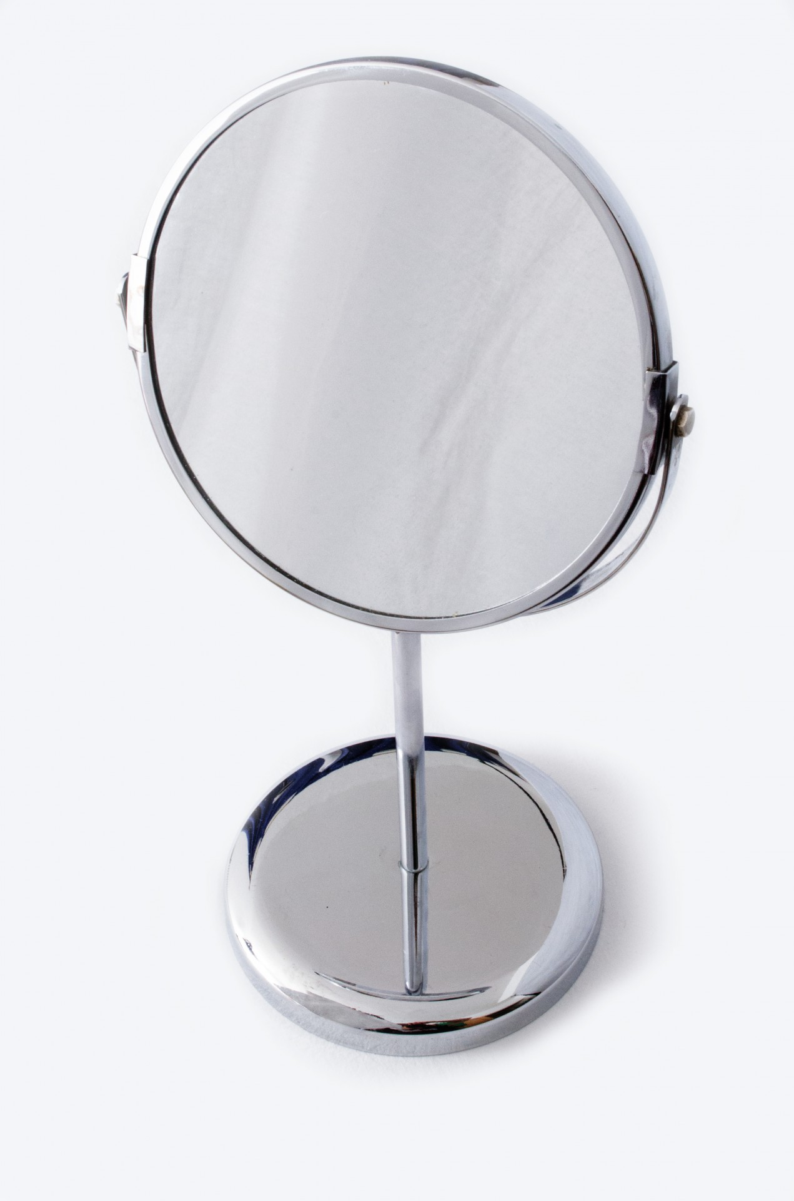
Feeling sad or upset
Use a mirror to copy the facial expressions
Notes:
Use a mirror to copy the facial expressions of someone feeling sad. Talk about how our face changes when we are sad or upset. Talk about a furrowed brow and tears and and upturned mouth. You could also take photos of yours and your learner’s face after practising with the mirror.
To extend the activity you could ask or give an example of a time when you have felt sad.

Slide 8
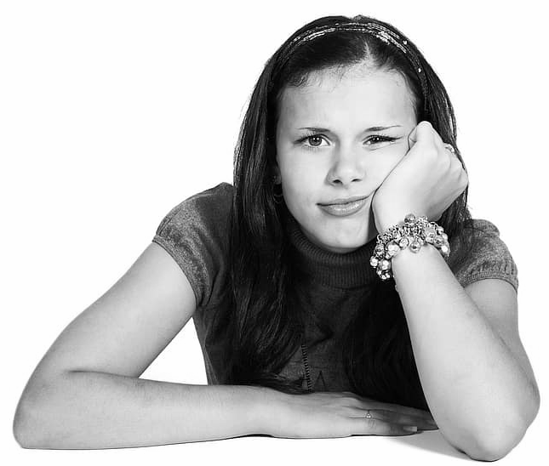
Feeling tired or bored
Use a mirror to copy the facial expressions
Notes:
Use a mirror to copy the facial expressions of someone feeling tired or bored. Talk about how our face changes when we are tired or bored. Talk about yawning, closed eye and using hands to hold head up. You could also take photos of yours and your learner’s face after practising with the mirror.
To extend the activity you could ask or give an example of a time when you have felt tired or bored.

Slide 9
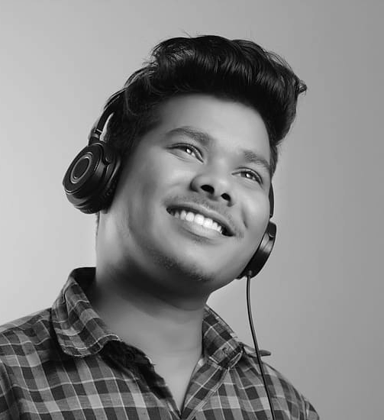
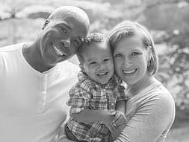
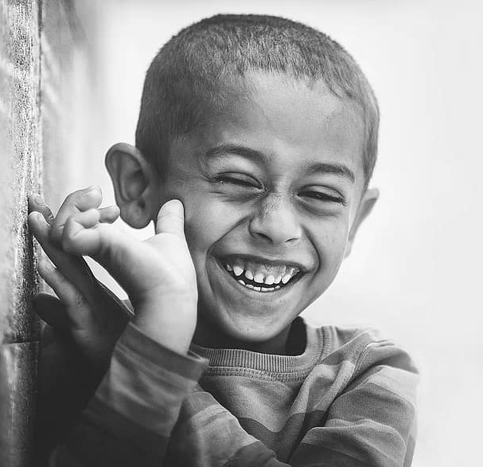
Feeling calm or happy
Use a mirror to copy the facial expressions
Notes:
Use a mirror to copy the facial expressions of someone feeling calm or happy. Talk about how our face changes when we are calm or happy. Talk about mouths turning into a smile and open eyes. You could also take photos of yours and your learner’s face after practising with the mirror.
To extend the activity you could ask or give an example of a time when you have calm or happy.

Slide 10
Feeling excited
Use a mirror to copy the facial expressions
Notes:
Use a mirror to copy the facial expressions of someone feeling excited. Talk about how our face changes when we are feeling excited. Talk about open mouth, clenched mouth, open eyes, raised eyebrows and moving our hands. You could also take photos of yours and your learner’s face after practising with the mirror.
To extend the activity you could ask or give an example of a time when you have felt excited

Slide 11
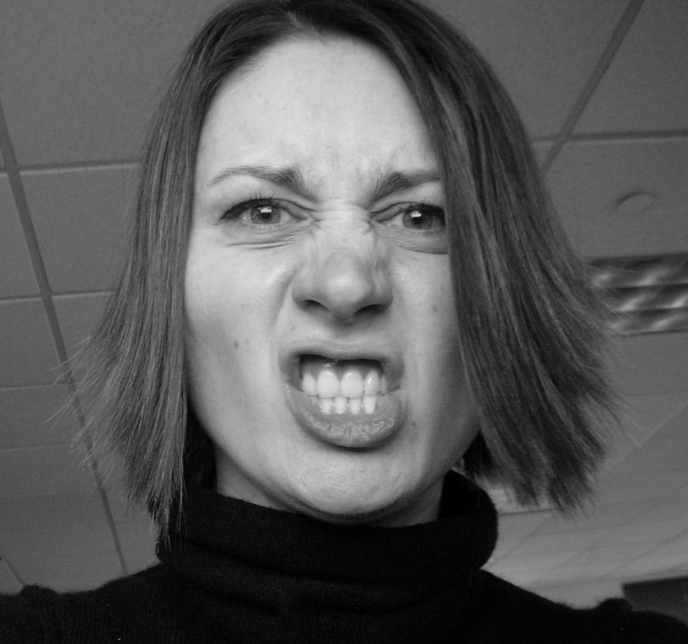
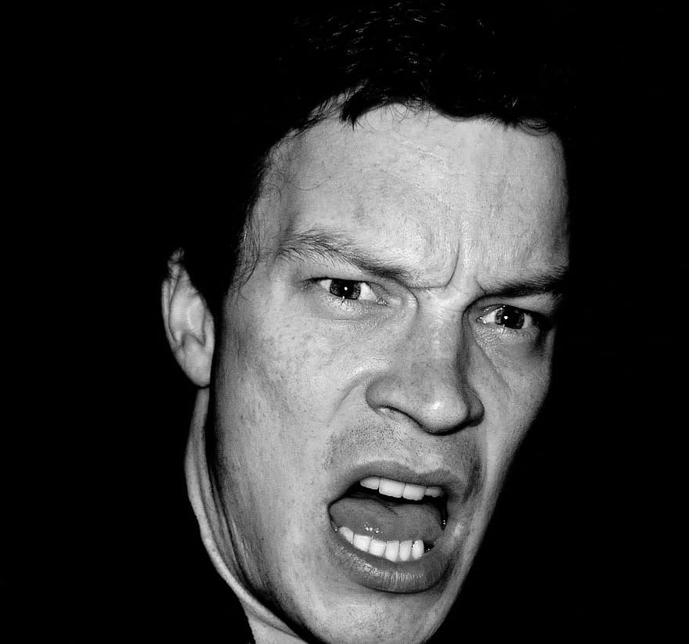
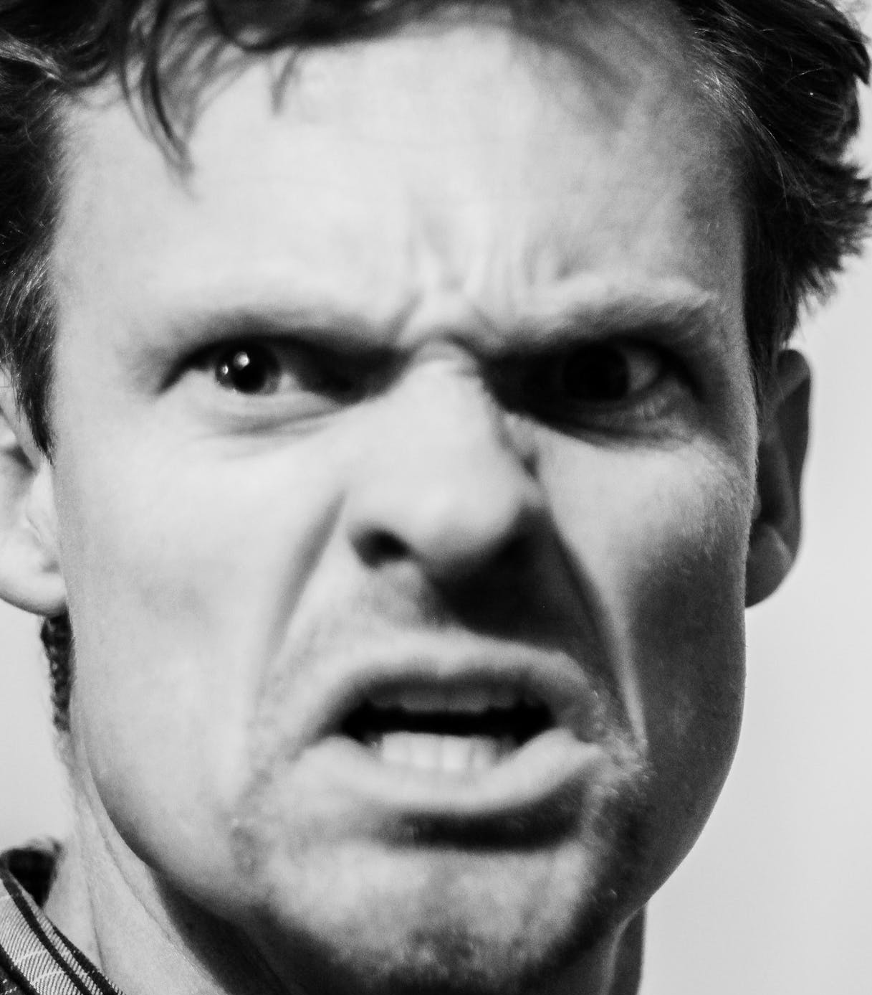
Feeling frustrated or angry
Use a mirror to copy the facial expressions
Notes:
Use a mirror to copy the facial expressions of someone feeling frustrated or angry. Talk about how our face changes when we are feeling frustrated or angry. Talk about furrowed brow, scrunched up face, open mouth showing teeth, closed fists. You could also take photos of yours and your learner’s face after practising with the mirror.
To extend the activity you could ask or give an example of a time when you have felt frustrated or angry

Slide 12
Activities/strategies to help
Talking | Jumping | Relaxing | Listen to music | Dancing | Deep breaths
Yoga | Go for a run | Painting | Play a game | Have a drink | Sing or hum
Notes:
Note: add images or symbols that best support your learner. You can amend the activities and strategies in the grid if you know there are certain ones that best suit your learner.
There are many things we can do when we are feeling different emotions which help us manage our behaviour. Talk through each of the activities in the grid. Can your learner sign them? Or find them in their communication book? These are just suggestions, you might have some other activities you know are helpful.

Slide 13
If I’m feeling…..
I can…..
This is the lesson activity. Choose emotions that your learner is familiar with and that they may need support in managing. The task is to create help cards so that there is a visual support to identify ways to help. It is often tricky to think clearly when we are feeling different emotions or even recognise and label the emotion.
Notes:
This is the lesson activity. Choose emotions that your learner is familiar with and that they may need support in managing. The task is to create help cards so that there is a visual support to identify ways to help. It is often tricky to think clearly when we are feeling different emotions or even recognise and label the emotion.

Slide 14
If I’m feeling sad…
I can….
Listen to music
Talk to someone
Have a drink
Notes:
Note: add images or symbols that best support your learner. You can amend the activities to suit your learner too.
This is an example. If I am feeling sad, I can listen to music, talk to someone or have a drink. This will look different for each individual. What helps you when you are feeling sad? Use the activity grid to support answers.

Slide 15
Create help cards
Create help cards for emotions that are familiar to your learner and that they may need support with to manage.
Use the cards when you can see that they are experiencing an emotion.
Label the emotion- “I can see that you’re feeling….”.
Flip the help card to the support activities on the back.
This can then prompt your learner to choose an activity to help with managing the emotion.
Praise them for choosing something to help them.
You may want to make the cards to put on a lanyard so that they are easily accessible.
Notes:
Create help cards for emotions that are familiar to your learner and that they may need support with to manage. Use the cards when you can see that they are experiencing an emotion. Label the emotion- “I can see that you’re feeling….”. Flip the help card to the support activities on the back. This can then prompt your learner to choose an activity to help with managing the emotion. Praise them for choosing something to help. You may want to make the cards to put on a lanyard so that they are easily accessible.

Slide 16
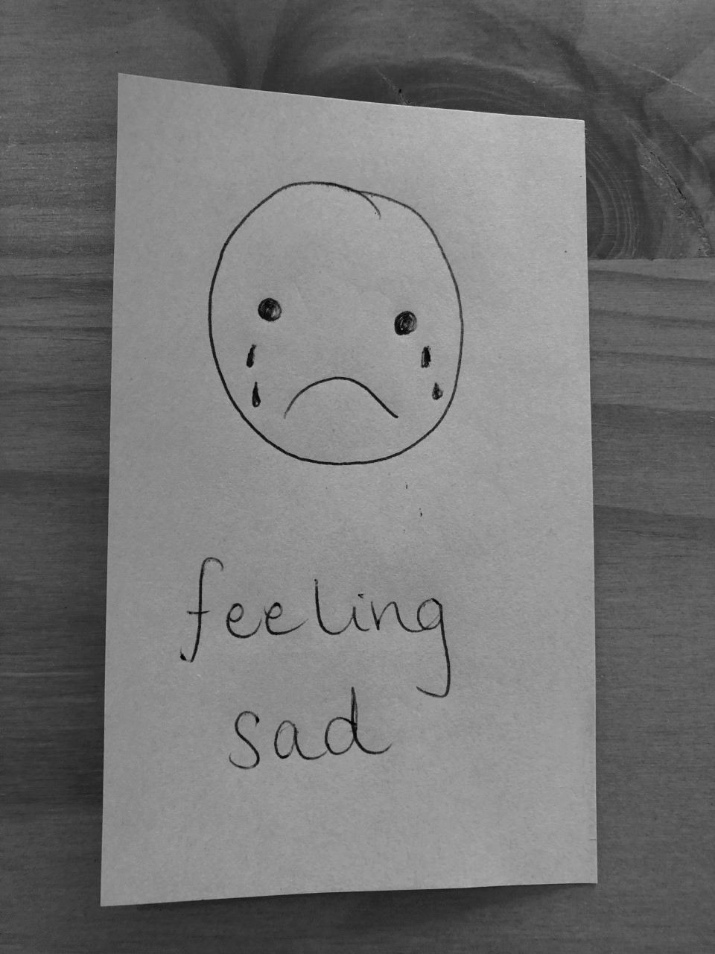
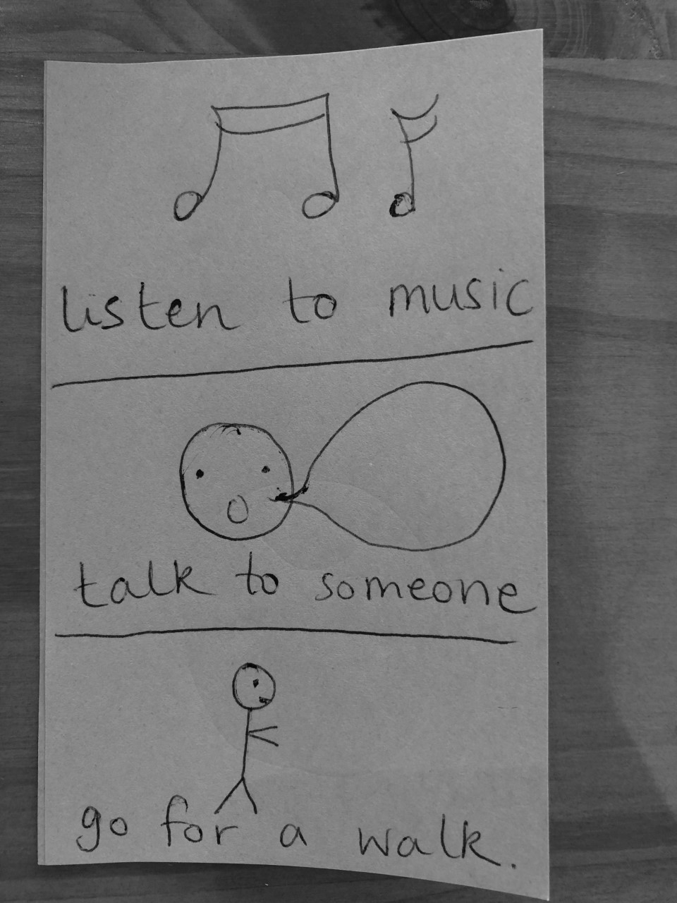
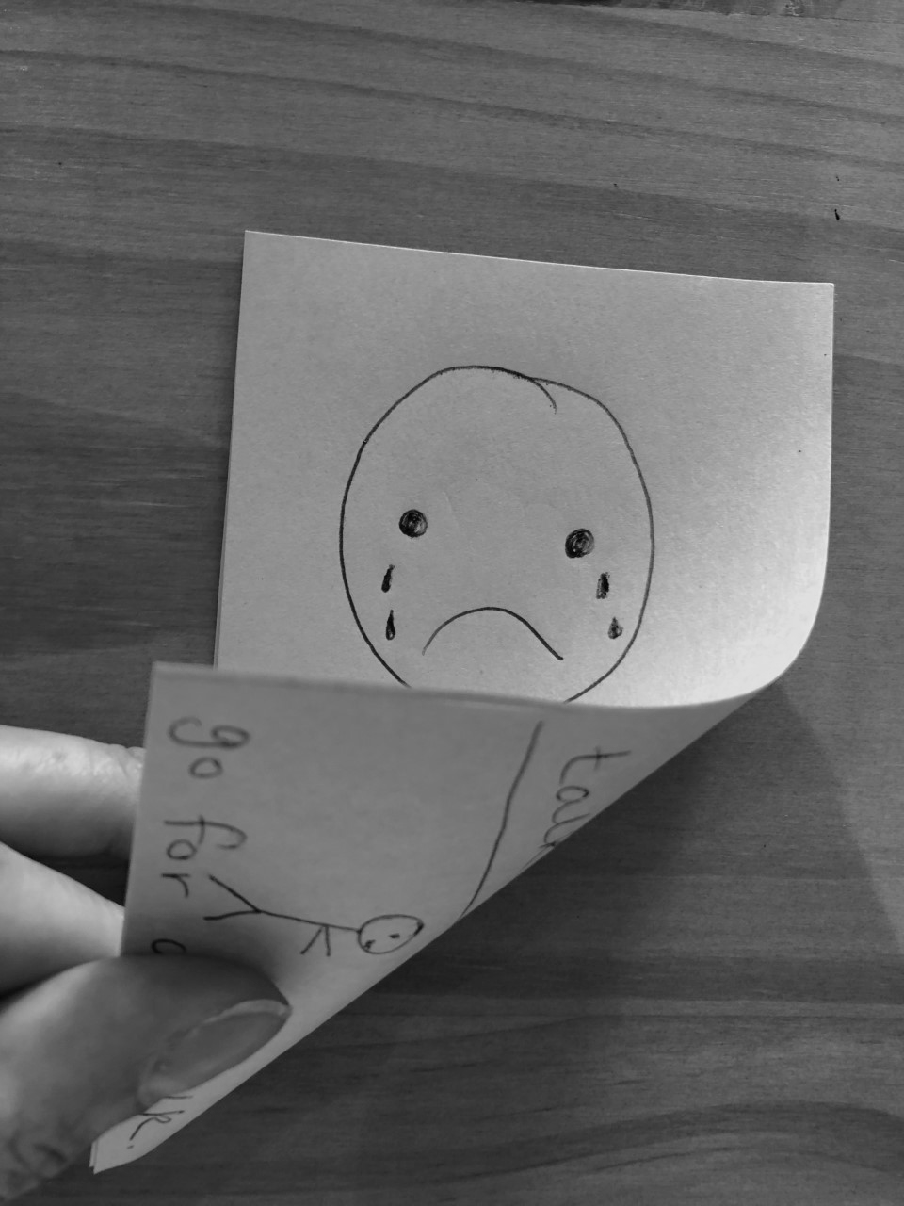
Create help cards
Images teacher’s own
Notes:
Create help cards for emotions that are familiar to your learner and that they may need support with to manage. Use the cards when you can see that they are experiencing an emotion. Label the emotion- “I can see that you’re feeling….”. Flip the help card to the support activities on the back. This can then prompt your learner to choose an activity to help with managing the emotion. Praise them for choosing something to help. You may want to make the cards to put on a lanyard so that they are easily accessible.

Slide 17
Independent Living: Personal Care
Managing emotions
Make it easier
Make it harder
More ideas
- Choose emotions your learner is familiar with.
- Model choosing an activity when identifying a feeling.
- Can you think of other emotions not listed? How do you manage these?
-How do you share your feelings?
- Use emojis when teaching emotions.
- Use images/videos of others to label and talk about emotions.

Slide 18
Further Learning with Oak National
Independent Living:
Building Understanding- How to relax (Unit 2)
Applying Learning- Managing feelings (Unit 2)
Applying Learning- Balanced leisure activities (Unit 2)
Communication and Language:
Building Understanding/Applying Learning- Our World (Unit 5)
Notes:
Insert info for subject/lesson name/stage (if appropriate)

Slide 19
References
Slide 8- Mirror, George Hodan, Publicdomainpictures / Sad Woman, Pxfuel / Child Crying, Pxfuel / Upset Man, Pxfuel
Slide 9- Bored Girl, Pikist / Tired Woman, Andrea Piacquadio, Pexels / Woman sleeping, Andrea Piacquadio, Pexels
Slide 10- Man, DMCA, Pxfuel / Happy Child, DMCA, Pikist / Happy Family, DMCA, Pikist
Slide 11- Excited Woman, RobinHiggins, Pixabay / Thumbs up, Public Domain, Pxhere / Boy, DMCA, Pikist
Slide 12- Nathan Cowley, Pexels, Man / Man, DMCA, Pxfuel / Woman, Linsenhajhaj, Wikimedia Commons / Man, DMCA, Pikist / Boy, DMCA, Pikist

