Slide 1
Lesson 3: Making Connections Part 1
Physical Computing
Computing
Allen Heard
Materials from the Teach Computing Curriculum created by the National Centre for Computing Education

Slide 2
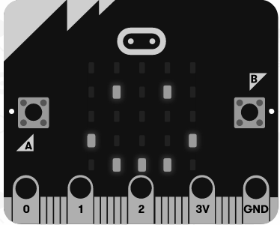
Task 1 - Connecting through pins
Previously we saw a program that displays a ‘happy face’ when the micro:bit is lying face up, and displays nothing otherwise.
1
2
3
4
5
6
from microbit import *
while True:
if accelerometer.is_gesture("face up"):
display.show(Image.HAPPY)
else:
display.clear()
Credit: micro:bit Foundation

Slide 3
Task 1 - Connecting through pins
The program below computes and displays a decimal number that depends on which of the buttons are pressed.
In these examples, display, accelerometer, and button_a are objects that represent the micro:bit’s components.
Methods like show, is_gesture and is_pressed correspond to possible actions that can be performed on these components.
object method method arguments
display . show ( “Hello world!” )
1
2
3
4
5
6
7
8
from microbit import *
while True:
decimal = 0
if button_a.is_pressed():
decimal = decimal + 2
if button_b.is_pressed():
decimal = decimal + 1
display.show(decimal)

Slide 4
Task 1 - Connecting through pins - Touchy
Copy the program below in your development environment. It is similar to the example, but instead of detecting a gesture, the program now detects if pin0 is being touched.
Flash the program to your micro:bit to run it and touch pin0 with one hand and GND with the other to test it.
1
2
3
4
5
6
from microbit import *
while True:
if pin0.is_touched():
display.show(Image.HAPPY)
else:
display.show(Image.SAD)
Credit: micro:bit Foundation
Hand: Pixabay

Slide 5
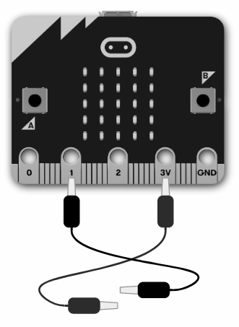
Task 2 - Makeshift switch - part 1
Note: you will need crocodile clips for this task.
Connect a wire to the “power” pin (labelled 3V).
Connect another wire to pin 1. This will be the input pin, i.e. the pin that the program will be checking to see if the switch is closed.

Slide 6
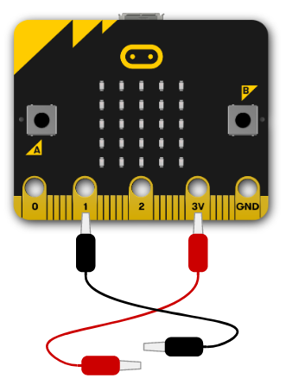
Task 2 - Makeshift switch - part 2
Copy the program below in your development environment:
Flash the program to your micro:bit, to run it and test it.
Questions.
What is the value displayed when the wires are not connected (switch is off)?
What is the value displayed when the wires are connected (switch is on)?
1
2
3
4
from microbit import *
while True:
in_value = pin1.read_digital()
display.show(in_value)
Answer:
Answer:

Slide 7
Task 2 - Makeshift switch - part 3
Extend your program so that a different image is displayed on the 5⨉5 LED matrix, depending on whether or not the switch is ‘on’ or ‘off’ (e.g. Image.YES and Image.NO).
Flash the program to your micro:bit, to run it and test it.

Slide 8
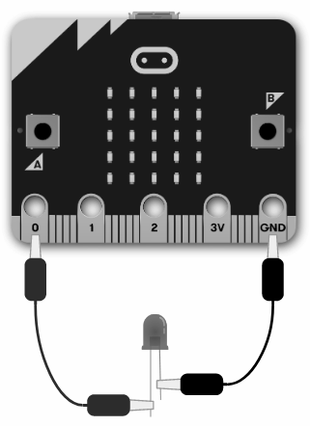
Task 3 - Light it up
Note: you will need crocodile clips and an LED for this task.
Connect pin 0 to the long leg of the LED (the anode). This will be the output pin, i.e. the pin that the program will use to control the LED.
Connect the “ground” pin (GND) to the short leg of the LED (the cathode).

Slide 9
Task 3 - Light it up
Copy the program below into your development environment.
Flash the program to your micro:bit, to run it and test it.
Try to figure out how the program works.
What do you need to do in order for the LED to light up?
1
2
3
4
5
from microbit import *
while True:
out_value = int(button_a.is_pressed())
pin0.write_digital(out_value)
display.show(out_value)

