Slide 1
Further triangles Lesson 8 of 8
Mathematics
Miss Kidd-Rossiter

Slide 2
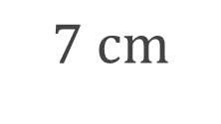
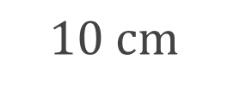
Xavier and Yasmin are finding the area of the nested triangles below.
Who do you agree with? Explain your answer.
I think that the areas of the two triangles are the same.
No, I don’t think their areas can be the same!
Xavier
Yasmin

Slide 3
Two parallel lines are used to construct two triangles.
What’s the same and what’s different about the two triangles?
Explain why the areas of the triangles are equal.
Imagine sliding point A along the dashed line to a point you can no longer see. Is the area of this triangle the same?

Slide 4
Work out the area of triangles A and B in this diagram.
B
A

Slide 5
Triangle C is partly on top of triangle D.
They have the same base.
The two lines are parallel.
Work out the area of each triangle.
C
D

Slide 6
Work out the area of the triangle.
Draw a different triangle with the same base as this triangle but:
the same area;
a larger perimeter;
a smaller area.
Notes:
Note:
A answers in pink
B answer in purple
C answer in blue

Slide 7
Are these statements always true, sometimes true or never true?
Can you draw some examples for each?
For any triangle there is another with the same area but with a greater perimeter.
For any triangle there is another with the same perimeter but with a smaller area.

