Slide 1
Physics - Key Stage 3
Electricity and Magnetism
Magnetic Forces
(Downloadable student document)
Mr Humphries

Slide 2
Independent Task
Complete the sentences.
This pair of magnets will ___________.
This pair of magnets will ____________.
This pair of magnets will ____________.
N
S
N
S
N
S
N
S
S
N
S
N
Image created by R Humphries
Notes:
Magnets can attract and repel other magnets.
Each magnet has two poles. The north pole and the south pole. (this is where the force of the magnet is strongest)

Slide 3
Independent Task
Put the steps in the correct order:
Repeat steps 1-3 but start at different points around the magnet
Draw a dot next to the south pole of the plotting compass and then move the north pole of the plotting compass to this dot
Use a plotting compass and place it at the south pole of the bar magnet
Join the dots and add an arrow in the direction the north arrow on the compass points.
Notes:
Recap before task

Slide 4
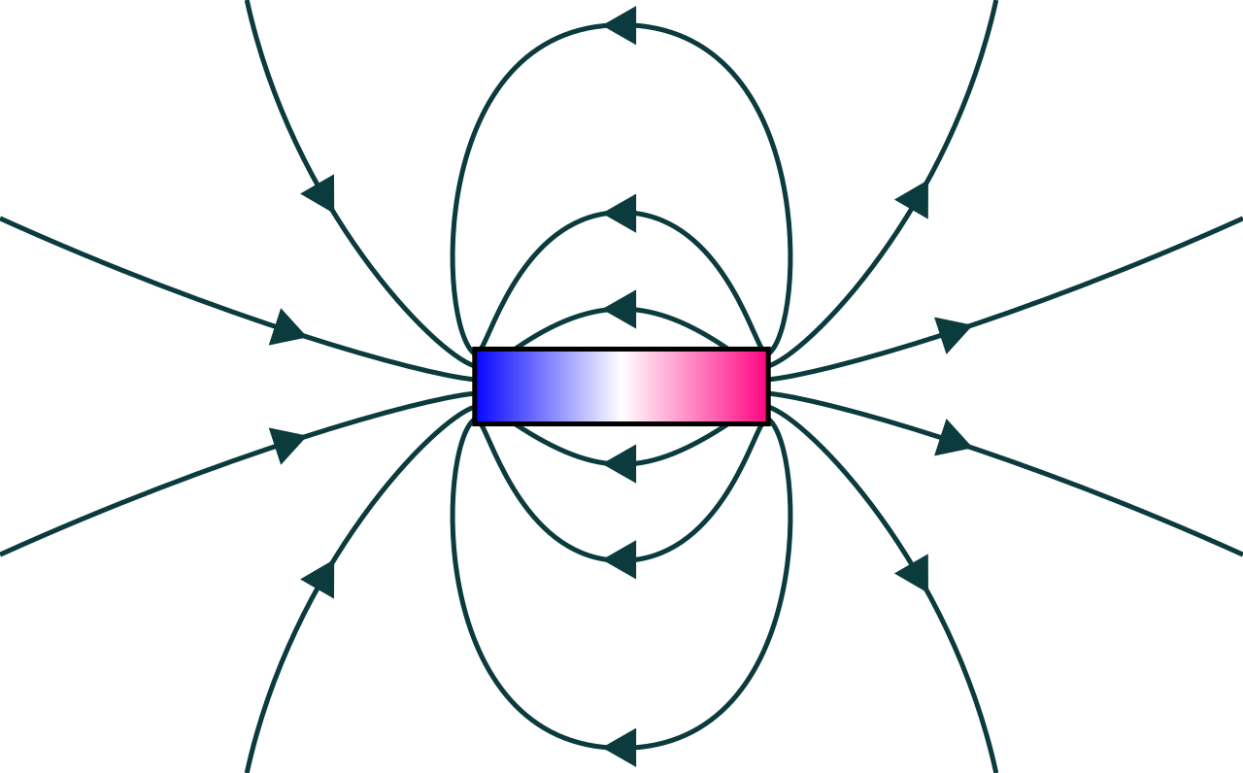
Independent Task
Answer the questions
Draw two circles around the places where the magnetic field is strongest
Why have you chosen these two places?
N
S
Image created by R Humphries
Notes:
Recap before task

