Slide 1
Linear and non-linear graphs
Downloadable Resource
Mathematics
Mr Maseko

Slide 2
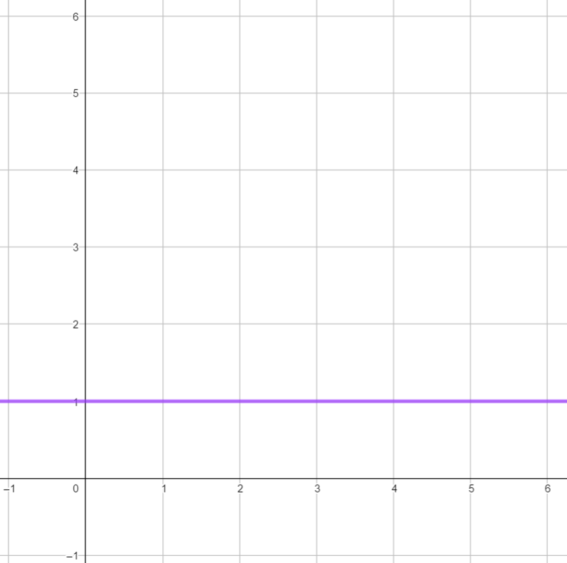
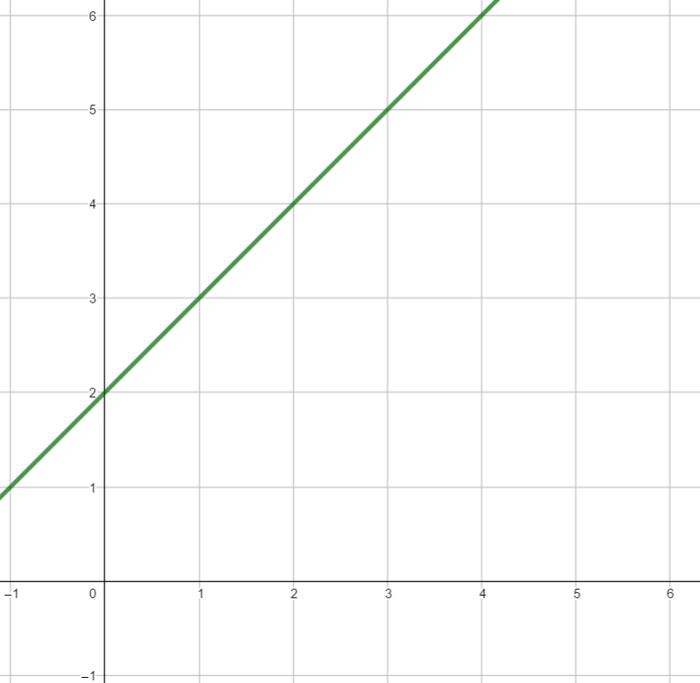
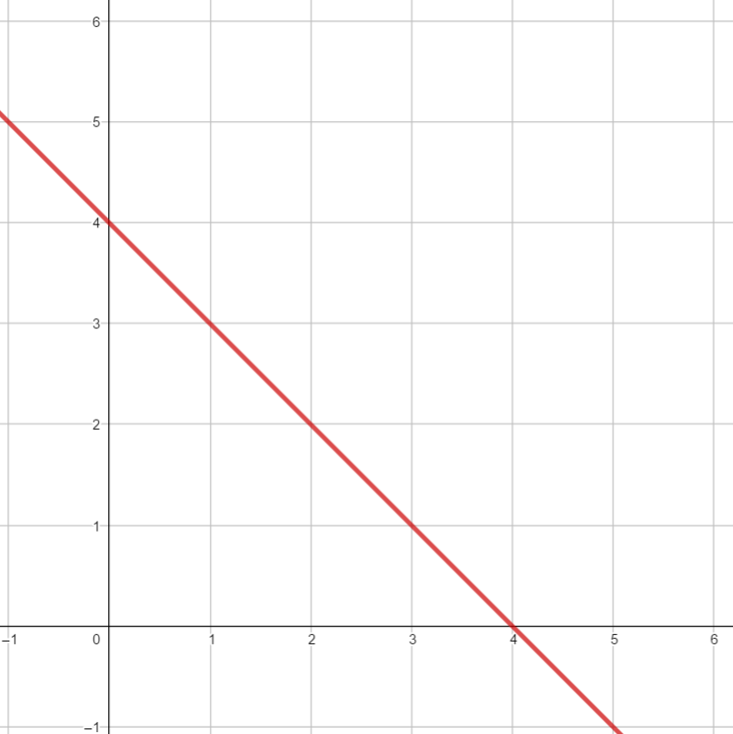
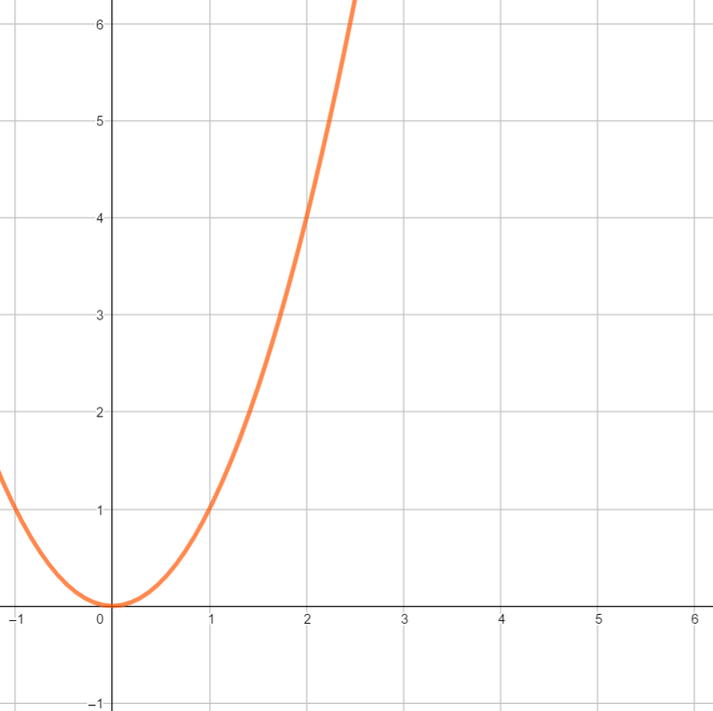
Find some similarities between characteristics of these graphs. Yasmin and Cala have made some of their observations
The red and orange graphs both have parts that tilt downwards
The purple and green graphs both go through (-1, 1)

Slide 3
Linear graphs are straight lines
The green, purple and red lines are examples of linear graphs
The orange line is not a linear graph

Slide 4
By looking at coordinates on each of these graphs we can name them

Slide 5
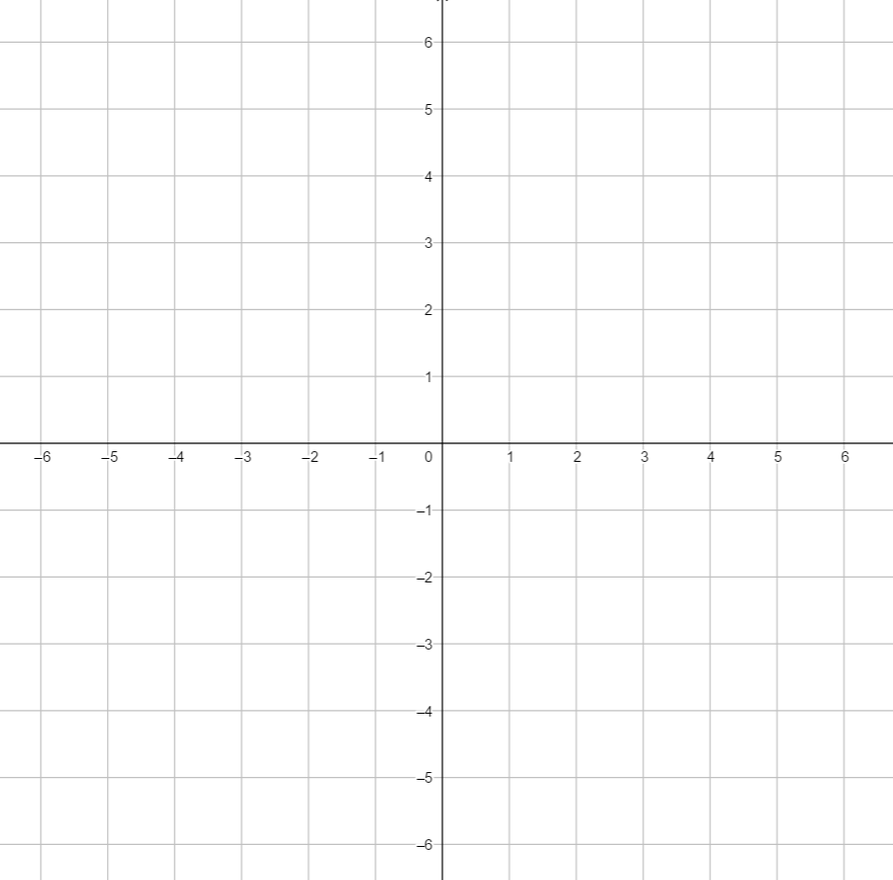
Use the coordinate grid to help you with these questions
Give two sets of three coordinates that would lie on a linear graph
Give two coordinates that would lie on a linear graph with (5,7) and (8, 10)

Slide 6
(0, 0)
(3, 9)
(4, -4)
1
Find some linear graphs that each of these points would lie on
2
Can you find any non-linear graphs that each of these points would lie on

