Slide 1
How to use grid references
Physical Education (PE) - Outdoor and adventurous activity: Developing critical thinking
Guy Wnuk

Slide 2
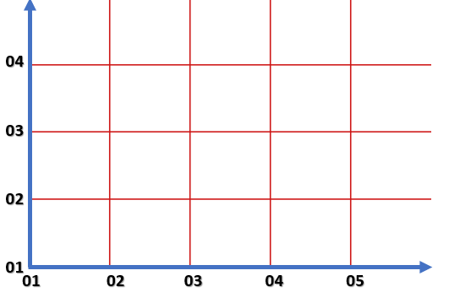
Grid referencing
Time yourself collecting and re-distributing the items
Grid references:

Slide 3
Grid referencing physical challenge
Time yourself completing 5 different physical challenges.
Suggested challenges:
10 press-ups
10 sit ups
10 jacks
10 mountain climbers
10 ski runs
10 tuck jumps
10 burpees
10 squats
10 lunges
10 star jumps

