Slide 1
Introduction to Surface Area
Downloadable Resource
Mathematics
Mrs Buckmire

Slide 2
Try this
All of these have the same volume.
How many faces will be visible on each shape?
For each shape, can you sketch a shape with the same number of visible faces, but a different volume?

Slide 3
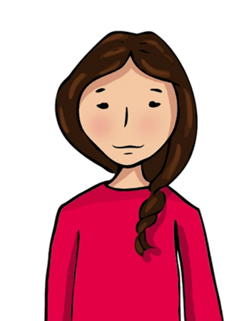
Independent task
1. Binh says this solid has a surface area of 15cm²
a) What is the correct surface area?
b) What mistake do you think she made?
2 a) What is the surface area of this solid?
b) Where could you add a cube to make the surface area 40 units²?

Slide 4
Explore
Zaki attaches 8 of these cubes together. What is the maximum surface area? What is the minimum surface area?
What if there are 9 cubes?
What do you notice?

