Slide 1
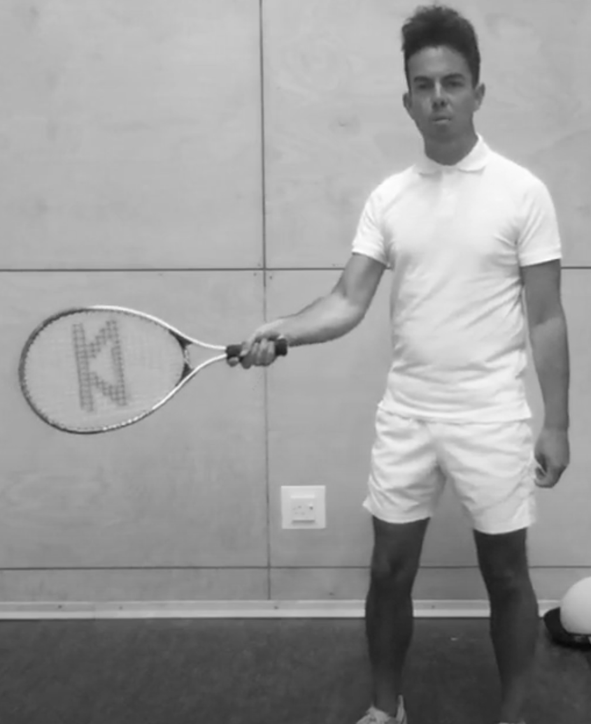
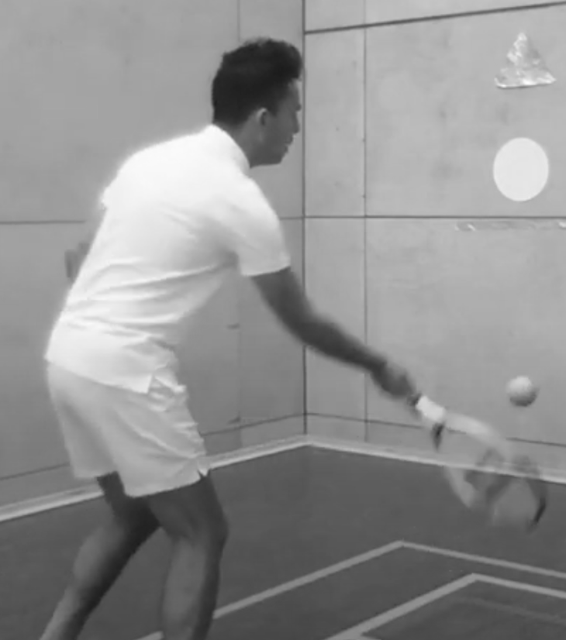
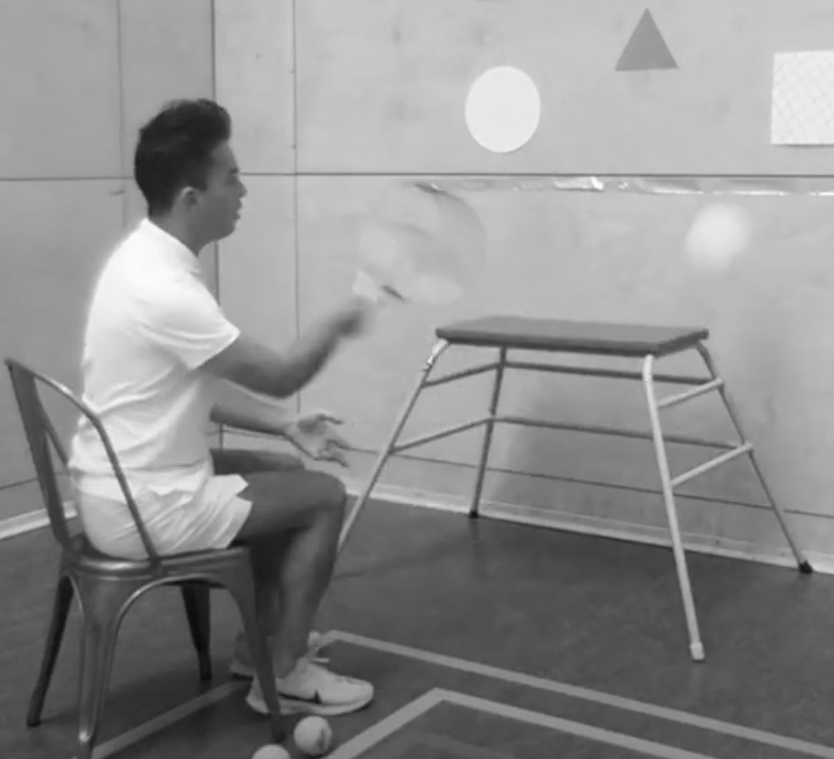
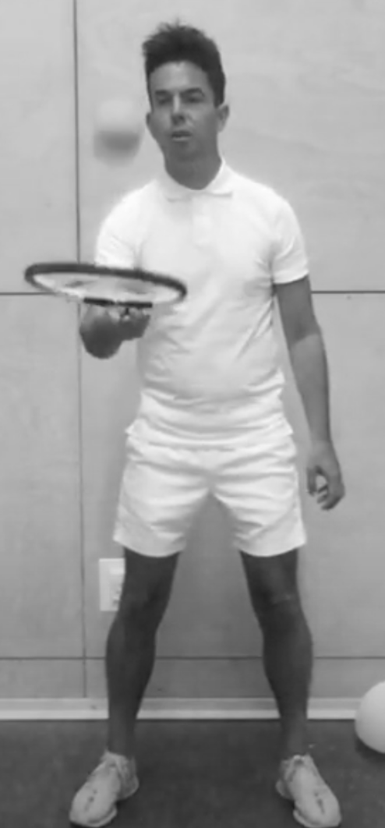
Activity Card
Net/Racket Sports: Tennis
Explore different shots you can play in a tennis match.
Use the ‘shaking hands’ grip and make sure you have control of the racket.
Try to play shots in different directions and experiment with the power and speed.
Use tennis equipment safely and be independent in getting ready to play.
Begin to move confidently and fluently in different directions.
Develop an understanding of tactics and how points are scored in tennis.
Practise your skills from a seated position against a wall with targets on it.
How many shots can you play before the ball bounces on the floor?

