Slide 1
Matching Symbols & Objects
Feelings
Communication and Language: Changes and Transition - Building Understanding
Alison
Notes:
Items to count from your house:
This can be anything! Stones, pencils, spoons, cups, plates are just some examples.
A Number line:
This can be a line on a piece of paper with the numerals and dots underneath to represent the value.
Messy Play:
This can be porridge, cornflakes, sand, shaving foam

Slide 2
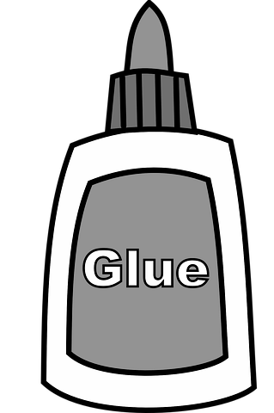
Equipment for this lesson
In this lesson you will need:
Mirror
Pictures of faces
Symbols for features of the face
Glue
Scissors (parent / carer supervision is necessary)
Paper
Images from Pixabay, FreeSVG
Notes:
You will need your sketchbook, a pencil, some clay, either natural earthen clay or air drying clay, clay tools and a smooth surface to work on. Cover the surface with a slightly dampened material such as a tea towel or you can use a plastic place mat. As you may get a bit messy when working with clay it is best to wear an apron or an old t-shirt or shirt.

Slide 3
Pulling faces
Begin the session by looking at your face in the mirror. Talk about what you can see and point to the different features of the face whilst naming them.
Try pulling different faces together in the mirror. Use simple language, for example ‘happy’, ‘sad’.
Notes:
Count through - “How many dots are there here?”

Slide 4
Time to complete your task
Pulling faces
Print out or draw the symbol for happy or sad
Show your child the symbol and reinforce the word
Ask your child to pick a symbol and then make a matching face in the mirror
Notes:
Count through - “How many dots are there here?”

Slide 5
Matching faces
Find lots of different pictures of faces. Make sure you have a mixture of happy and sad faces. Look together at the pictures. Talk about which faces are happy and which faces are sad.
Using the happy and sad symbol, sort the pictures into 2 piles.

Slide 7
Time to complete your task
Sorting faces
Sort out the pictures of the faces into happy and sad faces
You can stick these onto paper or just arrange on the floor

Slide 8
Self-portrait
Look at your face in the mirror or feel your face with your hands.
Can you identify all the different parts of your face? Use the symbols to help you to identify your:
Images from Pixabay

Slide 9
Time to complete your task
Making a self-portrait
Start with a face shape drawn on paper or a face shape cut out of paper
Print off or draw the different features of your face
Stick these onto your paper. Can you get them in the right place?
You can use a mirror to help you

Slide 10
Make it easier
Make it harder
More ideas
Use pictures of faces to match to the symbols and arrange on a page to make a portrait
Try drawing your own face and then use symbols or words to label your picture
Look at lots of pictures of faces and point to or name the different facial parts
Try matching up different facial expressions with words or symbols
Choose an expression symbol and then pull the face in a mirror

