Slide 1
Numbers to 30
Mathematics
Independent Task
Miss Robson

Slide 2
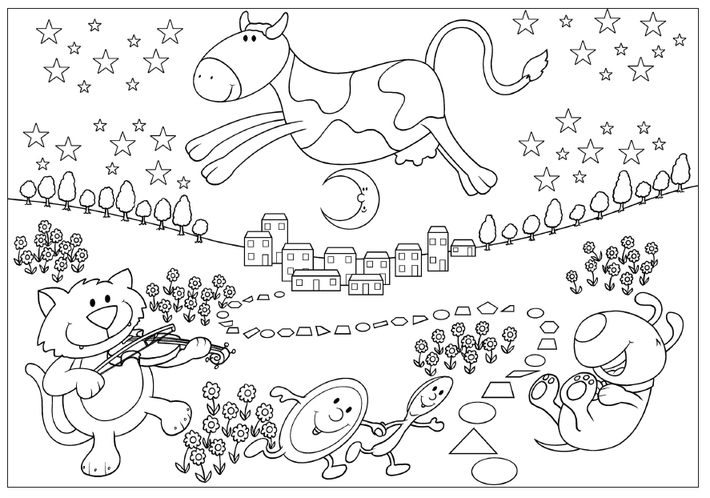
Activity

