Slide 1
Review Lesson
Higher
Combined Science - Chemistry - Key Stage 4
Quantitative Chemistry
Mrs Begum

Slide 2
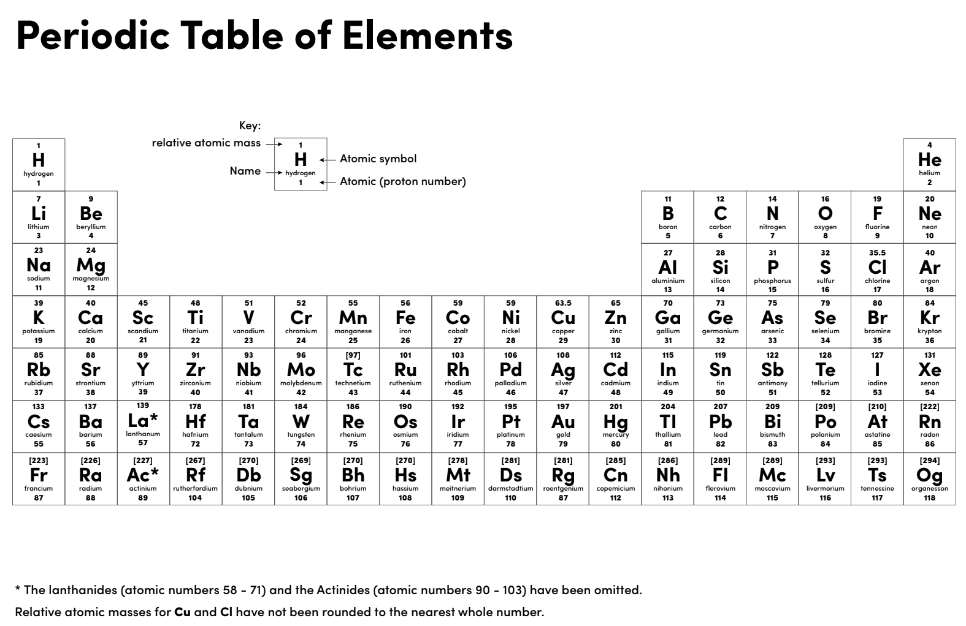

Slide 3
Independent practice 1
Relative atomic masses (M_{r}):
H - 1
Al - 27
Mg - 24
N - 14
C - 12
O - 16
S - 32
Calculate the M_{r} of the following:
1. Ethanoic acid - CH₃COOH
2. Ethane - C₂H₆
3. Magnesium Nitrate - Mg(NO₃)₂
4. Aluminium nitrate - Al(NO₃)₃
5. Aluminium sulfate - Al₂(SO₄)₃

Slide 4
Independent practice 2
The relative formula mass (M_{r}) of a Group 2 sulfate is 142.
Formula X₂SO₄
Relative atomic masses (A_{r}): S = 32, O = 16
Calculate the relative atomic mass (A_{r}) of the Group 2 metal in the metal carbonate.
Name the Group 2 metal.

Slide 5
Independent practice 3
Relative atomic masses (A_{r}):
H - 1
Al - 27
Mg - 24
N - 14
C - 12
O - 16
Sn - 119
F - 19
What is the percentage of fluorine in tin fluoride (SnF₂)?
What is the percentage of magnesium in magnesium carbonate (MgCO₃)?
What is the percentage of oxygen in aluminium hydroxide Al(OH)₃?
What percentage of nitrogen in magnesium nitrate Mg(NO₃)₂?

Slide 6
Independent practice 4
How many grams in:
5 mol of CaCO₃?
0.01 mol of NaHCO₃?
How many moles are in:
303 g of KNO₃?
9.80 g of H₂SO₄?
How many:
atoms are 0.1 mol of carbon?
molecules are in 0.01 mol of CH₄?
atoms are in 0.01 mol of CH₄?

Slide 7
Independent practice 5
Balance the following equations:
H₂ + Cl₂ HCl
CaO + HCl CaCl₂ + H₂O
KCl + F₂ KF + Cl₂
ZnO + C Zn + CO₂
CuSO₄ + NaOH Cu(OH)₂ + Na₂SO₄

Slide 8
Independent practice 6
Iron can be extracted from its ores by heating it with carbon. Some students found that 6.4 g of Fe₂O₃ reacted with 0.72 g of C to produce 4.48 g of Fe and 2.64 g of CO₂. Use the masses to deduce the balanced equation.

Slide 9
Independent practice 7
Convert the volumes below to dm³:
20 cm³
600 cm³
100 cm³
0.07 cm³
370 cm³
Convert the volumes below to cm³:
2 dm³
50 dm³
38 dm³
0.8 dm³
6.4 dm³

Slide 10
Independent practice 8
Fe + H₂SO₄ → FeSO₄ + H₂
80 g of Fe reacted with 100 g of H₂SO₄. Which reactant is the limiting reactant? Relative atomic masses (M_{r}): Fe = 56, H = 1, O = 16, S = 32

Slide 11
Independent practice 1 answers
Calculate the M_{r} of the following:
1. Ethanoic acid - CH₃COOH. 60
2. Ethane - C₂H₆. 30
3. Magnesium Nitrate - Mg(NO₃)₂. 148
4. Aluminium nitrate - Al(NO₃)₃. 213
5. Aluminium sulfate - Al₂(SO₄)₃. 342

Slide 12
Independent practice 2 answers
X₂SO₄ = 146
X + X + 32 +(4 x 16) = 146
X +X + 32 + 64 = 146
X + X + 96 = 1146
X + X = 146 - 96
2X = 46
X = 46/2
X = 23
X = Sodium

Slide 13
Independent practice 3 answers
Relative atomic masses (A_{r}):
H - 1
Al - 27
Mg - 24
N - 14
C - 12
O - 16
Sn - 119
F - 19
What is the percentage of fluorine in tin fluoride (SnF₂)? 38/157 x 100% = 24%
What is the percentage of magnesium in magnesium carbonate (MgCO₃)? 24/84 x 100% = 29%
What is the percentage of oxygen in aluminium hydroxide Al(OH)₃? 48/73 x 100% = 66%
What percentage of nitrogen in magnesium nitrate Mg(NO₃)₂? 28/148 x 100% = 19%

Slide 14
Independent practice 4 answers
How many grams in:
5 mol of CaCO₃? 5 x 100 = 500g
0.01 mol of NaHCO₃? 0.01 x 84 = 0.084 g
How many moles are in:
303 g of KNO₃? 303/101 = 3
9.80 g of H₂SO₄? 9.8/ 98 = 0.1
How many:
atoms are 0.1 mol of carbon? (6.02 x 10²³) x 0.1 = 6.02 x 10²²
molecules are in 0.01 mol of CH₄? (6.02 x 10²³) x 0.01 = 6.02 x 10²¹
atoms are in 0.01 mol of CH₄? (6.02 x 10²¹) x 5 = 3.01 x 10²²

Slide 15
Independent practice 5 answers
Balance the following equations:
H₂ + Cl₂ 2HCl
CaO + 2HCl CaCl₂ + H₂O
2KCl + F₂ 2KF + Cl₂
2ZnO + C 2Zn + CO₂
CuSO₄ + 2NaOH Cu(OH)₂ + Na₂SO₄

Slide 16
Independent practice 6 answers
Convert the volumes below to dm³:
20 cm³ 0.02 dm³
600 cm³ 0.6 dm³
100 cm³ 0.1 dm³
0.07 cm³ 0.00007 dm³
370 cm³ 0.37 dm³
Convert the volumes below to cm³:
2 dm³ 2000 cm³
50 dm³ 50000 cm³
38 dm³ 38000 cm³
0.8 dm³ 800 cm³
6.4 dm³ 6300 cm³

Slide 17
Independent practice 7 answer
Fe + H₂SO₄ → FeSO₄ + H₂
Work out the M_{r}
56 98 153 2
Take one mass from the question
÷56 x 80
You need 140 g of H₂SO₄ to react with 80 g Fe, but we added 100 g of H₂SO₄, so H₂SO₄ will run out first.
Work out scale factor
80
÷56 x 80
Apply to the other reactant to see how much is needed
140g

Slide 18
Independent practice 8 answer
Fe + H₂SO₄ → FeSO₄ + H₂
Work out the M_{r}
56 98 153 2
Take one mass from the question
÷56 x 80
You need 140 g of H₂SO₄ to react with 80 g Fe, but we added 100 g of H₂SO₄, so H₂SO₄ will run out first.
Work out scale factor
80
÷56 x 80
Apply to the other reactant to see how much is needed
140 g

