Slide 1
Multiplication patterns
Worksheet
Mr Ward

Slide 2
Warm up - Missing values
Can you complete the calculations?

Slide 3
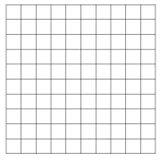
Using a counting stick to show times tables
Shading 10 x 10 grids
Shade all multiples of 6 in the grid
Continue beyond 10 x 6 = 60
What patterns do you notice?

Slide 4
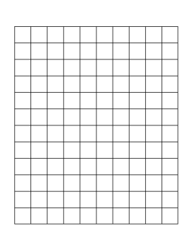
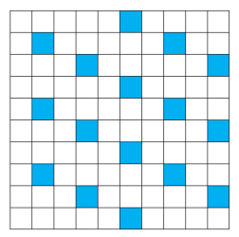
Using a counting stick to show times tables
Shading 10 x 10 grids
Shade all multiples of 12 in the grid
What patterns do you notice?

Slide 5
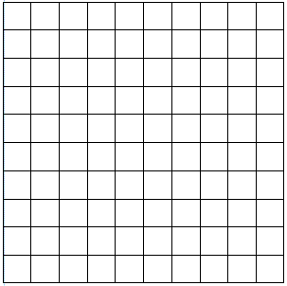
Talk Task - Exploring multiplication patterns
Shade in the 10 x 10 grids for the 2x, 4x and 8x tables
Reflect on the following questions:
What do you notice? What’s the same? What patterns exist?
2x multiplication table
4x multiplication table
8x multiplication table

Slide 6
Identifying multiplication patterns.
Shade in the 10 x 10 grids for the 3x, 7x, 11x and 12x tables
Compare the different multiplication tables
Consider the questions already asked such as:
What do you notice? What’s the same? What patterns exist?
11x table
12x table
3x table
7x table

Slide 7
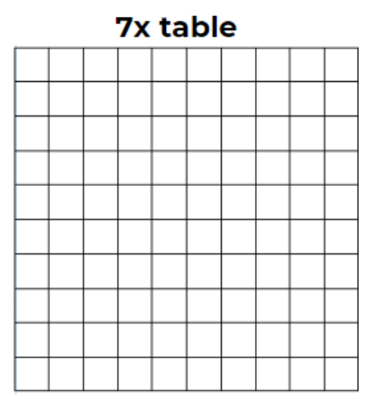
Identifying multiplication patterns.

Slide 8
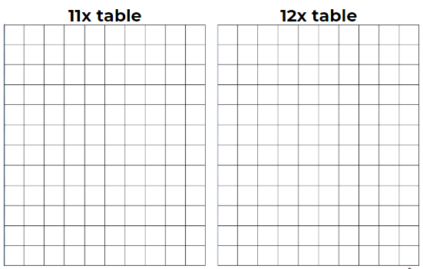
Identifying multiplication patterns.

Slide 9
Challenge Slide
How many different ways can you complete the multiplications shown below?
x = 24 x = 50
x = 32 x = 75
x = 44 x = 100

