Slide 1
Representing Inequalities on a Number Line
Mr Lund
Maths
‹#›

Slide 2
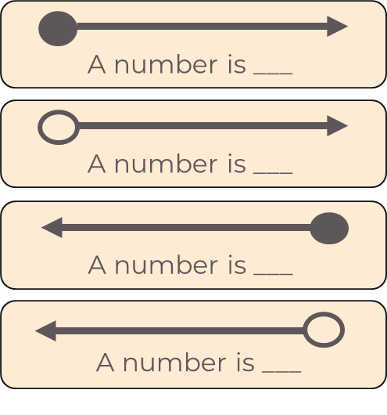
Representing Inequalities on a Number Line
1. What do these symbols represent?
Use <, > or ≤, ≥ to fill in the gaps.
‹#›

Slide 3
Representing Inequalities on a Number Line
4. Do the statements match the diagram?
a)
b)
c)
All the values between -3 and 1
All the values between -3 and 1
All the values between -3 and 1, not including one
‹#›

Slide 4
Answers
‹#›

Slide 5
Representing Inequalities on a Number Line
1. What do these symbols represent?
Use <, > or ≤, ≥ to fill in the gaps.
‹#›

Slide 6
Representing Inequalities on a Number Line
4. Do the statements match the diagram?
a)
b)
c)
No
All the values between -3 and 1
Yes
All the values between -3 and 1
Yes
All the values between -3 and 1, not including one
‹#›

