Slide 1
Talking about what people do [2/2]
Present tense -er & -ir verbs: ‘We’ & ‘they’
Spanish
Señorita Vázquez

Slide 2
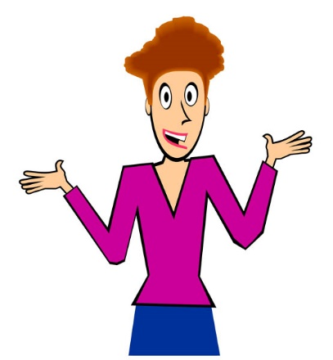
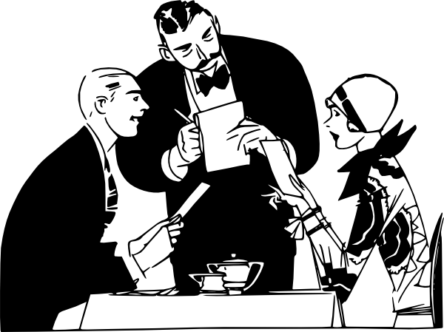
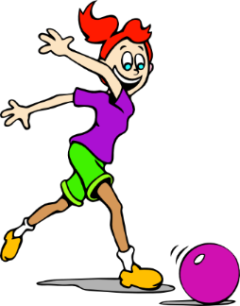
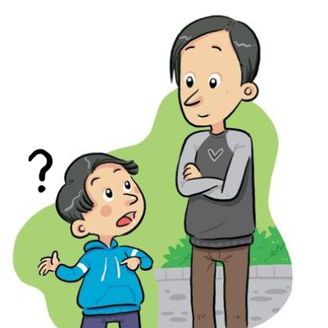
[z]
[que]
[qui]
[ñ]
[go]
[gu]
[ga]
La fonética
zona
porque
quiero
español
ganar
gol
pregunta

Slide 3
 | Word | English meaning
1 | las manualidades | crafts
2 | el canal | channel
3 | la receta | recipe
4 | el comedor | dining hall
5 | los apuntes | (school) notes
6 | privado | private
7 | las chuches | sweets
8 | abrir | to open, opening
9 | las zapatillas | trainers

Slide 4
Using the ‘we’ form of -er verbs
Remember, some Spanish infinitives end in –er.
The verb ending changes depending on who the verb refers to.
–o
To mean ‘I’ with an –er verb, remove –er and add ___.
I sell
I respond
vendo = _________.
respondo = ___________.
To mean ‘we’ with an –er verb, remove –er and add –emos.
aprender
aprend
aprendemos
comprender
comprend
comprendemos

Slide 5
Using the ‘we’ form of -ir verbs
Remember, some Spanish infinitives end in –ir.
The verb ending changes depending on who the verb refers to.
–o
To mean ‘I’ with an –ir verb, remove –ir and add ___.
I open
I upload
abro = _________.
subo = ___________.
To mean ‘we’ with an –ir verb, remove –ir and add –imos.
recibir
recib
recibimos
compartir
compart
compartimos

Slide 6
Present tense
-er, -ir verbs: 1st person singular & plural (I / we)
I
we
o
-emos
-imos
Leo revistas.
I read magazines.
Leemos revistas.
Vivimos en una ciudad.
We read magazines.
We live in a city.
Vivo en una ciudad.
I live in a city.
beber
bebo
bebemos
escribir
escribo
escribimos

Slide 7
Present tense: -er & -ir verbs: 3rd person plural (‘they’)
-e
To mean ‘S/he’ with an –er & -ir verb, remove –er/-ir and add ___.
-en
To mean ‘they’ with an –er & -ir verb, remove –er/-ir and add ___.
S/he
They
Lee revistas.
Leen revistas.
S/he reads magazines.
They read magazines.
Abren tarjetas de felicitación.
Abre tarjetas de felicitación.
They open greeting cards.
S/he opens greeting cards.
Elegir Ver
Eligen ven

Slide 8
Empareja los números con las letras
To refer to ‘we’ with an action you do now with -er verbs, add _________ to the stem.
a) en
-emos
2. To refer to ‘we’ with an action you do now with -ir verbs, add _________ to the stem.
b) reciben
-imos
5
4
3. To refer to ‘they’ with an action you do now, -er and -ir verbs have the same ending: __________.
c) imos
3
-en
2
vendemos
4. Mi hermano y yo ______________ cosas por internet.
d) vendemos
1
reciben
5. Mi madre y mi hermana _______ visitas a menudo.
e) emos

