Slide 1
Combined Science - Chemistry - Key Stage 4
Atomic Structure & the Periodic Table
Group 1 elements
Dr Patel

Slide 2
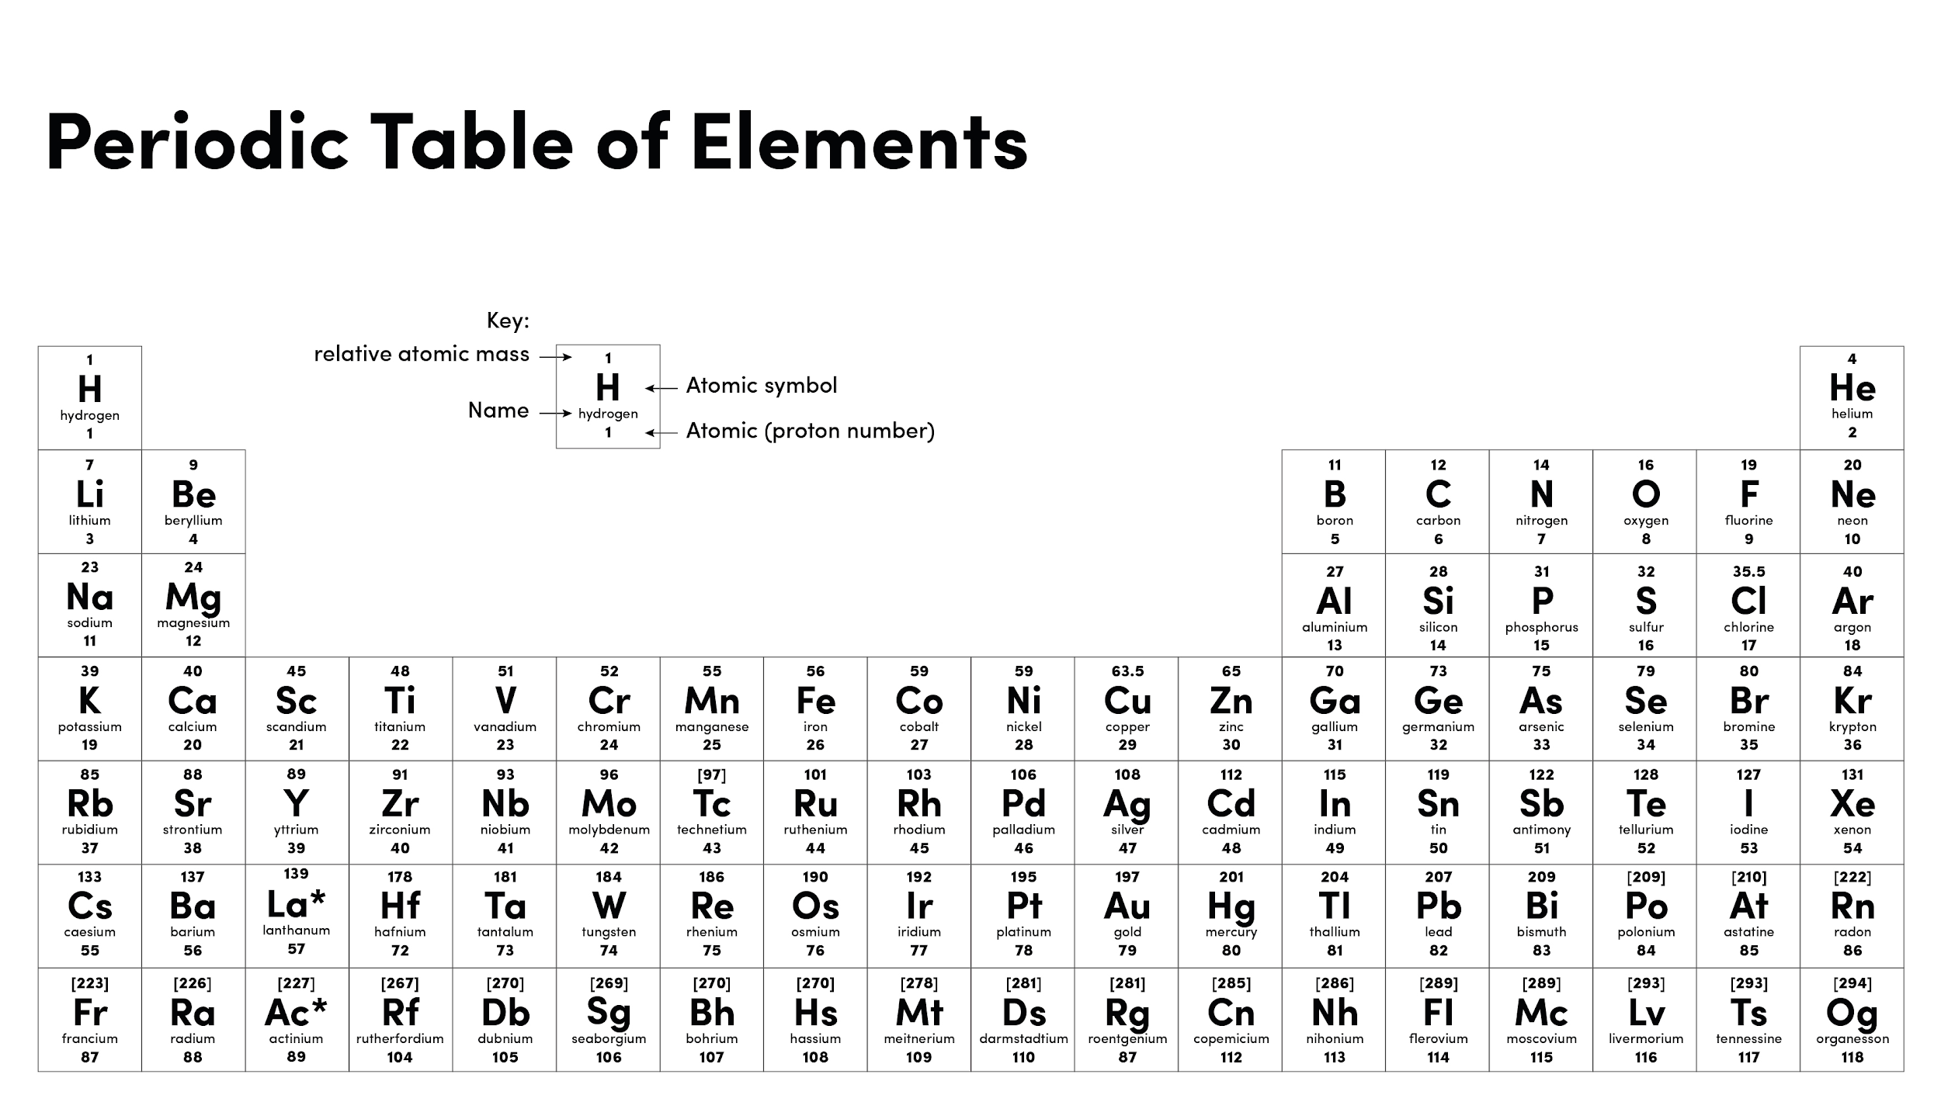

Slide 3
Pause point
Physical change | Chemical change
New substance produced
No new substance produced
Involves the transfer/sharing of electrons
Involves the forces of attraction between particles
Examples: boiling point, melting point and density
Examples: reactions with oxygen and water

Slide 4
Independent practice - density
Alkali metal | Density (g/cm³)
Lithium | 0.53
Sodium | 0.97
Potassium | 0.86
Rubidium | 1.53
Caesium | 1.87
A good answer, always contains:
General description of a trend (increase/decrease)
States values from the table with UNITS
Uses comparative language

Slide 5
Describing trends in physical properties - density
Alkali metal | Density (g/cm³)
Lithium | 0.53
Sodium | 0.97
Potassium | 0.86
Rubidium | 1.53
Caesium | 1.87
A good answer, always contains:
General description of a trend (increase/decrease)
States values from the table with UNITS
Uses comparative language
As you go down group 1, the density increases.
For instance lithium is at the top of group one, and has the lowest density of 0.53 g/dm³, whereas, caesium is at the bottom of group one and has the highest density of 1.87 g/dm³.

Slide 6
Independent practice
Describe how reactivity changes as you go down group 1.
What is the general word equation for the reaction between alkali metals and water?
What is the general word equation for the reaction between alkali metals and oxygen?
Complete the word equations for the reaction between:
Potassium + oxygen →
Potassium + water →
Challenge: Write a balanced symbol equation for the reactions between potassium and water.

