Slide 1
How can melody and rhythm communicate a language that we don’t understand?
Music Unit 1 Lesson 8
Miss Al-Hanoush

Slide 2
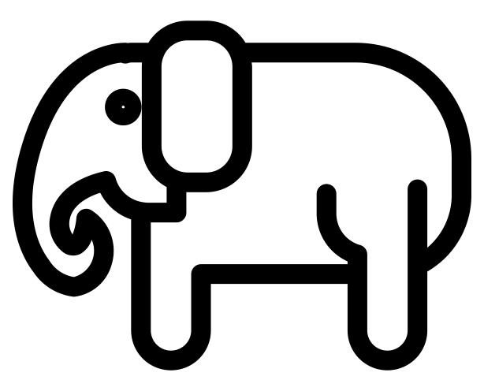
‘Elefantea’
Alberto Grau
[The Noun Project] - [Fahmi Ramdani] - [Elephant]
Lyrics
Elefantea Nun Da?
Zirkoa omen dago
Hortxe dabil zirkoan
Dado baten gainean
Elefantea dantzan
Pronunciation
El-a-fan-tey-a noon da
Zear-ko-a-men da-go
Hort-say da-bill zear-ko-an
Da-bo ba-ten ga-nay-an
El-a-fan-tey-a dan-say-an

Slide 3
Create your own...
Body percussion
1 | + | 2 | + | 3 | + | 4 | +

