Slide 1
Transcription Cultural Fact File
Communication and Language: Our World - Applying Learning
Leanne

Slide 2
For this lesson, you will need:
Paper
Pencil or pen
Scissors (parent / carer supervision is necessary)
Ruler
Colouring pencils
Access to the internet (parent/carer supervision is necessary)

Slide 3
Introduction to the lesson
In this lesson we are going to be creating a fact file of an author of your choice.
We will learn about their life and culture and add your findings to the fact file.

Slide 4
Making a writing frame
Name of the author
Picture of their country
Picture of the author
Before we start the lesson, we need to draw our writing frame for a fact file.
Use your ruler to draw the lines so you have different sections.
Copy the layout but don’t add the titles. These are there for reference.
Name of their country
Traditional clothing from that country
Traditional food from that country

Slide 5
Choose an author
To begin this lesson, we will be choosing which author we want to focus on.
Which author would you like to make a fact file about?
Nnedi Okorafor from Nigeria.
Timothée de Fombelle from France.
Yangsook Choi from South Korea

Slide 6
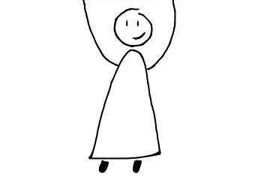
Author
Yangsook Choi
Picture of their country
Picture of the author
Now you have chosen your author, you can write their name into the correct box and then you can draw a picture of them in the writing frame.
Use the internet to find out what they look like. Ask a parent / carer to help you.
Name of their country
Traditional clothing from that country
Traditional food from that country

Slide 7
Country
Now we can start researching the author’s country.
I have chosen Yangsook Choi for my example. She is an author from South Korea.
I will then use the internet to look at images of South Korea.
Choose your favourite image of the country and draw this onto your fact file.

Slide 8
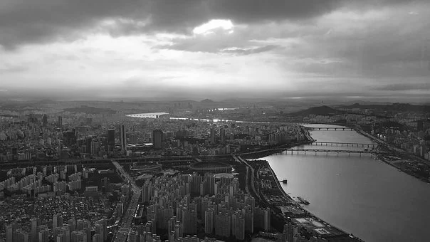
Country
Yangsook Choi
Picture of their country
Picture of the author
This is what the fact file will look like now.
Write the name of the author’s country and draw your favourite picture from their country.
South Korea
Traditional clothing from that country
Traditional food from that country

Slide 9
Clothing
Next we can research traditional dress in the author’s country.
Type the name of the country into a search engine and add the word ‘dress’.
‘South Korean dress’.

Slide 10
Clothing
Yangsook Choi
Picture of their country
Picture of the author
Choose an image you like.
You can find out the name of the clothing and write that into your fact file.
Build a sentence.
In South Korea, people wear…
South Korea
In South Korea, some people wear a hanbok.
Traditional food from that country

Slide 11
Food
Next we can research traditional food of the author’s country.
Type the name of the country into a search engine and add the word ‘food’.
‘South Korean food’.

Slide 12
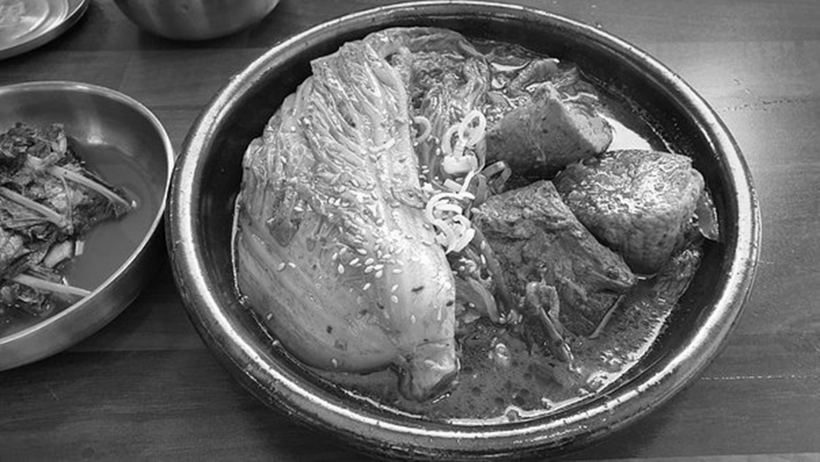
Food
Yangsook Choi
Picture of their country
Picture of the author
Choose an image you like.
You can find out the name of the food and write that into your fact file.
Build a sentence.
In South Korea, the traditional food is…
South Korea
In South Korea, some people wear a hanbok.
In South Korea, the traditional food is Kimchi.

Slide 13
Now it’s time to complete the activity
Cultural fact file
Draw your writing frame.
Choose which author you would like to focus on.
Work through the sections and use the internet to research about your chosen author.
Add the information to your fact file.

Slide 14
Make it easier
Make it harder
More ideas
Have pictures and symbols available to support the learner to make choices and answer questions.
Scribe for the learner.
Add a ‘fun fact’ section where the learner can add additional information.
Reduce the support given.
Find music from the author’s country and learn a traditional dance with your friends and family.
Read stories from around the world by different authors.

