Slide 1
Uses of hydrocarbons
Worksheet
Chemistry - Key Stage 4
Organic Chemistry
Dr. Patel

Slide 2
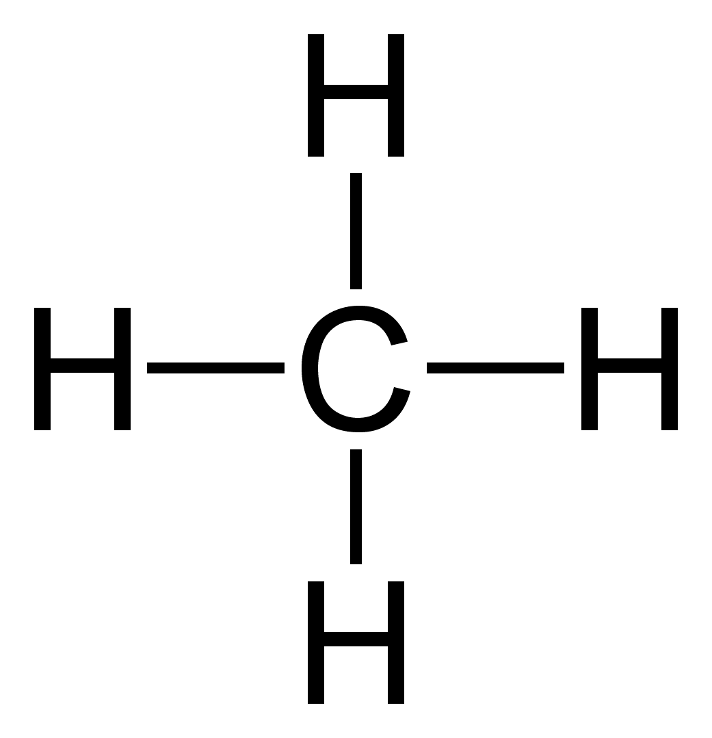
Recap
Name, draw and write the molecular formula for the first 4 alkanes in the homologous series.
(CH₄)
2. Which fraction from crude oil has the highest boiling point and explain why.
3. Which fraction from crude oil has the lowest boiling point and explain why.
Methane
__________ has the highest/lowest boiling point. This is because there are _____________ i______________ forces of attraction between _________, and so _______ energy is required to break these ________ i________________ forces of attraction.
[Wikimedia Commons] - [Methan Lewis] - Methane-2D-square
Notes:
So before we start, I want you to complete the recap questions on the screen, to see how much you remember. If you’re not sure where to start for question one, here is the first one, methane, to support you. You can also use this paragraph to help structure your answers to questions 2 and 3. Pause the video now and answer the questions. Resume playing the video once you’ve done these.

Slide 3
Viscosity
If something is very viscous, it will be very ______ and not very r______. For example, b________.
If something is not very viscous, it won’t be very _______ and it will be very r______. For example, p
Short-chain hydrocarbons are…
Long-chain hydrocarbons are...
Notes:
To test your understanding, I want you to pause the video now and copy and complete the task on the screen. Resume playing the video when you’ve done this.
So hopefully your answers look similar to the ones on the screen. Pause the video now and self assess your answers, remembering to pay close attention to the underlined words.

Slide 4
Flammability
Flammability describes how easy it is for something to…
Short-chain hydrocarbons are _____ flammable than long-chain hydrocarbons which means they are more useful to us as f_____.
Notes:
Please pause the video now and complete the task on the screen. Resume playing the video once you have done this.
Ok so hopefully you got these as your answers. Well done if you got them correct!

Slide 5
A hydrocarbon undergoes an incomplete combustion reaction. Write the word equation for this.
Propane reacts with oxygen in a complete combustion reaction. How would this look as a symbol equation?
Write a balanced symbol equation for the reaction between ethane and oxygen in a complete combustion reaction.
Notes:
So here’s what you should’ve got. Pause the video now and self assess your answers.

