Slide 1
Find frequency from a histogram
Maths
Miss Parnham

Slide 2
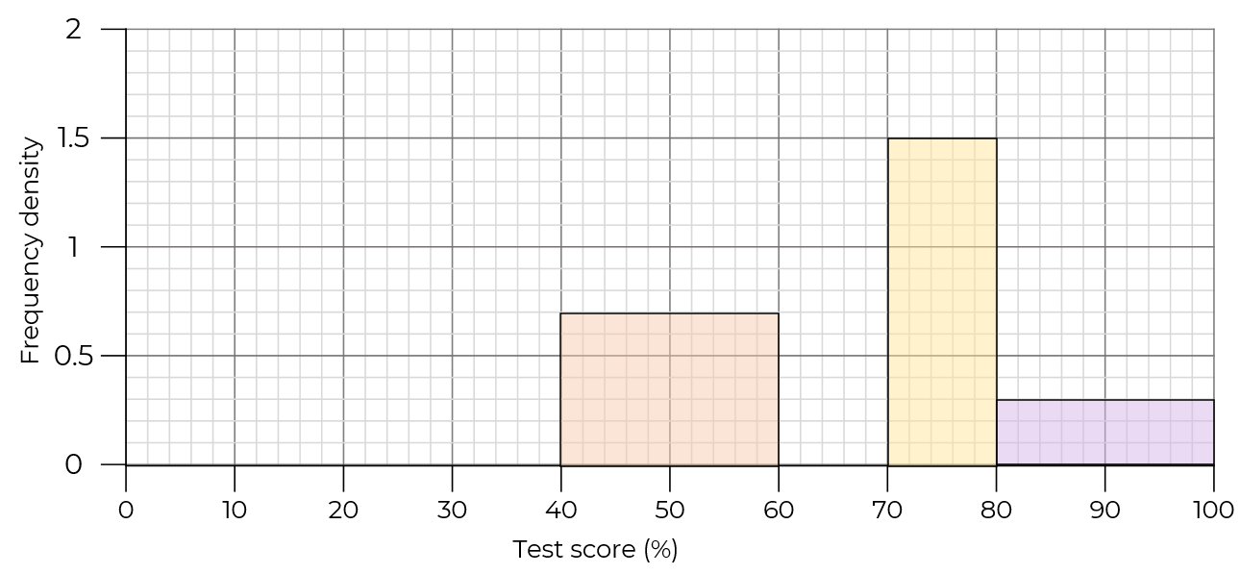
Find frequency from a histogram
1. Complete the table and histogram.
Test score (%) | Frequency | Class width | Frequency density
0 < s ≤ 40 | 8
40 < s ≤ 60
60 < s ≤ 70 | 17
70 < s ≤ 80
80 < s ≤ 100

Slide 3
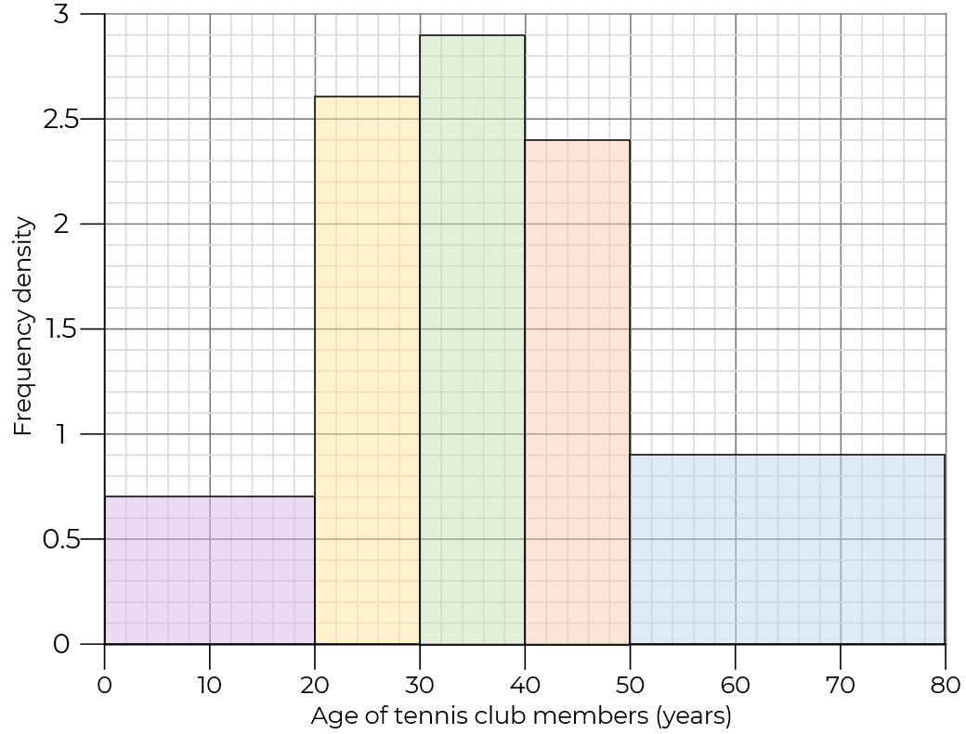
Find frequency from a histogram
2. Complete the table using the histogram.
Age (years) | Frequency | Class width | Frequency density
0 < a ≤ 20
20 < a ≤ 30
30 < a ≤ 40
40 < a ≤ 50
50 < a ≤ 80

Slide 4
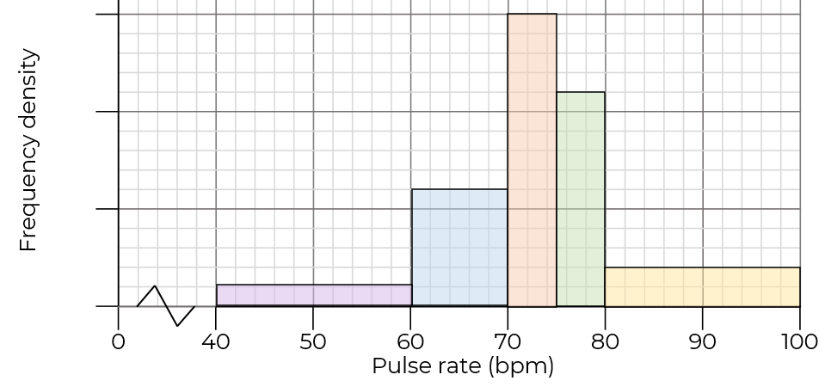
Find frequency from a histogram
3. Complete the table and the scale on the vertical axis.
Pulse rate (bpm) | Frequency | Class width | Frequency density
40 < r ≤ 60 | 4
60 < r ≤ 70 | 12
70 < r ≤ 75 | 15
75 < r ≤ 80
80 < r ≤ 100

Slide 5
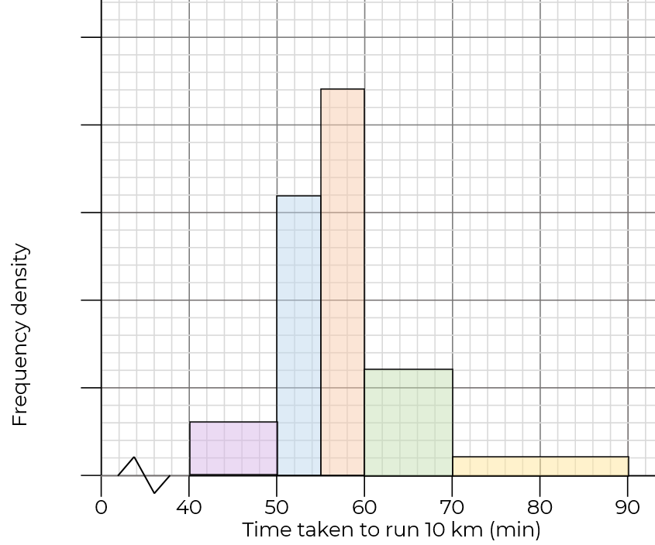
Find frequency from a histogram
4. Complete the table and the scale on the vertical axis.
Time (min) | Frequency | Class width | Frequency density
40 < t ≤ 50
50 < t ≤ 55
55 < t ≤ 60
60 < t ≤ 70 | 6
70 < t ≤ 90

Slide 6
Answers

Slide 7
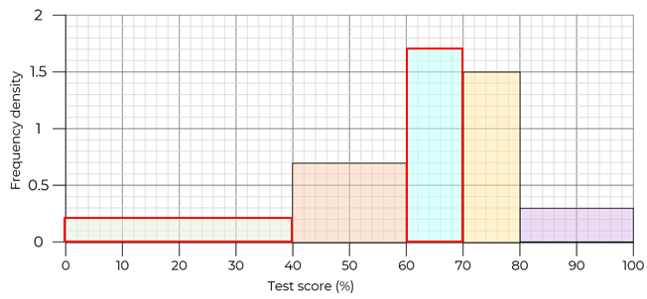
Find frequency from a histogram
1. Complete the table and histogram.
Test score (%) | Frequency | Class width | Frequency density
0 < s ≤ 40 | 8 | 40 | 0.2
40 < s ≤ 60 | 14 | 20 | 0.7
60 < s ≤ 70 | 17 | 10 | 1.7
70 < s ≤ 80 | 15 | 10 | 1.5
80 < s ≤ 100 | 6 | 20 | 0.3

Slide 8
Find frequency from a histogram
2. Complete the table using the histogram.
Age (years) | Frequency | Class width | Frequency density
0 < a ≤ 20 | 14 | 20 | 0.7
20 < a ≤ 30 | 26 | 10 | 2.6
30 < a ≤ 40 | 29 | 10 | 2.9
40 < a ≤ 50 | 24 | 10 | 2.4
50 < a ≤ 80 | 27 | 30 | 0.9

Slide 9
Find frequency from a histogram
3. Complete the table and the scale on the vertical axis.
Pulse rate (bpm) | Frequency | Class width | Frequency density
40 < r ≤ 60 | 4 | 20 | 0.2
60 < r ≤ 70 | 12 | 10 | 1.2
70 < r ≤ 75 | 15 | 5 | 3
75 < r ≤ 80 | 11 | 5 | 2.2
80 < r ≤ 100 | 8 | 20 | 0.4
3
2
1
0

Slide 10
Find frequency from a histogram
4. Complete the table and the scale on the vertical axis.
2.5
Time (min) | Frequency | Class width | Frequency density
40 < t ≤ 50 | 3 | 10 | 0.3
50 < t ≤ 55 | 8 | 5 | 1.6
55 < t ≤ 60 | 11 | 5 | 2.2
60 < t ≤ 70 | 6 | 10 | 0.6
70 < t ≤ 90 | 2 | 20 | 0.1
2
1.5
1
0.5
0

