Slide 1
Oak Specialist
Independent Living Unit 1- Home Management
Applying Learning

Slide 2
Unit 1- Home Management
Lesson 1- Using cleaning products
Lesson 2- Hygiene at home
Recognising common cleaning products and warnings on the labels.
Using the correct cleaning product and cloth for the job.
Lesson 3- Reading clothes labels
Lesson 4- Organising clothes
Option 3
Option 4
Identifying key washing symbols and what they mean.
Sorting clothes by category and folding correctly.
Lesson 5- Using the kitchen safely
Lesson 6- Reading food labels
Option 3
Option 4
Recognising different kitchen utensils and appliances, and how to use them safely.
Counting equipment needed and using a visual to set the table.

Slide 3
Lesson 2 - Hygiene at home

Slide 4
Teacher notes- Lesson 2
Hygiene at home
Learning Intention: To understand how to keep your home hygienic.
Introduce chores that need to be done to keep your home hygienic.
What do we use to clean?
Why is it important to have a hygienic home?
Creating our own list of chores to keep our home hygienic and clean.
Resources needed: examples of cleaning products and cloths.

Slide 5
Safety notice
This lesson involves cleaning products which may be harmful to you or the learner if used incorrectly. Please follow the safety guidelines on the products and ensure adult supervision when handling these products.

Slide 6
Home Management
Hygiene at home
Applying Learning

Slide 7
Lesson activity stages:
This lesson will be taught in 4 stages:
Thinking about what we need to do to keep our home clean.
What do we use for each job?
Why is it important to keep our homes clean?
Create a list of weekly chores.

Slide 8
What do we need to do to make sure our bedroom is clean?
Notes:
Activity;
Ask student to make a list of things that they think needs to be kept clean in the home.
Start by thinking of the different rooms in your home.
Floor
Furniture
Bedding

Slide 9
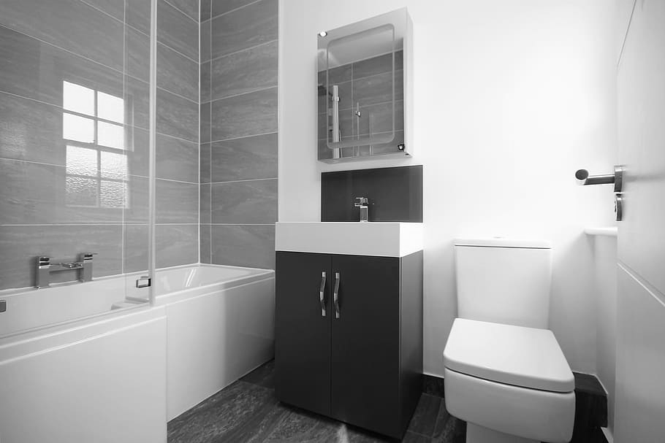
What do we need to do to make sure our bathroom is clean?
Notes:
Activity;
Ask student to make a list of things that they think needs to be kept clean in the home.
Start by thinking of the different rooms in your home.
Floor
Bath/ Shower
Toilet
Sink
Towels

Slide 10
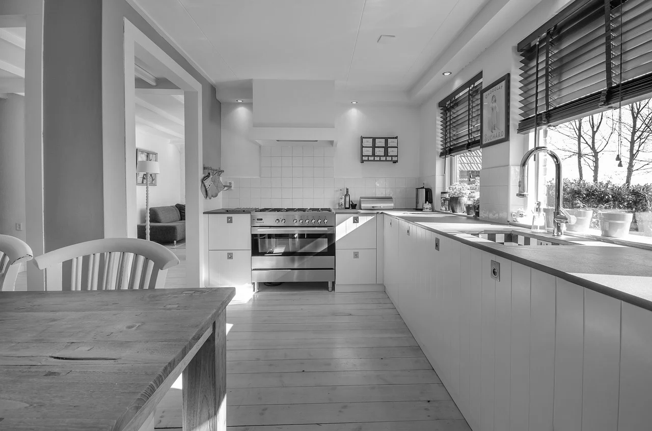
What do we need to do to make sure our kitchen is clean?
Notes:
Activity;
Ask student to make a list of things that they think needs to be kept clean in the home.
Start by thinking of the different rooms in your home.
Floor
Cooker
Sink
Dishes/ Pans/ Cups
Worktops

Slide 11
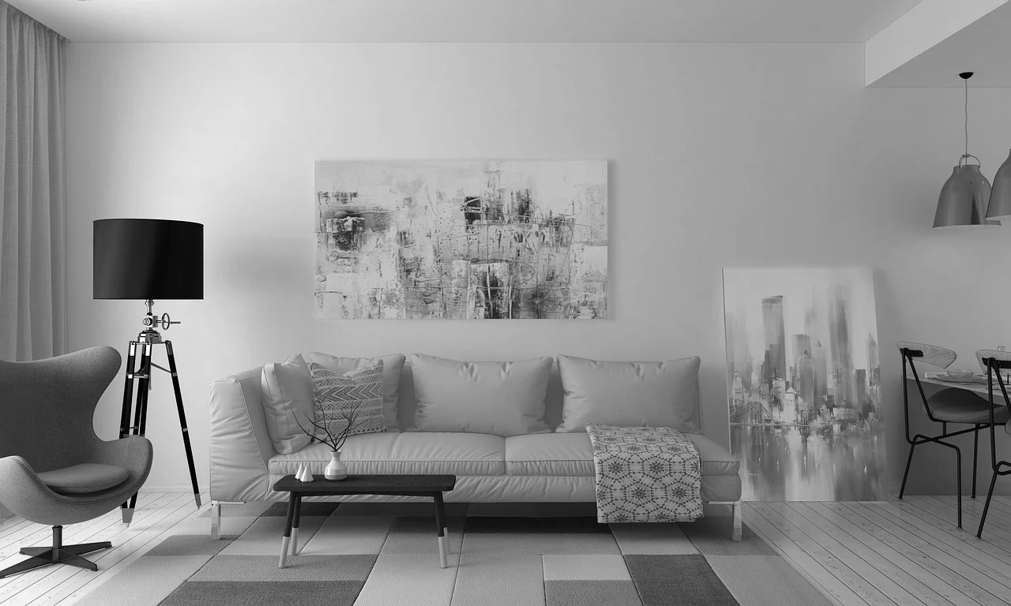
What do we need to do to make sure our living room is clean?
Notes:
Activity;
Ask student to make a list of things that they think needs to be kept clean in the home.
Start by thinking of the different rooms in your home.
Floor/ rug
Furniture

Slide 12
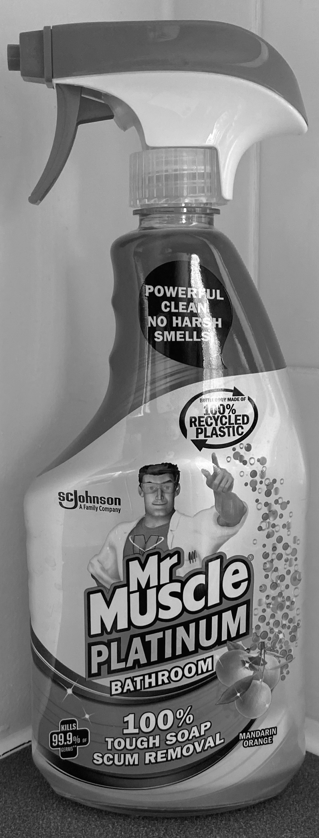
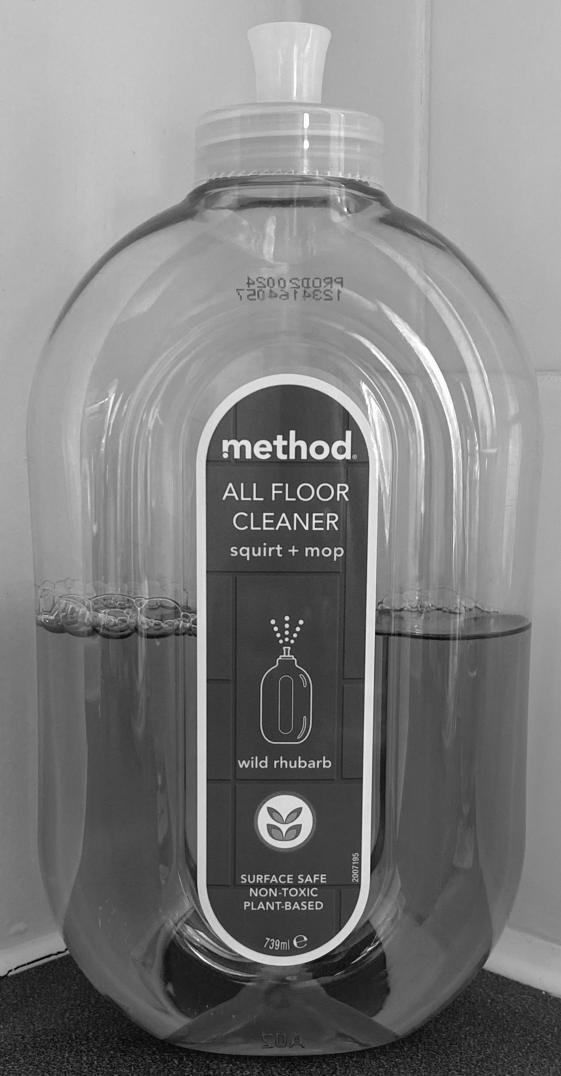
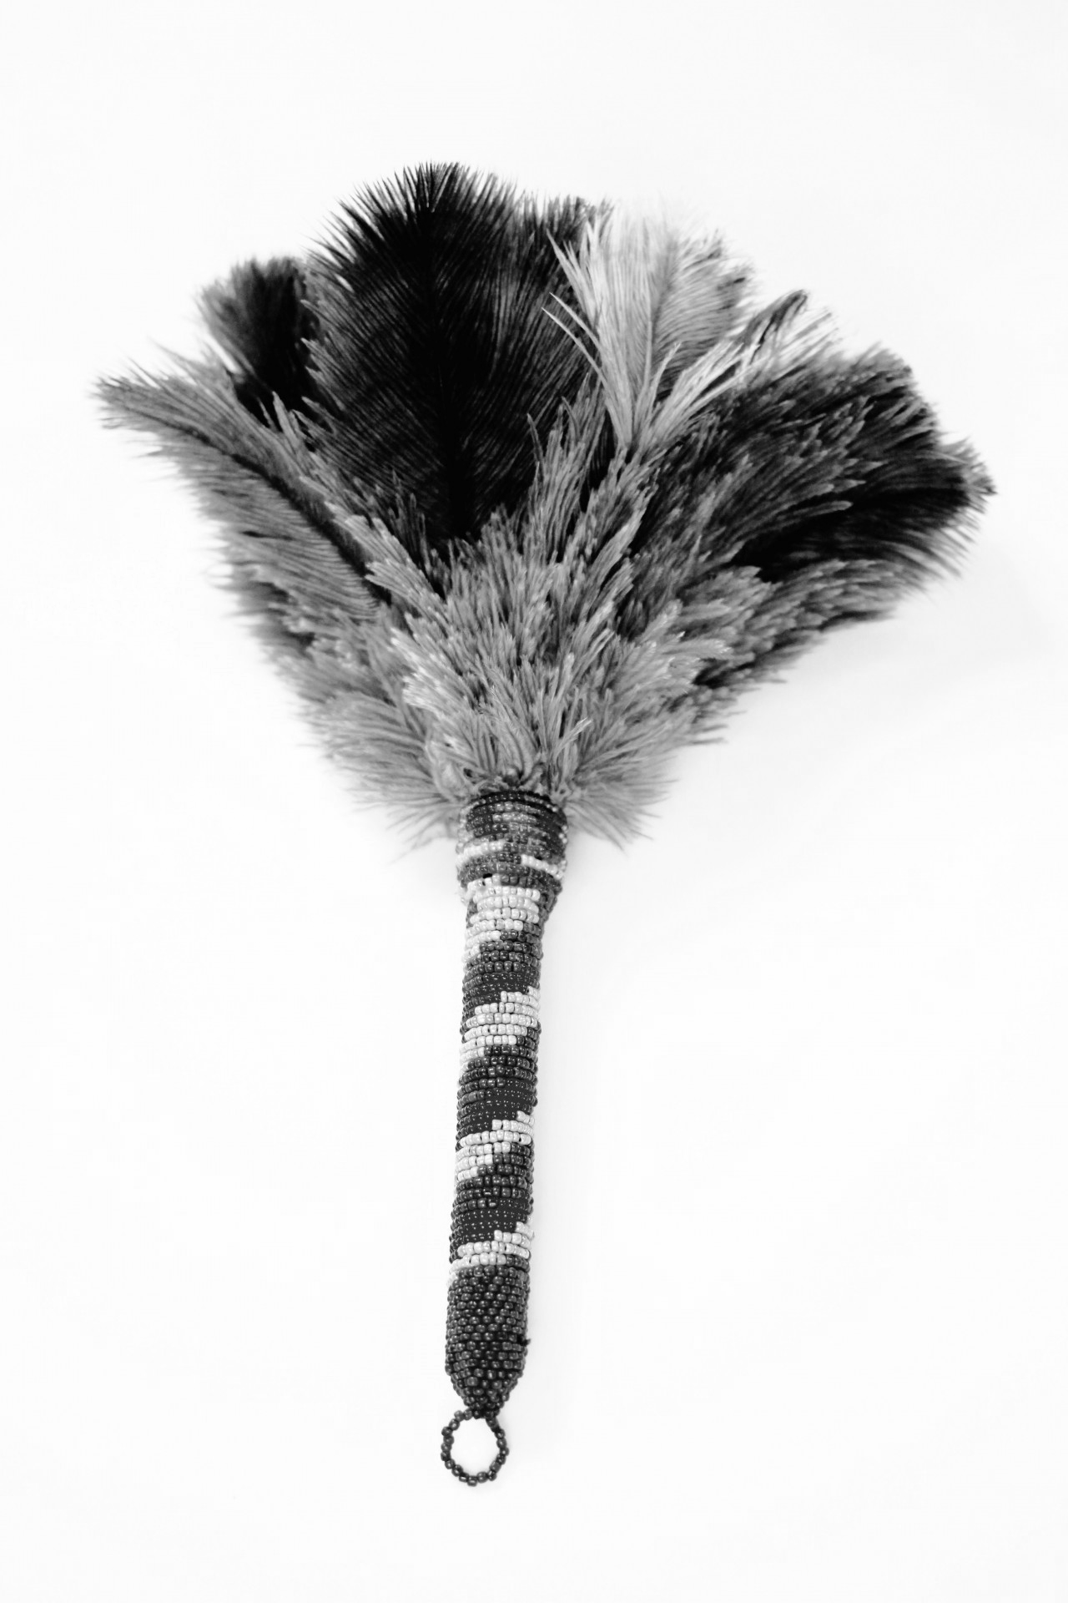
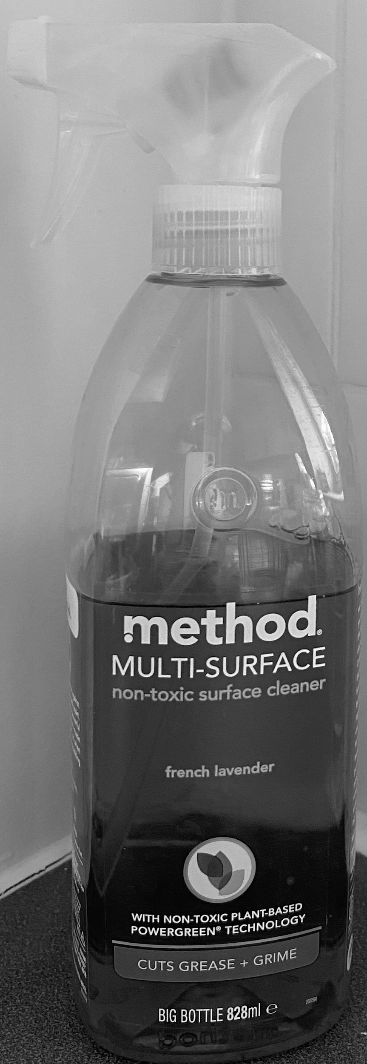
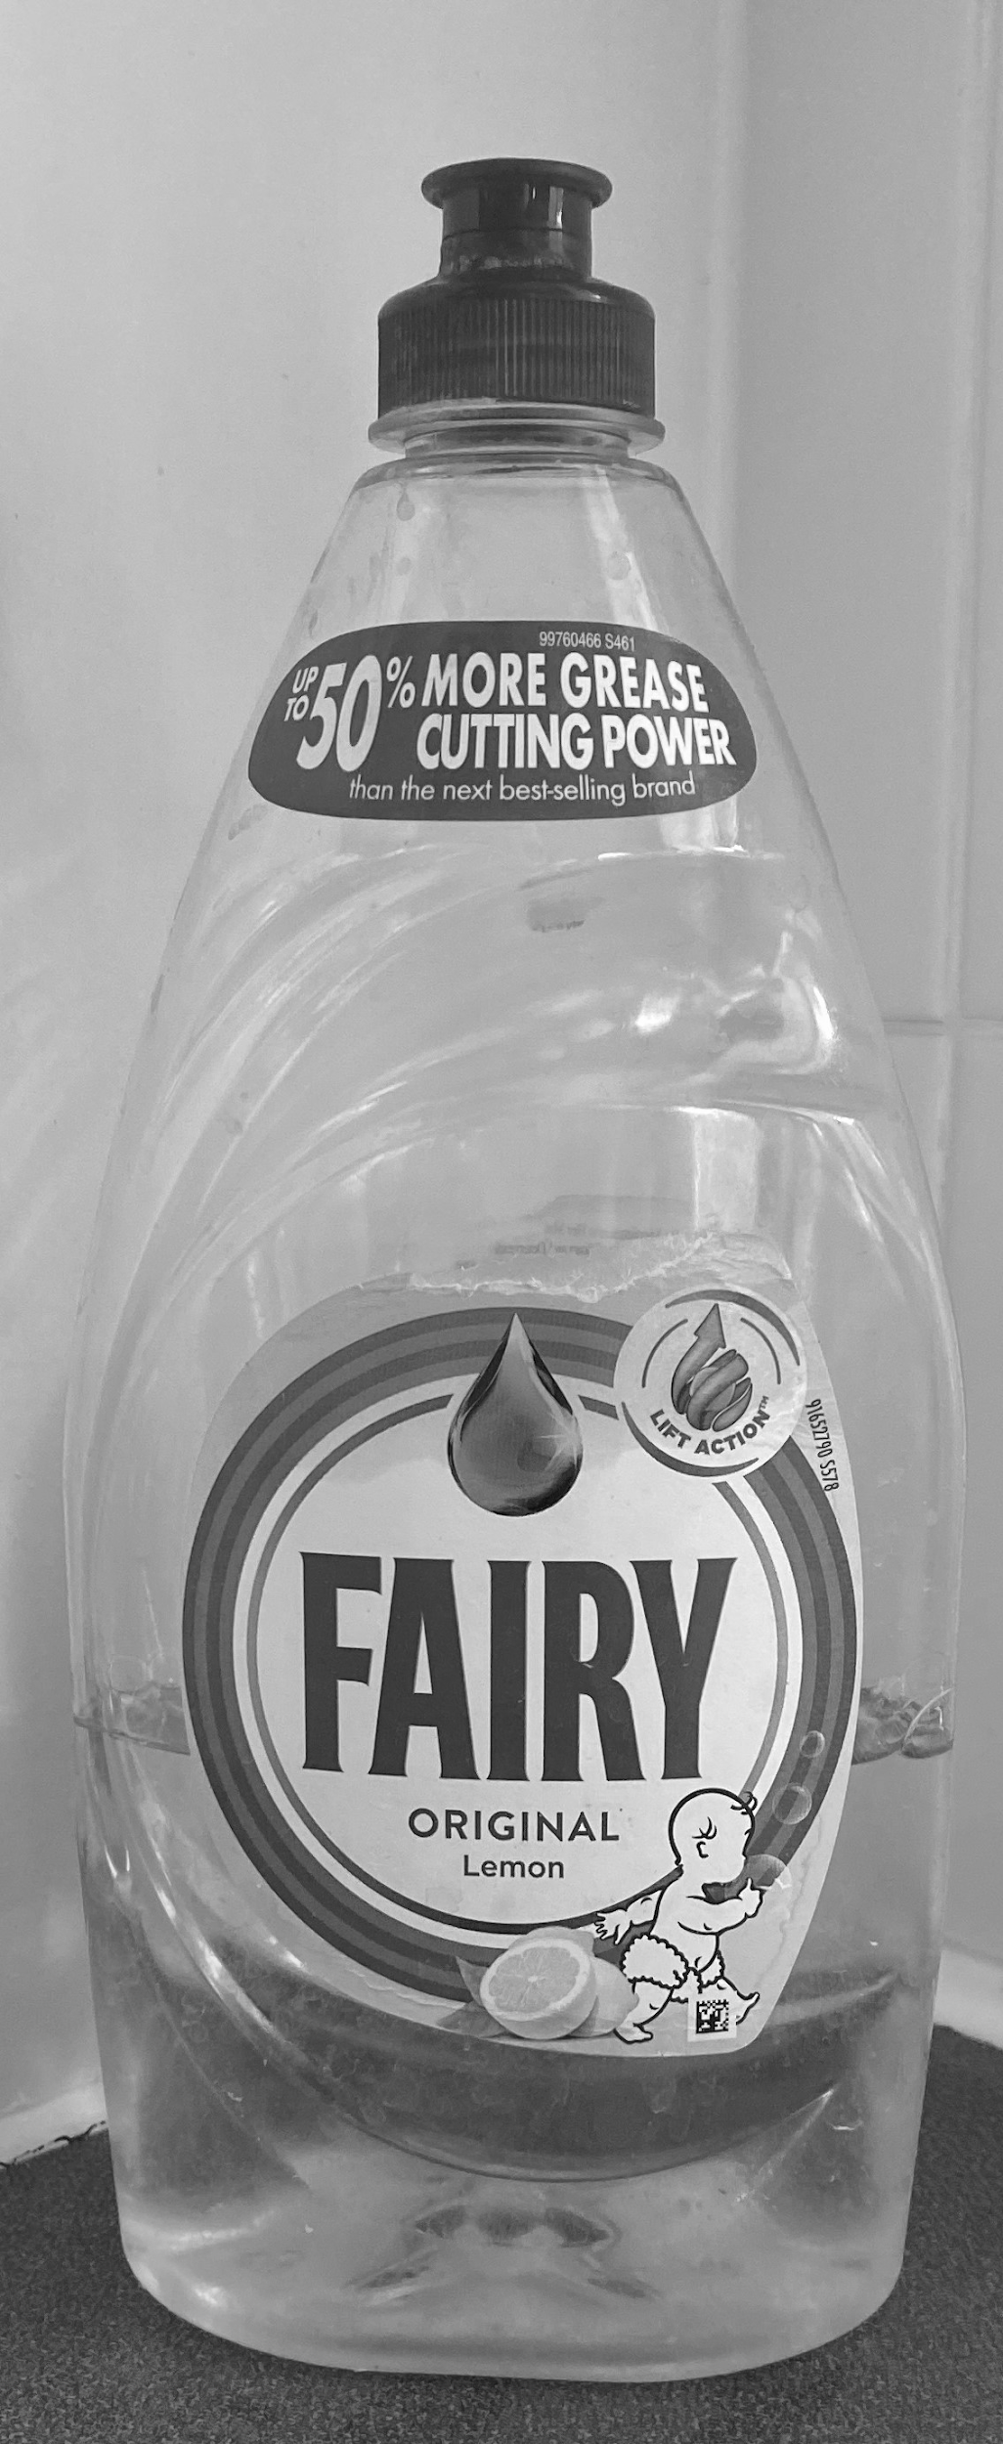
What do we need to clean each area/ item?
Notes:
Discuss;
Why we need different products for different household chores?
Why do we use a different cloth for each job?
Why wouldn’t we use the same cloth?
Can you guess what each product and cleaning tool might be used for?

Slide 13
Now we know how to keep our homes clean, let's make a schedule of your weekly chores.
Monday | Hoover | Wash the dishes
Tuesday | Clean the floors | Wash the dishes
Wednesday | Clean the kitchen | Wash the dishes
Thursday | Dust the furniture | Wash the dishes
Friday | Clean the bathroom | Wash the dishes
Saturday | Wash bath towels | Wash the dishes
Sunday | Wash the bedding | Wash the dishes
Notes:
Discuss;
Frequency of tasks/ How often does each job need doing to keep your home hygienic?
Activity;
Ask learners to have a go at creating their own schedule and following it.

Slide 14
Independent Living Home Management
Hygiene at home
Make it easier
Make it harder
More ideas
Just look at one room, such as the kitchen, or bathroom and how to keep it clean and hygienic.
Ask your parent or guardian to help you while you learn how to wash your towels and sheets using the washing machine.
Think about how you might use a schedule for other things, such as personal hygiene routine, or exercise routines. Have a go at creating another one.
Notes:
Final slide of the lesson. Suggest adaptations for teachers/parents.

Slide 15
Signposting
Independent Living
Building Understanding- Cleaning in the home (Unit 1)

Slide 16
References
Slide 7- Widgit Symbols © Widgit Software 2002-2020
Slide 8- Bedroom, Pexels
Slide 9- Bathroom, Pxfuel
Slide 10- Kitchen, Pixabay
Slide 11- Couch living room, Pixabay
Slide 12- Duster, Publicdomainpictures / Surface cleaner, teachers own / Cloth, Piqsels / Floor cleaner, teachers own / Fairy Liquid, teachers own / Mop, Wikimedia Commons / Spray, teachers own / Sponge, Pxfuel / Cloth, Pxfuel / Washing powder Tide, Pngimg / Lemon Pledge, Mike Motzart, Flickr Attribution 2.0 Generic (CC BY 2.0)
Slide 13- Tick symbol, Pixabay

