Slide 1
Talking about TV programmes [1/3]
Using adjectives to describe plural nouns
Using je préfère vs préféré(e)(s)
French
Madame Clare
Notes:
Bonjour et bienvenue. Je m’appelle Madame Williams. Comment ca-va? In this lesson we are going to start work on the final GCSE theme - social and global issues. Our lesson will focus on discussing healthy and unhealthy lifestyles. I hope you are in a quiet space without distractions, and have a pen and paper or your exercise book to hand.

Slide 2
[ qu ]
?
question
Notes:
The second phoneme we are going to need in today’s lesson is the sound associated with this grapheme. The oi. This grapheme makes a oi sound. Let’s practise this together. ‘Wa’ Écoute. Répete. Excellent.
Let’s look at this in some familiar words which contain this sound.

Slide 3
[ qu ]
que
quatre
[what / that]
musique
Notes:
Phonics practice slide [Presentation slide to practice cluster words.
Phonics template - grapheme in the middle - space for NCELP picture. These words have been chosen based on their frequency and the fact that there are limited other ‘sounds’ within the word. All pictures are copyright free. Timing: 1 minute
Procedure: 1. Say the SSC sound 2. Ask student to repeat (use TL for ‘repeat’). 3. Bring on five CLUSTER words which have the same sound. Ask student to repeat. Then you say each word and leave space for the student to say them after you.

Slide 4
une émission | programme
les actualités | the news
un jeu télévisé | a game’s show
un magazine culturel | a cultural show
divertissant | entertaining
ennuyeux | boring
passionnant | exciting
un animateur / une animatrice | a presenter
le scénario | the plot
en direct | live
Notes:
On the screen, you can see the new vocabulary together. Now, I’ll say the French again, but I will say them out of order. You say the correct translation out loud. If you want to challenge yourself - close your eyes, focus on what I’m saying and say the correct translation out loud.

Slide 5
Adjectives- masculine plural and feminine plural.
Adjective | masculine plural | feminine plural
passionnant (exciting) | passionnants | passionnantes
amusant (amusing) | amusants | amusantes
divertissant (entertaining) | divertissants | divertissantes
intéressant (interesting) | intéressants | intéressantes
marrant (funny) | marrants | intéressantes
barbant (boring) | barbants | barbantes
Notes:
yes - that’s right- they add -es. Please make a note of this table as a summary of what we have just learnt. Mets la vidéo en pause maintenant.

Slide 6
Adjectives- masculine plural and feminine plural.
Adjective | masculine plural | feminine plural
éducatif (educational) | éducatifs | éducatives
sérieux (serious) | sérieux | sérieuses
ennuyeux (boring) | ennuyeux | ennuyeuses
original (original) | originaux | originales
Notes:
-if- ive -eux to -euse al - ales in the feminine. Experience helps to learn them but we do just need to learn them. Please now make a note of this in your books so you have a record of these different adjective endings. Mets la vidéo en pause maintenant.

Slide 7
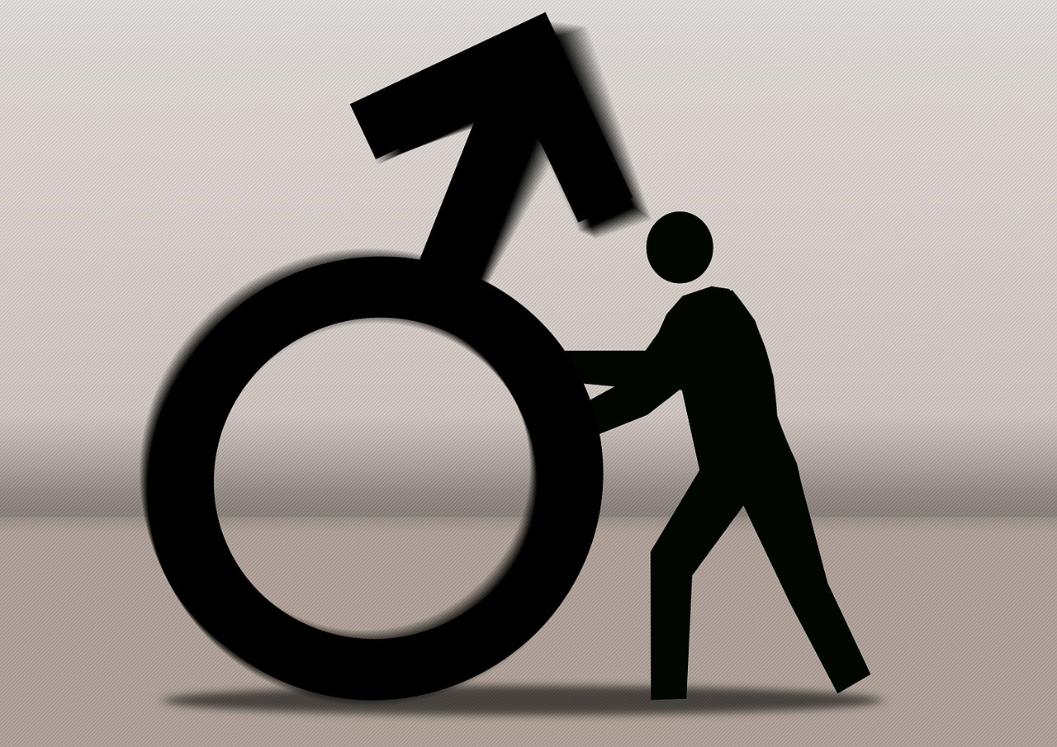
I like sports programmes - they are interesting...
il est - he is
ils sont - they are
masculine noun is
Any masculine plural noun are
elle est - she is
elles sont - they are
feminine noun is
Any feminine plural noun are
Notes:
so now you are feeling more confident with adjectives let's look at how we combine all of this language to form sentences. To do this we need to consider the words is and are in French. Need to mention here that we learn il est as meaning he is. But it can also mean it is - when we are talking about a noun which is masculine. The same is true for elle est. We learn that it means she is - but it also means it is - when we are talking about a noun which is feminine.

Slide 8
Talking about TV programmes (1/3)
Most adjectives in French come ………….. the noun they describe.
2. The spelling of the adjective changes according to the gender of the noun and also whether it is ………………..
3. The plural endings for adjectives that end in -t are:
4. Je préfère means
5. Préféré(e)(s) is an ………………... and means
after
singular or plural
s (masculine)
es (feminine)
I prefer
adjective / favourite
Notes:
It’s time to summarise our learning.

