Slide 1
What are forces?
Worksheet
Science - Forces
Miss Hummel
Notes:
Hi everyone! My name is Miss Hummel and in this lesson we will be answering the question: What are forces?
In this lesson, we will learn what forces are. We will also learn about contact forces and non-contact forces. Finally, we will test our knowledge with some application questions.

Slide 2
Note-taking task:
Write down the definition of a force and write the three things it can do to an object.

Slide 3
Answer this question:
What were the four examples of contact forces?

Slide 4
Answer this question:
What are two examples of non-contact forces?

Slide 5
Match the words
Air resistance
Gravitational force
Friction
Magnetic force
Upthrust
- pushes objects upwards on objects that are in water.
- pulls everything downwards towards the earth.
- acts when something tries to move quickly through air.
- acts between two surfaces that are sliding, or trying to slide, across each other.
- makes magnetic objects attract or repel each other.
Notes:
Air resistance
Gravitational force
Friction
Magnetic force
Upthrust
pushes objects upwards on objects that are in water.
- pulls everything downwards towards the earth.
- acts when something tries to move quickly through air.
- acts between two surfaces that are sliding, or trying to slide, across each other
- which makes magnetic objects attract or repel each other

Slide 6
Answers
Air resistance
Gravitational force
Friction
Magnetic force
Upthrust
- pushes objects upwards on objects that are in water.
- pulls everything downwards towards the earth.
- acts when something tries to move quickly through air.
- acts between two surfaces that are sliding, or trying to slide, across each other.
- makes magnetic objects attract or repel each other.
Notes:
I would now like to see if you can match the names of the groups of mammals with their definitions.
We have placental mammals, monotremes and marsupials.
The first definition is: Hatch from eggs. The babies have to hatch out of an egg before they are prepared to continue growing outside of their mothers. Only two mammals actually lay eggs. These include the echidna, or spiny anteater, and the duck-billed platypus.
The second definition is: Continue to grow inside their mothers' pouches after they are born. Examples include kangaroos, wallabies, possums, sugar gliders, wombats, Tasmanian devils, and koalas.
The third definition is: Are born prepared to continue their growth outside of their mothers' wombs. Examples include humans, elephants, dogs, and cats.
Pause the video to complete the task above.

Slide 7
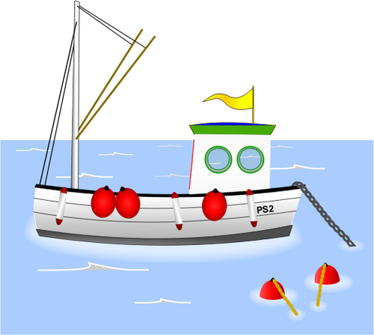
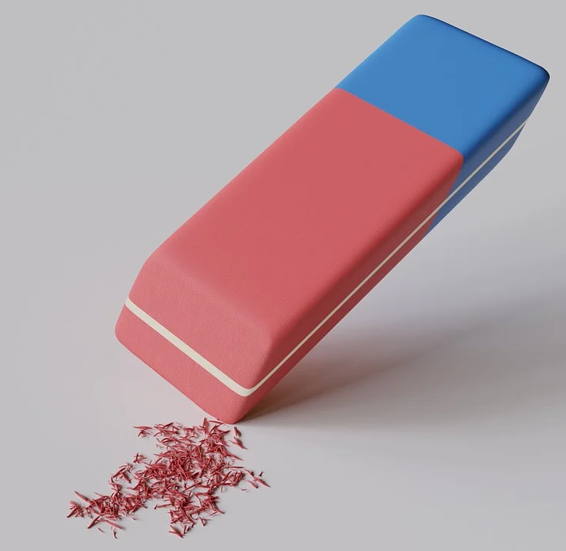
Which force is shown in each of the diagrams below:
🍎
🧔
Pixabay
Public Domain Vectors

Slide 8
Answers:
🍎
🧔
Gravitational force
Friction
Water resistance
Pixabay
Public Domain Vectors

Slide 9
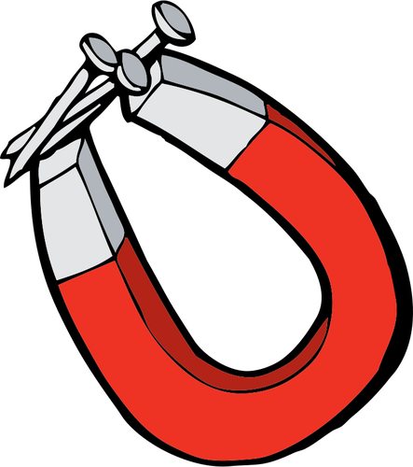
Which force is shown in each of the diagrams below:
Dog by Виталий Плут from the Noun Project
Public Domain Vectors

Slide 10
Answers:
Air resistance
Magnetic force
Dog by Виталий Плут from the Noun Project
Public Domain Vectors

Slide 11
Write down which force you think is acting in each case below and say why:
What has happened | Which force? | Why do think it was that force?
Jenna fell over and scraped the skin on her knee. Which force acted on her skin? | “Friction has acted” | “Because the force was caused by the floor and her knee rubbing against each other”
When Julia’s ball fell into a pond she noticed it did not sink. Which force pushes upwards from the water?
Maryam placed a new fridge magnet onto the side of the fridge and it stayed stuck to the side. Which force keeps it sticking to the fridge?
Thomas has toy soldiers and he noticed that the one with a parachute falls slowly to the ground when he drops them from the top of the stairs when the others fall quickly. Which force slows it down?

Slide 12
Answers:
What has happened | Which force? | Why do think it was that force?
Jenna fell over and scraped the skin on her knee. Which force acted on her skin? | “Friction has acted” | “Because the force was caused by the floor and her knee rubbing against each other”
When Julia’s ball fell into a pond she noticed it did not sink. Which force pushes upwards from the water? | Upthrust
Maryam placed a new fridge magnet onto the side of the fridge and it stayed stuck to the side. Which force keeps it sticking to the fridge? | Magnetic force
Thomas has toy soldiers and he noticed that the one with a parachute falls slowly to the ground when he drops them from the top of the stairs when the others fall quickly. Which force slows it down? | Air resistance

Slide 13
Answer this question:
What are all the forces acting on a boat when it is moving forward in water?

