Slide 1
Calendar and time:
Exploring and discussing time and the seasons
Mathematics
Lesson 1 of 5
Miss. Molnar

Slide 2
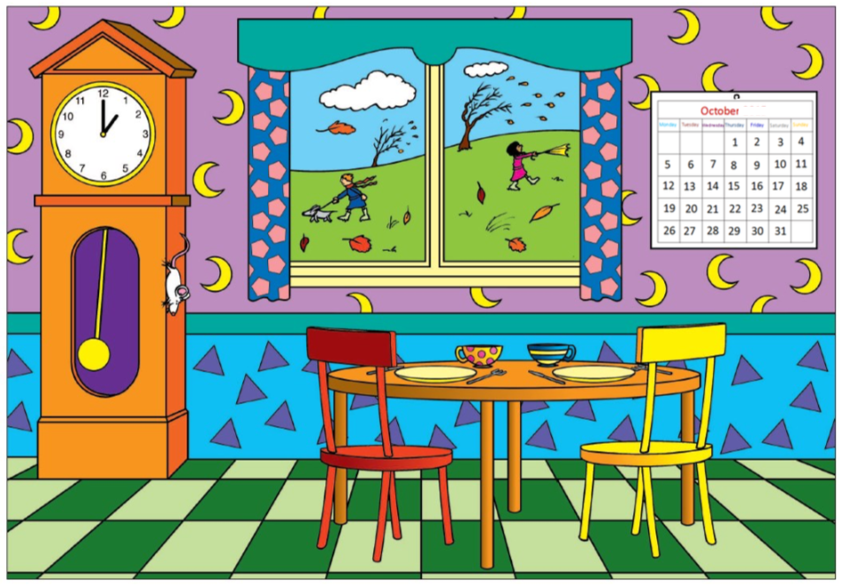

Slide 3
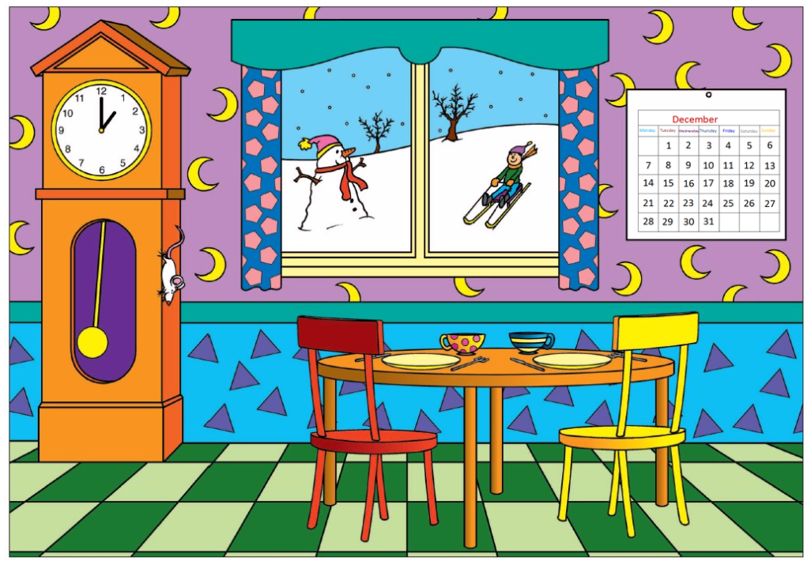

Slide 4
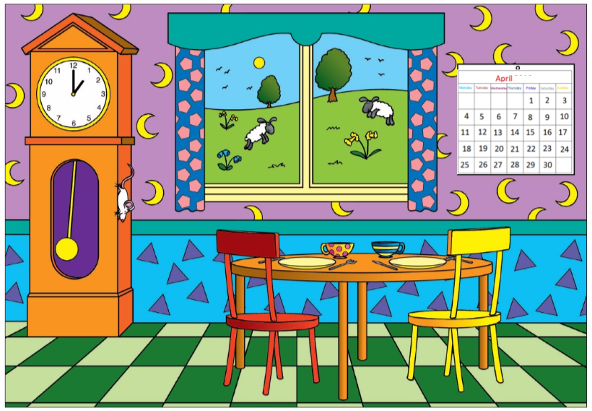

Slide 5
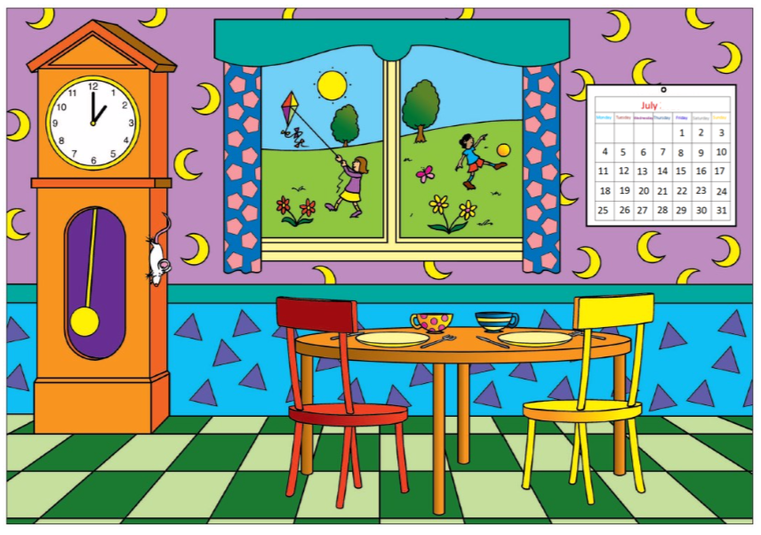

Slide 6
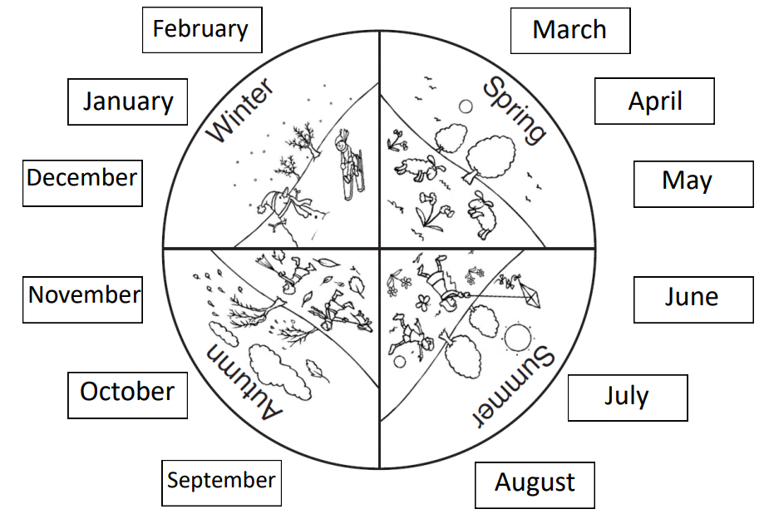
Can you talk about each of the seasons?

