Slide 1
Oak Specialist
Independent Living Unit 1- Home Management
Applying Learning

Slide 2
Unit 1- Home Management
Lesson 1- Using cleaning products
Lesson 2- Hygiene at home
Recognising common cleaning products and warnings on the labels.
Using the correct cleaning product and cloth for the job.
Lesson 3- Reading clothes labels
Option 3
Lesson 4- Organising clothes
Option 4
Identifying key washing symbols and what they mean.
Sorting clothes by category and folding correctly.
Lesson 5- Using the kitchen safely
Option 3
Lesson 6- Reading food labels
Option 4
Recognising different kitchen utensils and appliances, and how to use them safely.
Counting equipment needed and using a visual to set the table.

Slide 3
Lesson 3 - Reading clothes labels

Slide 4
Teacher notes- Lesson 1
Reading clothes labels
Learning Intention: To know how to prepare your clothes for washing and what the main 4 washing symbols on clothes labels mean.
Sort washing into piles ready for washing (whites, darks, colours).
Choose an item of clothing and find the washing label.
Find the washing symbols on the label; what do you think they mean?
Match the washing symbol to its meaning.
Resources needed: Different colour clothes, pen and paper

Slide 5
Home Management
Reading clothes labels
Applying Learning

Slide 6
Lesson Activity Stages
This lesson will be taught in 4 stages:
Sorting our washing into groups by colour.
Finding the washing symbols on our clothes.
Learning the meaning of 4 main washing symbols.
Putting our clothes into the washing machine.

Slide 7
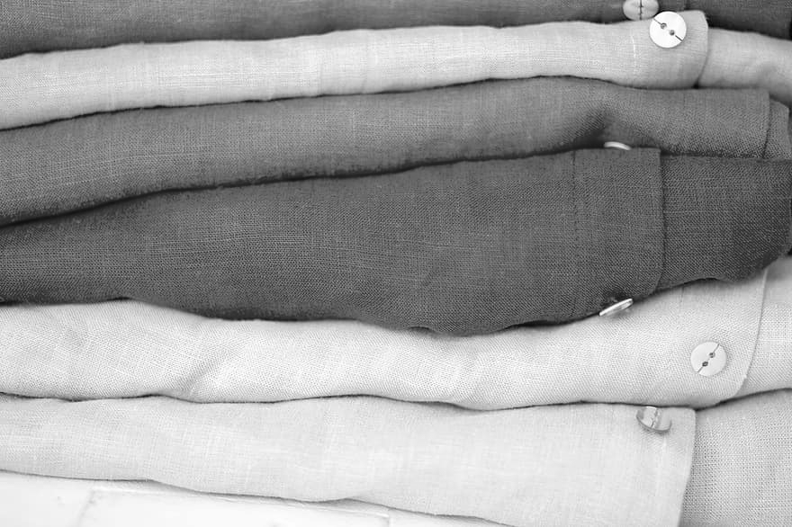
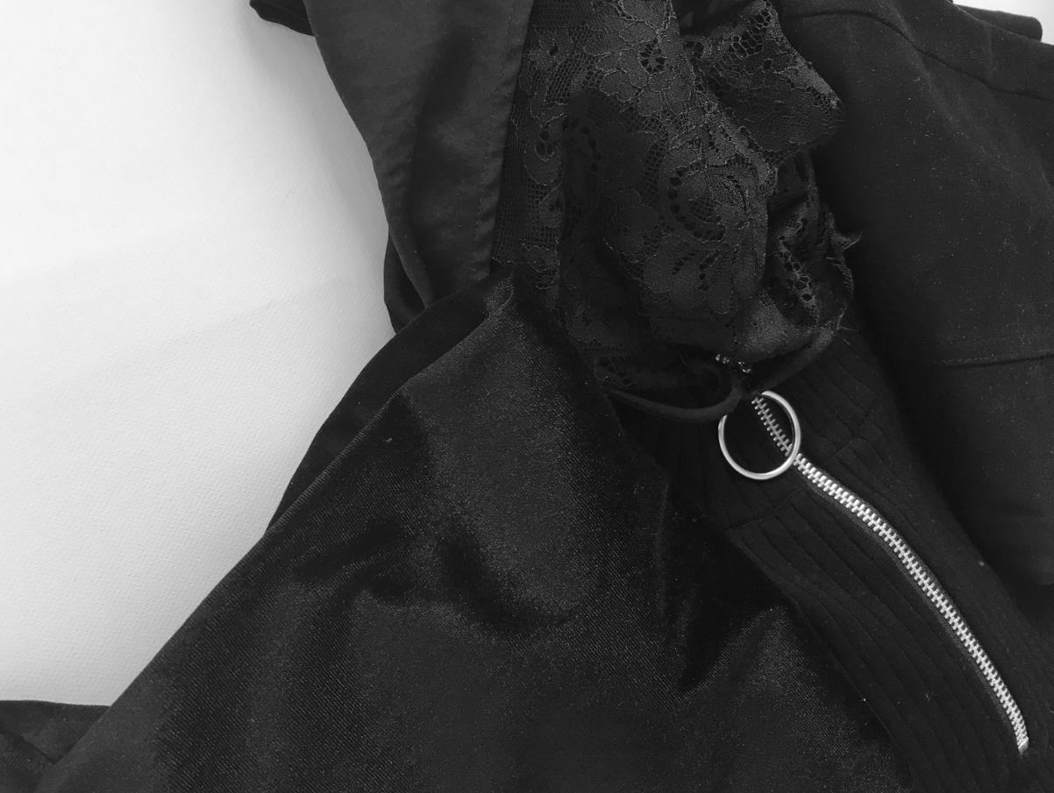
Activity
Begin by sorting your washing into piles by colours. To learn how to do this, Watch the support video on the following slide.
Whites
Colours
Darks
Notes:
Activity;
Sort the washing into piles by colour. (Lights, colours,darks)
Discuss;
Why do we need to do this?

Slide 8
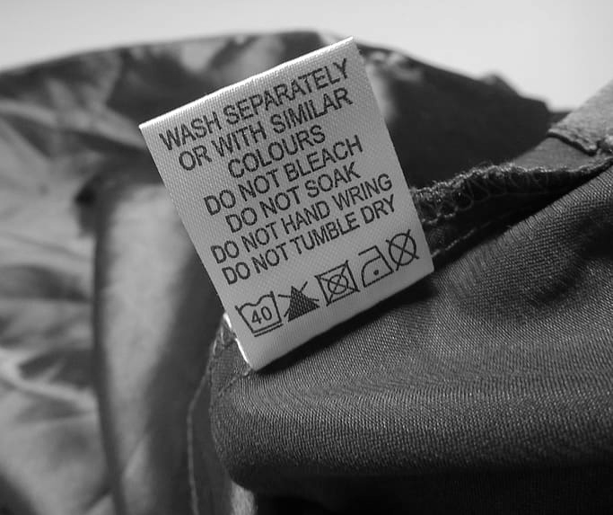
Activity
Choose an item of clothing and find the label. What symbols can you see?
Notes:
Activity;
Find the label on the inside of some of your clothes
Discuss;
What can you see?
What do you think the simbols are for?

Slide 9
Take a look at these 4 washing symbols found on some of your clothes.
1.
2.
3.
4.
Notes:
Discuss;
Look at each symbol individually, what do you think they could mean?

Slide 10
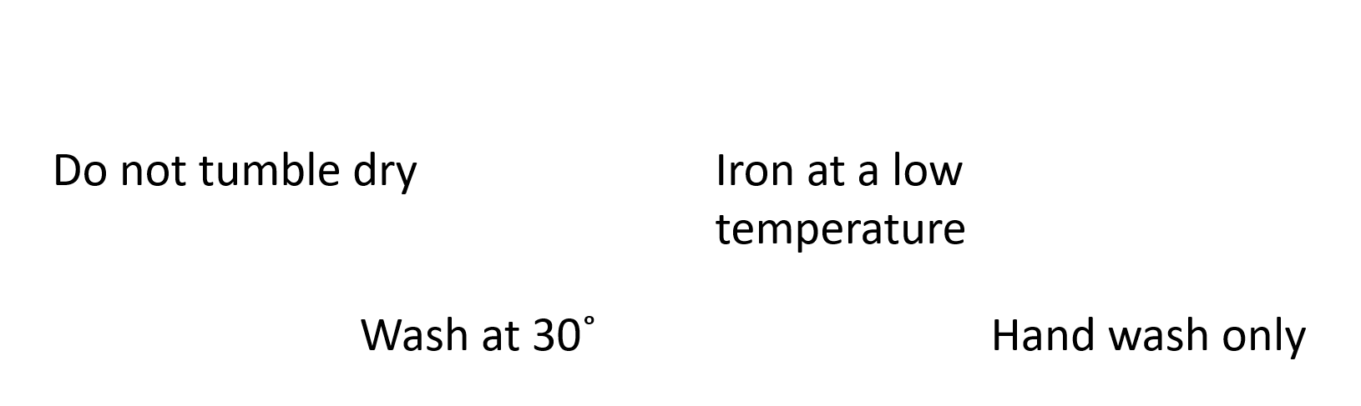
Activity
Can match the symbols with their true meaning.
1.
2.
3.
4.
Notes:
Activity;
Match the symbols with the meaning

Slide 11
Let's check your answers
1.
2.
2.
3.
4.
4.

Slide 12
Independent Living
Applying Learning
Reading labels on clothes
Make it easier
Make it harder
More ideas
Practice sorting your clothes into dark and light colour piles.
Try to find and match one of the washing symbols on the labels of your clothes.
Find the best washing cycle for your clothes on the washing machine.
With parent/carer permission, use google to look up the meaning of some of the other washing symbols on your clothes.
Have a go at hanging your clothes out to dry, ironing them and folding them away.
Try hand washing an item of clothing using the correct washing detergent.

Slide 13
Further learning with Oak National
Independent Living:
Building Understanding- Using a washing machine (Unit 1)
Building Understanding- Organising clothes (Unit 1)

Slide 14
References
Slide 7- White Shirt Bright Free Photo, KaoruYamaoka, pixaby / red, color, clothing, stack, Artist (unknown), pxhere / Materialmix black clothes, Sari Montag, Flickr Attribution 2.0 Generic (CC BY 2.0)
Slide 8- Sign in clothes, clothing, tickets, Pixabay
Slide 9- Washing instructions clothing tag, Pixabay

