Slide 1
Designing and making a savoury salad
Design and technology - Cooking and nutrition: preparing fruit and vegetables
Mrs L Mee

Slide 2
Design ideas: savoury salad
Task
Create a sentence for each to describe the appearance, taste and who the user will be.
Design criteria
Appearance
Taste
User

Slide 3
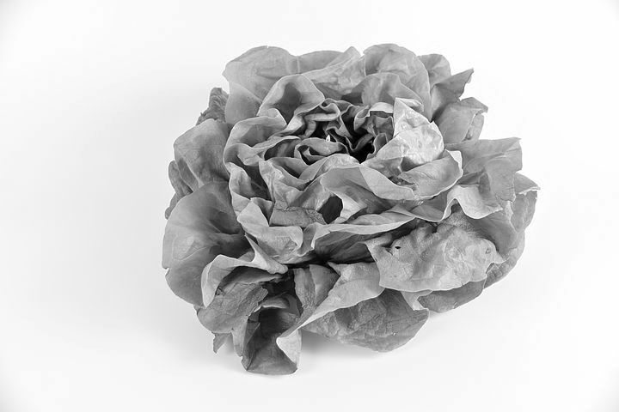
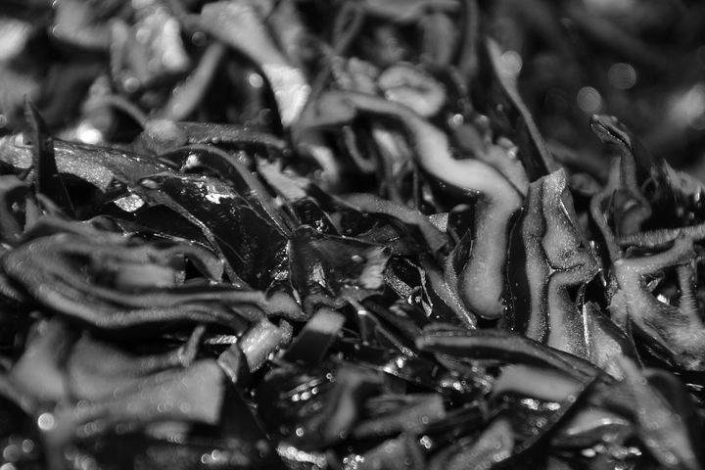
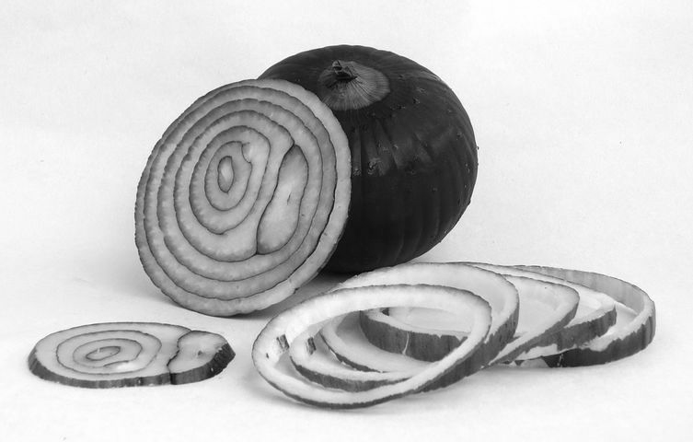
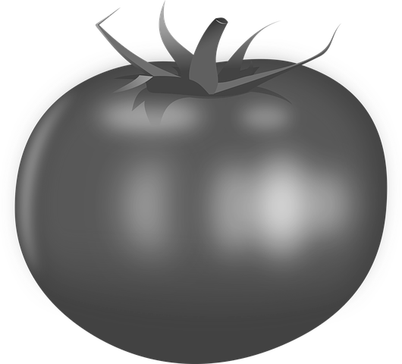
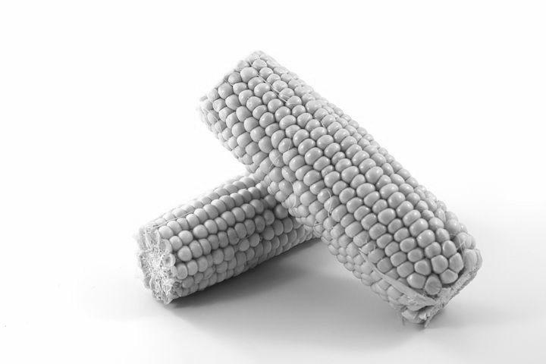
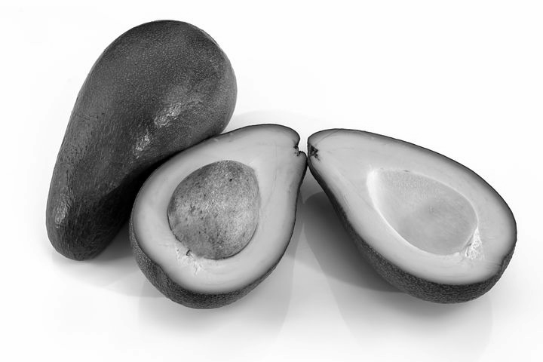
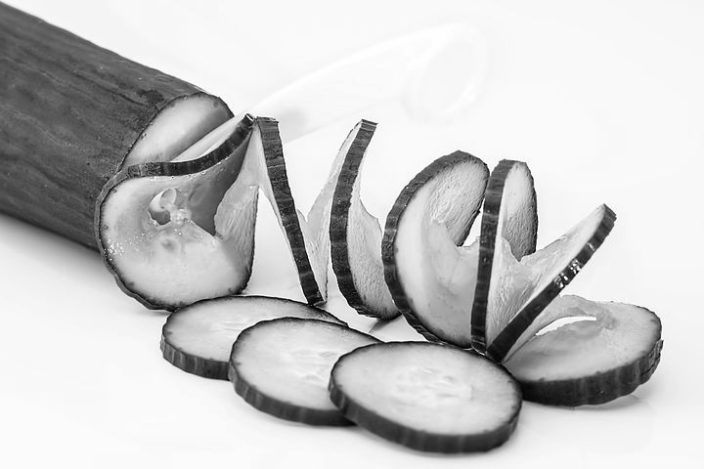
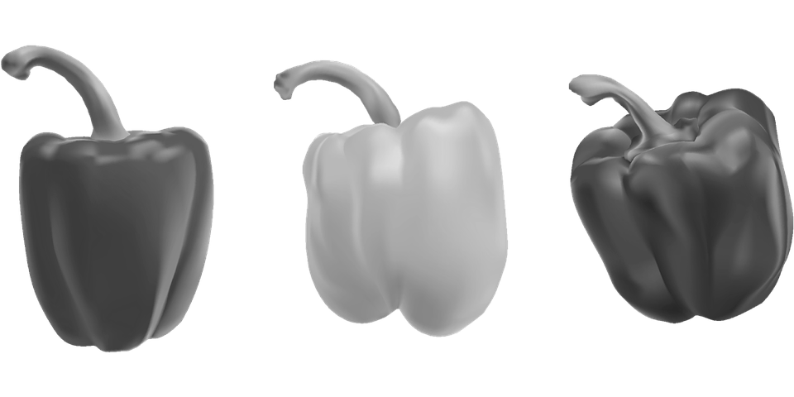
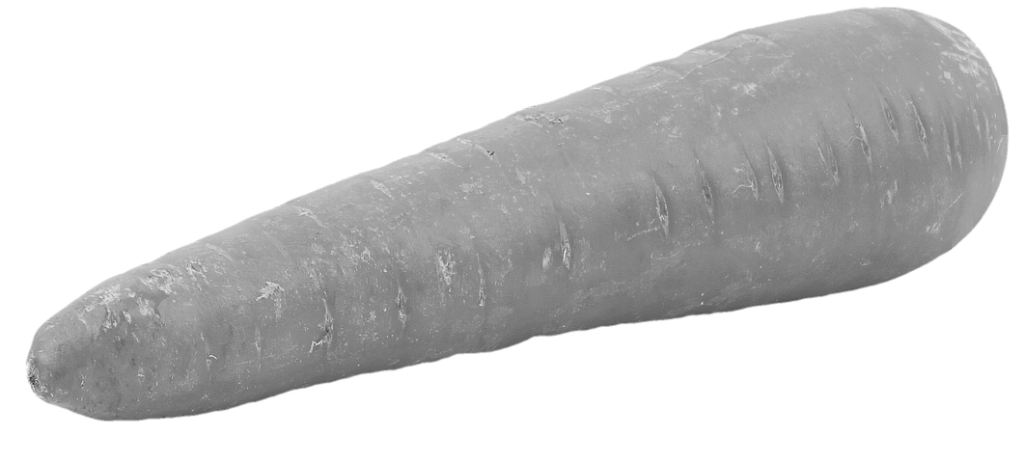
Design ideas: savoury salad
Now we are going to create our own idea for a savoury salad. Have a look at the images below and select which ingredients you would put into your savoury salad.

Slide 4
Design ideas: savoury salad
You can list your ingredients or place images below
Savoury salad
Ingredients for my salad

