Slide 1
Numbers within 15
Counting up to 15 objects and putting them in order
Mathematics
Independent Task
Mrs Khaira

Slide 2
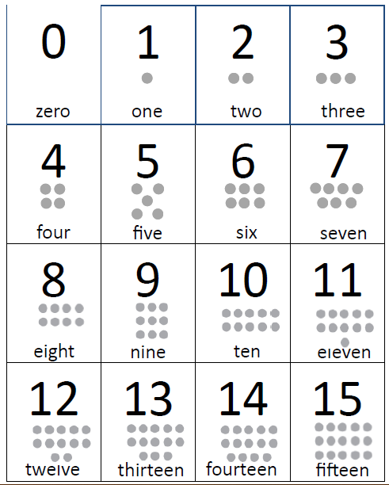
Activity 1

Slide 3
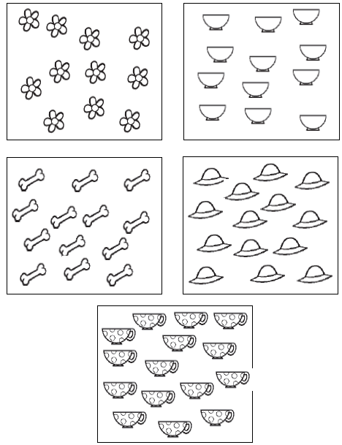
Activity 1
Notes:
Number track
Countable resources (cubes, counters, toys)

Slide 4
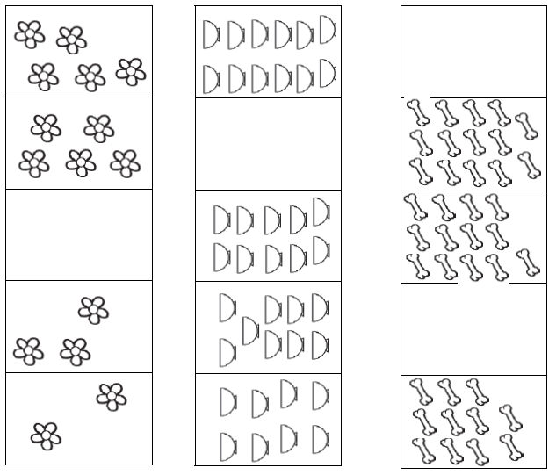
Activity 2
Notes:
Number track
Countable resources (cubes, counters, toys)

