Slide 1
Structures and Bonding
Metallic Bonding
Worksheet
Combined Science - Chemistry - Key Stage 4
Mr Robbins

Slide 2
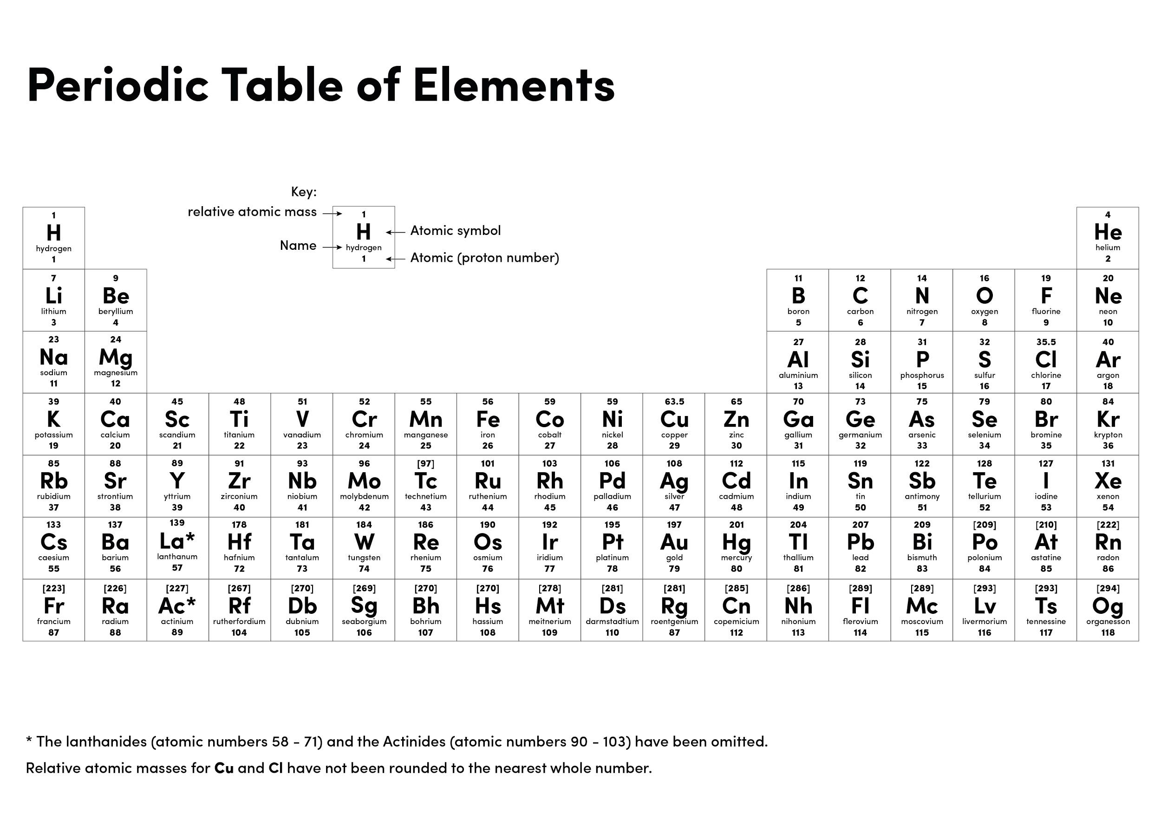

Slide 3
Element 1 | Element 2 | Type of bond
Sodium | Sodium | Metallic
Carbon | Silicon | Covalent
Carbon | Carbon
Oxygen | Lithium
Silver | Fluorine
Magnesium | Chlorine
Magnesium | Calcium
Beryllium | Nitrogen
Phosphorous | Oxygen
For each of the elements below, state which type of bond would be formed. The first two have been done for you.
Explain how the particles are held together in a metal

Slide 4
3. Explain why metals have high melting and boiling points
4. Copper is used to make wires for household circuits. Give two reasons why.
5. Explain why graphite can conduct electricity
6. Explain why most covalent substances do not conduct electricity
7. State the conditions under which an ionic substance will conduct electricity
8. Define malleable
9. Explain why sodium atoms and potassium atoms cannot form ionic bonds
10. Challenge: which of sodium or magnesium do you think has the highest melting point? Explain your answer.
11. Explain how electricity is conducted in a metal. To gain full marks you must include a description of the structure and bonding of a metal. (4)
12. Describe how the structure of an alloy is different from the structure of a pure metal. (2)
13. Suggest one reason why coins are not made of pure copper. Do not give cost as a reason. (1)
14. Iron is used (as steel) to make the body panels for cars. Explain how the structure and bonding of iron:
a. allows the body panels to conduct electricity;
b. allows the body panels to be bent into shape;
c. gives the body panels strength.

Slide 5
Answers
1. See right
2. Layers of positive metal ions with a sea of delocalised electrons held together by electrostatic interaction between positive ions and negative electrons
3. the electrostatic force between the delocalised electrons and metal ions is strong
4. It is malleable and conducts electricity
5. Delocalised electrons are free to move through the graphite
6. They do not have free ions or delocalised electrons to carry charge
7. (l) or (aq)
8. Easy to bend into shape
9. They both need to lose electrons
10. Magnesium, more electrons in the sea of delocalised and greater positive charge on the ion means greater strength of electrostatic attraction and more energy required to break
11. Layers of positive metal ions with a sea of delocalised electrons held together by electrostatic interaction between positive ions and negative electrons. Delocalised electrons can move through the metal and carry charge
12. It has different sized atoms which disturb the layers
13. They would be too soft/would corrode too easily
14. –
a. Delocalised electrons free to move through the metal
b. Malleable as layers can slide over each other
c. Strong force of electrostatic attraction between metal ions and delocalised electrons
Sodium | Sodium | Metallic
Carbon | Silicon | Covalent
Carbon | Carbon | Covalent
Oxygen | Lithium | Ionic
Silver | Fluorine | Ionic
Magnesium | Chlorine | ionic
Magnesium | Calcium | Metallic
Beryllium | Nitrogen | Ionic
Phosphorous | Oxygen | Covalent

Slide 6
Independent practice
Metals are used to make a saxophone because they are….
Metals are used bridges because they are….
Metals are used in frying pans because they are…..
Metals are used in jewellery because they are…
Metals are used in electrical cables because they are….

Slide 7
Independent task
Metals bond by ______________ bonding. Each atom donates the ______________ in its outside shell forming an _____________. The electrons are ___________________ which means they are able to move freely around. The metal ions and the delocalised electrons are attracted together by ______________________ attraction because they have _______________ charges. The structure formed is a giant _______________ lattice.

Slide 8
Independent task
Why are pure metals soft?
What happens when we make an alloy?
Why is an alloy harder than the pure metal?

