Slide 1
Lesson 5: Drawing Designs
Selection In Physical Computing
Computing
Andy Bush
Materials from the Teach Computing Curriculum created by the National Centre for Computing Education

Slide 2
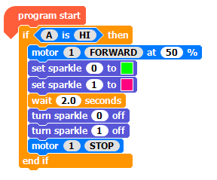
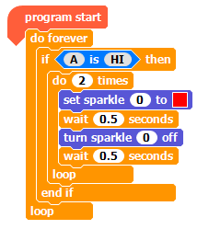
Task 1 - Review
Program 1
Program 2
Source:
Crumble software
Does one or both of the programs above:
Use three output devices?

Slide 3
Task 1 - Review
Program 1
Program 2
Source:
Crumble software
Does one or both of the programs above:
Use a count-controlled loop?

Slide 4
Task 1 - Review
Program 1
Program 2
Source:
Crumble software
Does one or both of the programs above:
Use selection?

Slide 5
Task 1 - Review
Program 1
Program 2
Source:
Crumble software
Does one or both of the programs above:
Use a loop to repeatedly check if a condition is met?

Slide 6
Task 2 - If… Then...
Use the If… Then… structure to write an algorithm to show how selection might be used in an automated house.
Identify the condition
Identify the action(s)
Identify the number of times the condition will be checked
Source: Pixabay

Slide 7
Task 3 - Design
Use selection to control a model of a carousel that uses at least two output devices
What materials and equipment do you need?
Which two output devices will you use? sparkle sparkle motor
How will your model use selection?
Draw a labelled diagram of your model.
Construct a wiring diagram showing how the Crumble and output devices will be connected

Slide 8
Task 4 - Build you model
Follow your design and build a model carousel.
Add in the Crumble components as shown in your design.

