Slide 1
Healthy vs unhealthy lifestyles [1 / 2]
Devoir + infinitive
Pour + infinitive
French
Madame Williams

Slide 2
[SFC]
c r f l
Be c a r e f u l with these!

Slide 3
[SFC]
dans
X

Slide 4
[SFC]
petit
grand
mot

Slide 5
[oi]
voir

Slide 6
trois
droite
[oi]
Pourquoi ?
[why?]

Slide 7
la santé | health
être en forme | to be in shape (physically)
éviter | to avoid
sainement | healthily
être sain | to be healthy
un régime équilibré | a balanced diet
se droguer | to take drugs
grossir | to put on weight
perdre du poids | to lose weight
fumer | to smoke

Slide 8
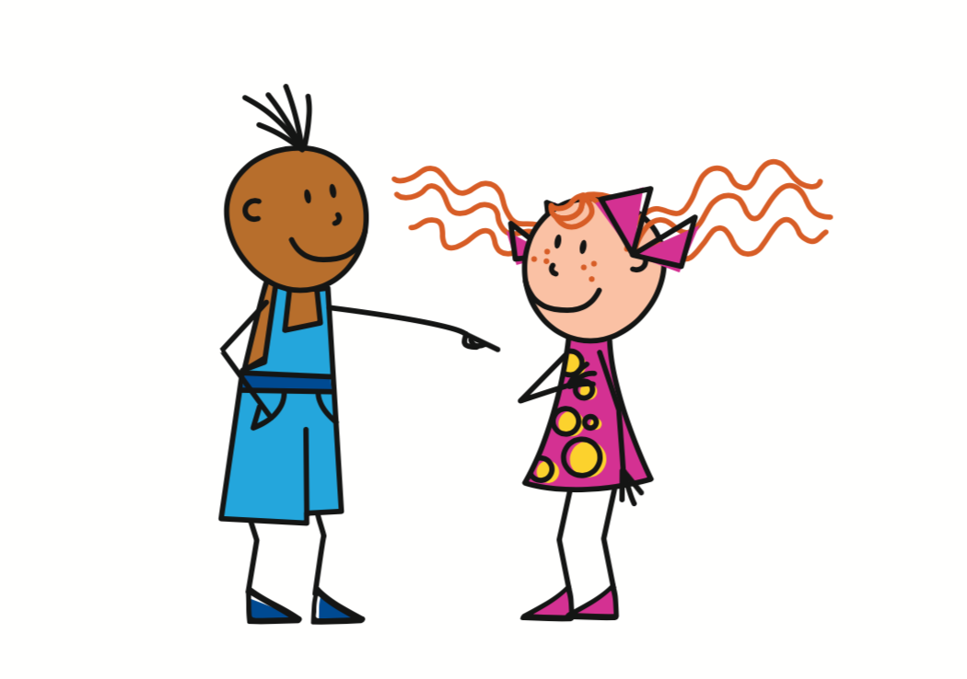
Devoir
- have to / must (irregular verb)
Tu dois
= You must, have to
On doit
= You must, have to
To refer to one specific person
To refer to people in general
Use devoir with an infinitive to say what someone must do:
Tu dois faire de l’exercice = You (specific) must do some exercise.
On doit faire de l’exercice = You (general) must do some exercise.

Slide 9
Pour
The word pour has two meanings in French.
Je vais aller pour deux semaines
=
I am going to go for two weeks
Pour rester en forme…
=
(In order) to stay in shape

Slide 10
Healthy vs unhealthy lifestyles
The verb devoir means
I must =
You (specific) must =
You (general) must =
The verb devoir is followed by the
This form of the verb ends in
have to / must
je dois
tu dois
on doit
infinitive
er, ir, re

