Slide 1
Lesson 7 - Investigating Elastic Objects
Physics - KS3
Forces in Action
Mrs Wolstenholme

Slide 2
Elastic Deformation
Elastic deformation: an object returns to its original shape when forces are removed
Elastic object: undergoes elastic deformation
Could be stretching or compressing
Notes:
Examples: stress ball, hair band
WHen an object changes shape we say there has been deformation.
A force causes this deformation.
When the force is removed, if the object returns to its original shape, we call it elastic.
If it does not return to its original shape we call it plastic deformation. E.g. blue tack or if you just break something, it cant go back to so it has been plastically deformed.

Slide 3
Which of these is an elastic object?
Option 1
Option 2
Plank of wood
Brick
Option 3
Option 3
Option 4
Option 4
Spring
Glass

Slide 4
Elastic deformation is when an object …….
Option 1
Option 2
changes shape permanently.
breaks.
Option 3
Option 3
Option 4
Option 4
returns to its original shape when the force is removed.
never changes shape.

Slide 5
Two examples of elastic deformation are:
Option 1
Option 2
Compressing
Stretching
Option 3
Option 3
Option 4
Option 4
Hiding
Breaking

Slide 6
Complete the task
Elastic deformation
What happens to an object undergoing elastic deformation when the forces are removed?
What type of deformation does an elastic object undergo?
Could be stretching or __________
Resume once you’re finished

Slide 7
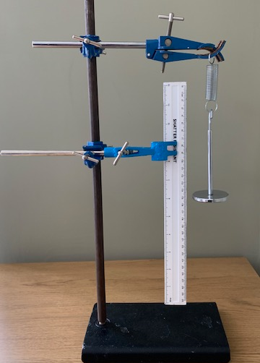
Investigate how force affects the extension of the spring
Spring
Mass
Ruler
Clamp stand
Credit: Andy Saville
Notes:
Make sure you mention independant, dependant control variable

Slide 8
Why do I line the zero on my ruler up with the bottom of the spring?
Option 1
Option 2
So that I am measuring the length of the spring
So that I am measuring the extension of the spring
Option 3
Option 3
Option 4
Option 4
So that the wind doesn’t move the spring
So that it is easier to see the spring

Slide 9
Why do I repeat?
Option 1
Option 2
For fun!!
To make sure my results are reproducible
Option 3
Option 3
Option 4
To help me spot anomalies

Slide 10
Variables
Independent variable (the one we change)
The force on the spring
Dependant variable (the one we measure)
The extension of the spring
Control variable ( the ones we keep the same)
The spring, the position of the ruler
Credit: Andy Saville

Slide 11
In this investigation, the independent variable is:
Option 1
Option 2
Extension of the spring
Position of the ruler
Option 3
Option 3
Option 4
Option 4
The spring
Force on the spring

Slide 12
In this investigation, the dependent variable is:
Option 1
Option 2
Extension of the spring
Position of the ruler
Option 3
Option 3
Option 4
Option 4
The spring
Force on the spring

Slide 13
In this investigation, the control variables are:
Option 1
Option 2
Extension of the spring
Position of the ruler
Option 3
Option 3
Option 4
Option 4
The spring
Force on the spring

Slide 14
The independent variable is:
Option 1
Option 2
The one we change
The one we ignore
Option 3
Option 3
Option 4
Option 4
The one we measure
The ones that stay the same

Slide 15
The dependent variable is:
Option 1
Option 2
The one we change
The one we ignore
Option 3
Option 3
Option 4
Option 4
The one we measure
The ones that stay the same

Slide 16
On your own:
Independent variable (the one _________)
The:
Dependant variable (the one ____________)
The:
Control variable ( the ones _____________)
The:
Credit: Andy Saville

Slide 17
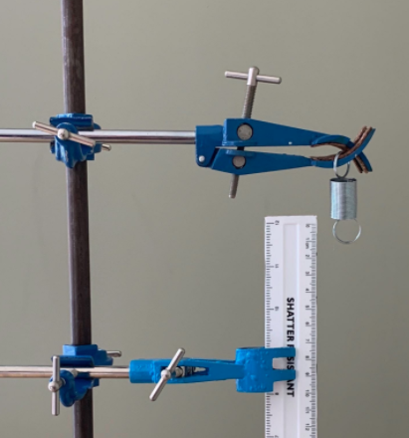
1. Hang a spring off a clamp and stand and clamp a ruler so the zero line is lined up with the bottom of the spring​
Credit: Andy Saville

Slide 18
2. Add 100 g mass on the bottom of the spring
3. Record the measurement from the base of the spring​
Force (N) | Extension (cm)
 | 1 | 2 | 3 | Mean
0 | 0
1 | 12
2
3
4
Credit: Andy Saville

Slide 19
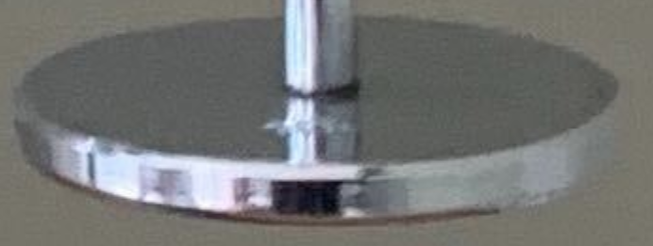
4. Continue to add 100 g masses and record the extension until you reach 800 g
Force (N) | Extension (cm)
 | 1 | 2 | 3 | Mean
0 | 0
1 | 12
2 | 24
3 | 36
4 | 48
Credit: Andy Saville

Slide 20
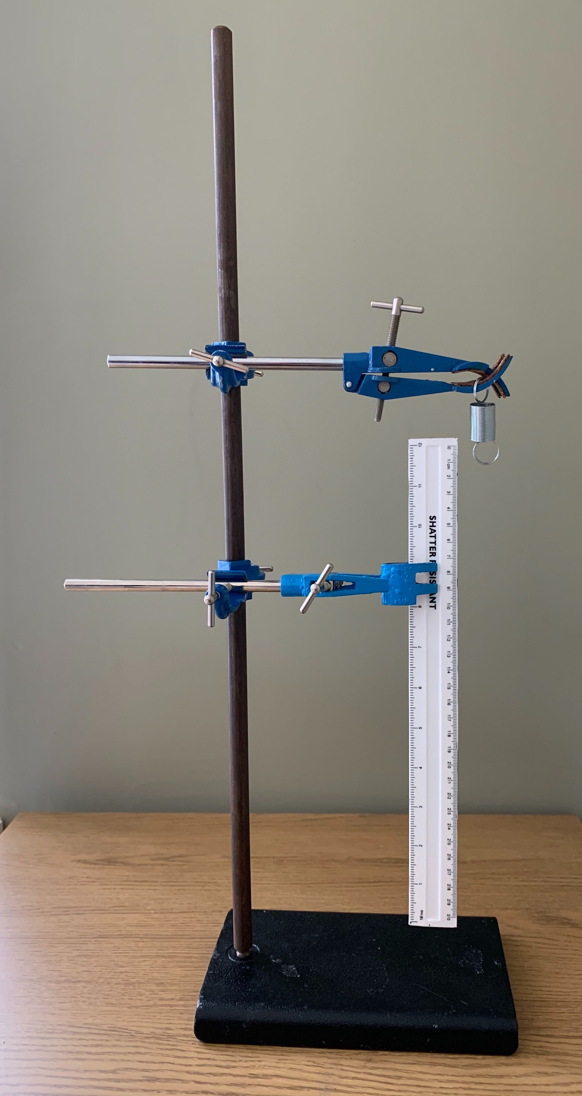
5. Remove the masses and repeat twice
Force (N) | Extension (cm)
 | 1 | 2 | 3 | Mean
0 | 0 | 0 | 0
1 | 12 | 12 | 13
2 | 24 | 24 | 26
3 | 36 | 36 | 39
4 | 48 | 50 | 50
Credit: Andy Saville

Slide 21
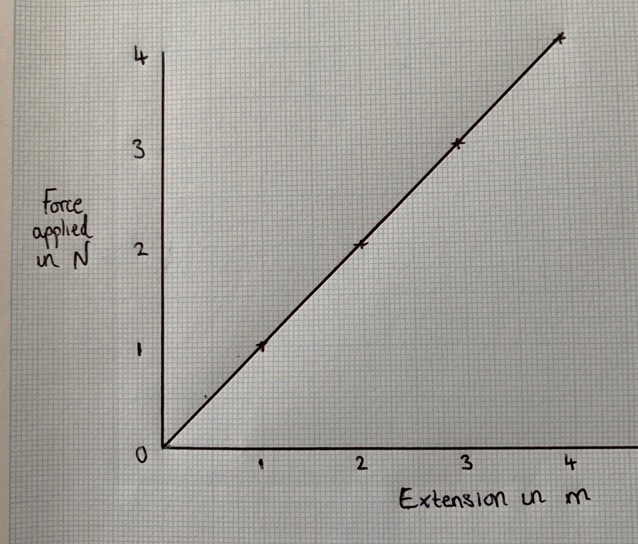
6. Plot a force vs Extension graph
Extension (cm)

Slide 22
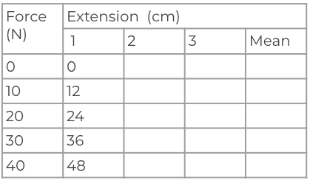
Method writing practice
Credit: Andy Saville
1
1. Hang a _______ off a clamp and stand and clamp a ruler so the ______ line is lined up with the ________ of the spring​
3
2
3. Record the measurement from the ________ of the spring​
2. Add ______ _________ on the bottom of the spring

Slide 23
Method writing practice
4
5
4. Continue to ________________ and record the ___________ until you reach ___________ g
5. _________ the masses and ___________ twice
6
Extension (cm)
6. __________ a force vs Extension graph
Credit: Andy Saville

Slide 24
Method writing practice
1
3
2
4
5
6
Extension (cm)
Credit: Andy Saville

