Slide 1
Structures and Bonding
Solids, Liquids and Gases
Worksheet
Combined Science - Chemistry - Key Stage 4
Mr Robbins

Slide 2
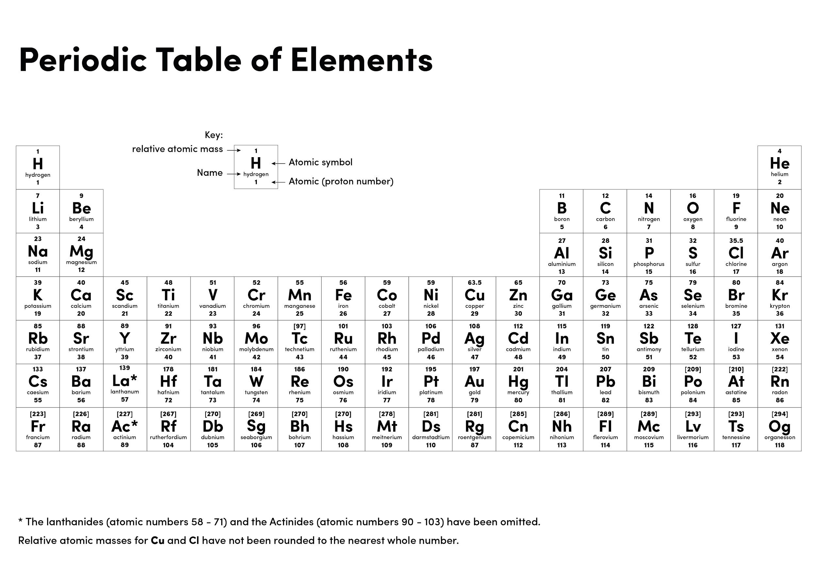

Slide 3
The table gives the melting points and boiling points of some elements.
a) What state is neon in at −247 °C?
b) What state is zirconium in at 2500 °C?
c) Which elements in the table are liquids at 2000 °C?
d) Which elements in the table are gases at 4000 °C?
e) Which elements are solids at −100 °C?
f) By using the data in the table which elements are most likely to be metals? Explain your answer.
g) David says “If an element has a high melting point then it must be because the atom is very heavy” Do you agree. Give a reason for your answer.
h) HT only. Why is the particle model not accurate when used for some substances?
Element | Melting point (°C) | Boiling point (°C)
Boron | 2076 | 2550
Neon | −249 | −246
Niobium | 2469 | 4927
Zirconium | 1855 | 4371
Yttrium | 1522 | 3337

Slide 4
Answers
Liquid
Liquid
Zirconium, Yttrium
Yttrium, Neon, Boron
Boron, Niobium, Zirconium, Yttrium
Boron, Niobium, Zirconium, Yttrium. All have high melting and boiling points
I do not agree. It is to do with the strength of bonds or forces of attraction between the particles
It assumes particles are perfect spheres, dense and have no attractive forces between them

Slide 5
Quick check
 | How are the particles arranged? | How do the particles move?
Solid
Liquid
Gas

Slide 6
Independent task
When the particles of a solid are heated they begin to vibrate __________. We register this as a change in ____________________. When it reaches the melting point the temperature does not ______________. The energy is used to overcome some of the _________________ forces between the particles. When it has completely melted the temperature begins to ___________ again.
When the boiling point is reached the ___________________ remains constant. The energy is used to overcome more intermolecular _________ allowing the particles to escape into the ___________ phase

Slide 7
Quick check
Na₂S₂O₃(s) + 2HCl(aq) → 2NaCl(aq) + H₂O(l) + SO₂(g) + S(s)
List the solids
How many liquids are there?
What is the formula of the gas
Which substance is in solution before the reaction begins?

