Slide 1
Talking about hobbies [2/ 2]
Using the imperfect tense for 3rd person singular and plural
When to use the imperfect to say ‘used to’ vs ‘was doing’
French
Madame Clare
Notes:
Take the title for the lesson from the context column of the SOL. Take the grammar focus from the grammar column. Show full green screen to start with and then bring in your face in the top right hand corner.
E.g. In this first lesson. ‘talking about sports,’ we will be looking at when to use je joue and when to use je fais. We will also be looking at the words that follow je fais and how to use them correctly

Slide 2
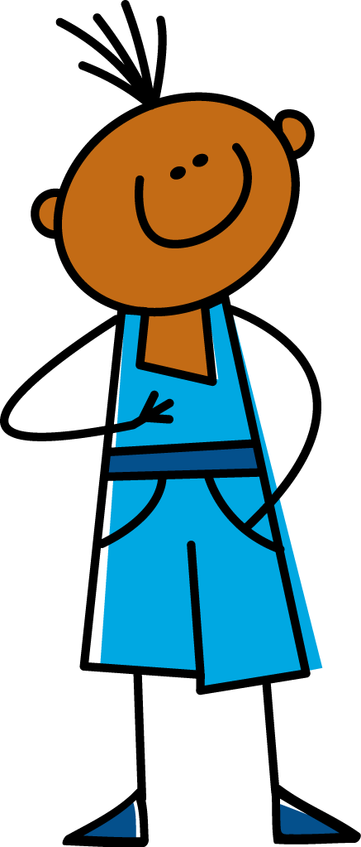
[ e ]
[ é ]
je
écrire
Notes:
Using a similar set of instructions when introducing two corresponding sounds next to one another. Then build a slide from the template slide where students can practise the difference in high frequency words.

Slide 3
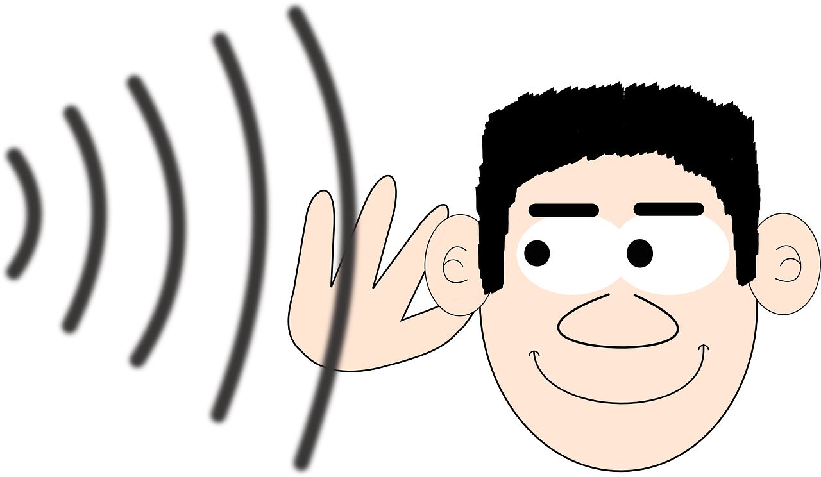
[ é ]
[ é ]
préférer
écouter
Notes:
Using a similar set of instructions when introducing two corresponding sounds next to one another. Then build a slide from the template slide where students can practise the difference in high frequency words.

Slide 4
[ ai ]
vrai
Notes:
The second phoneme we are going to need in today’s lesson is the sound associated with this grapheme. The oi. This grapheme makes a oi sound. Let’s practise this together. ‘Wa’ Écoute. Répete. Excellent.
Let’s look at this in some familiar words which contain this sound.

Slide 5
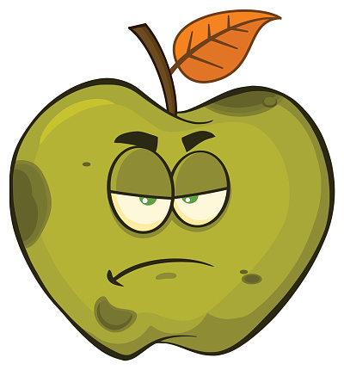
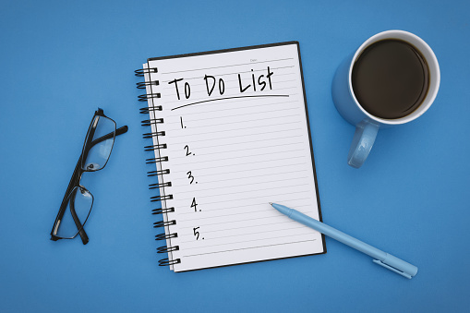
[ai]
français
mauvais
fais
Notes:
Let’s look at some more examples. Here’s our first example word - the word for French. We pronounce this word as ‘français’ Can you say this word aloud? Écoute et répète; français. What about this example the French word for ‘since’ or ‘for’. We pronounce this word as depuis. Can you say this word aloud? Écoute et répète. Our final example is the word for does or did. We pronounce this word as ‘fait’. Can you say this word aloud? Écoute et répète. ‘Fait’ The t is not pronounced
You could also ask the students how they would pronounce these words. Then say dis-moi! Then give them the feedback.

Slide 6
souvent | often
soudainement | suddenly
quand | when
lorsque | while
auparavant | before / in the past
autrefois | in times gone by
hier | yesterday
la semaine dernière | last week
l’année dernière | last year
il y a …… ans | …… years ago
Notes:
Min font size = 28 for the words on the slide. Nothing below the acorn.
On the screen, you can see the new vocabulary together. Now, I’ll say the French again, but I will say the words out of order. You say the correct translation out loud. If you want to challenge yourself - close your eyes, focus on what I’m saying and say the correct translation out loud.
Then go through some of the words - you don’t need to go through all 10 words - between 5 - 8 is fine.
LE.g. les grands événements
E.g. les grands événements

Slide 7
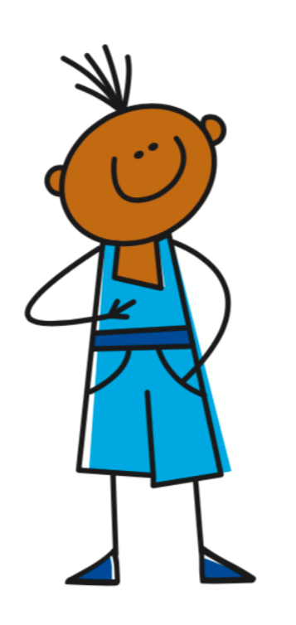
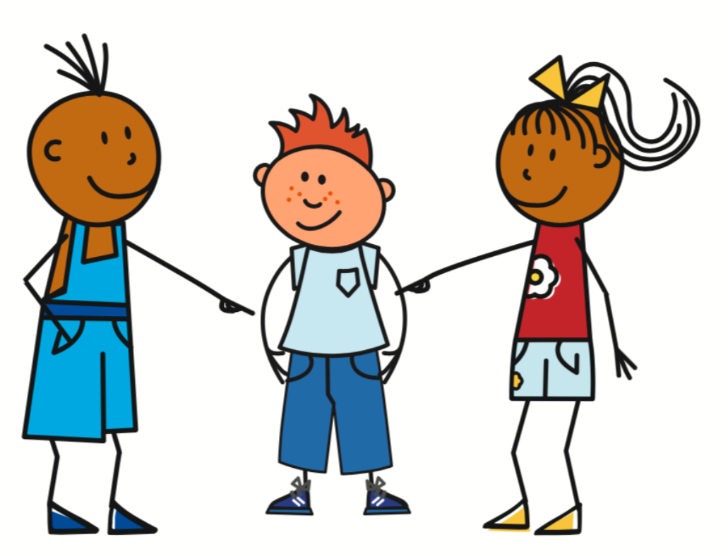
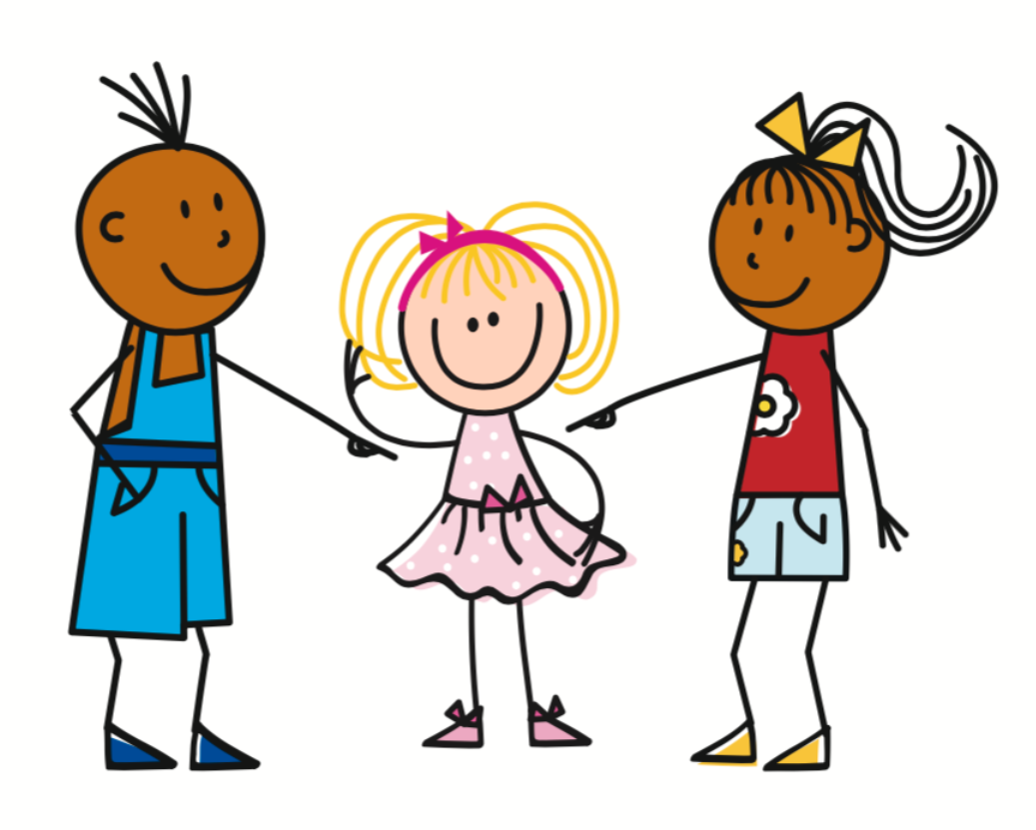
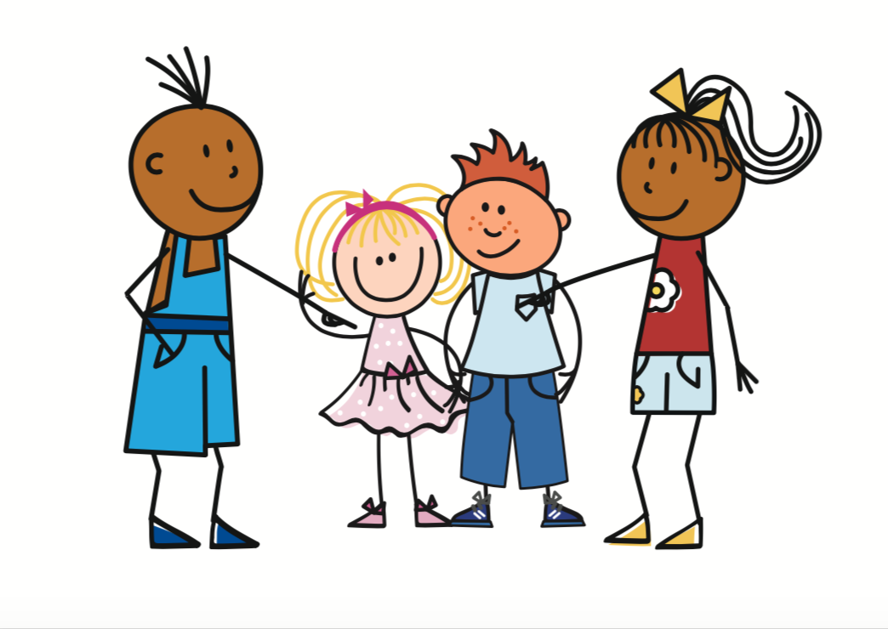
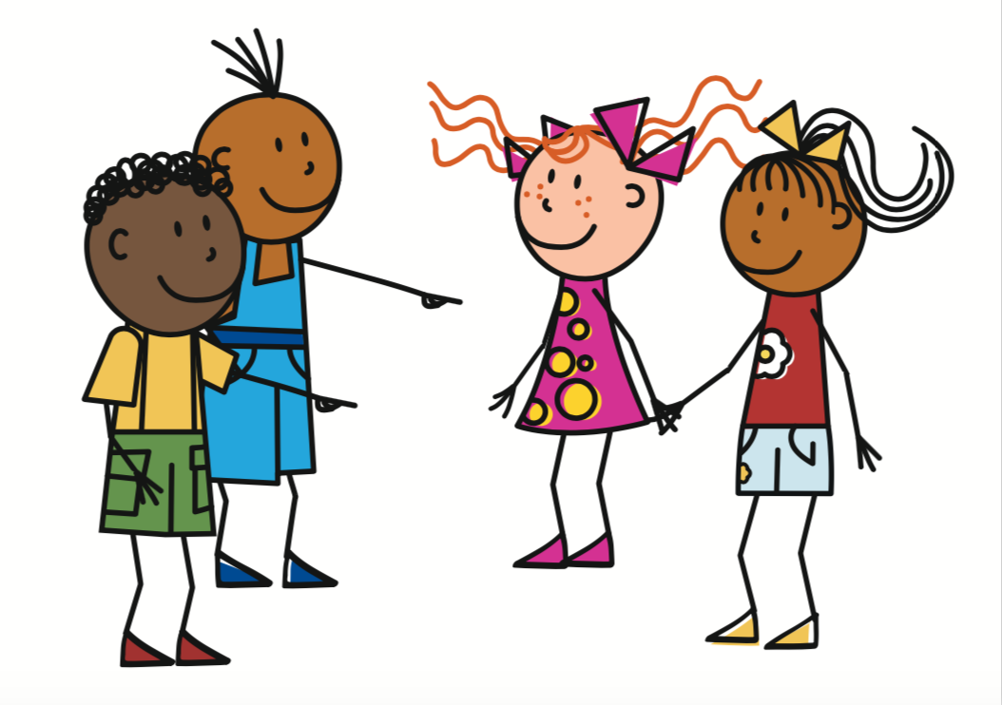
Forming the imperfect tense
je
ais
jou
mange
finiss
fais
av
Je mangeais
Il faisait
Elle avait
Ils jouaient
Elles finissaient
il/elle
ait
ils/elles
aient
Notes:
Once we have the imperfect stem, then it is easy to form sentence with all of the pronouns.
Let’s start with the pronoun ‘je’ RETURN Can you remember what the imperfect ending is for the je - dis-moi! That’s right it’s ais. RETURN The ending for RETURN il and elle is ait. And the ending RETURN for ils and elles is aient. Listen to the pronunciation of these endings - ais / ait /aient - what do you notice? Dis-moi. That’s right they all sound the same. That’s because the s and t are silent final consonants. We also know that ent on the end of a verb is silent. So how would I say I used to eat - return
He used to do - return
She used to have - return
They (mixture) used to play
They (all girls used to finish.

Slide 8
Forming the imperfect tense
Subject | Imperfect Stem | Ending | Meaning
Je (I) | mange | ais | …… used to eat
 | choisiss |  | …… used to choose
Il / Elle / On (He/She/You) | fais | ait | …… used to do
 | écriv |  | …… used to write
Ils / Elles (They) | mett | aient | …… used to put
 | pren |  | …… used to take

Slide 9
Forming the imperfect tense with être
je
ais
J’étais
Il était
Ils étaient
c’était
il/elle
ait
ét
ils/elles
aient
The verb être is the only irregular verb in the imperfect tense. The stem is ét
Notes:
Do you want to know the good news. There is only one verb which doesn’t follow this rule. The verb to be - etre.
Everything else says the same - the only thing which changes is the imperfect stem. The imperfect stem for the verb etre is RETURN ét So I would we say I was - j’étais
He was - il était
They were - ils étaient
What about - it was - c’était. This is probably a very familiar verb. Did you know it was in the imperfect tense? We can see the subject ce - the stem ét and the third person singular ending ait.

Slide 10
Talking about hobbies past and present
The imperfect tense is a ___________tense.
2) To find the imperfect stem we have to use the _____ form of the present tense. | -t
3) The ending for il/elle /on for all verbs in the imperfect tense is:
4) The ending for ils/elles for all verbs in the imperfect tense is:
5) The imperfect tense is used to tell us what we: _________________ 2) __________________
past
nous
-ait
-aient
used to do
was /were doing
Notes:
We now need to summarise our learning for today’s lesson. On the screen you can see 6 sentence starters. I want you to copy down the sentence starter and then complete rest of the sentence. mets la vidéo en pause maintenant.

